Slide 1
Migrant Education Program 2024–25 Online Application Training February 28, 2024
Welcome! Please complete the brief Google Form to confirm your attendance (link provided in the chat).

Slide 2
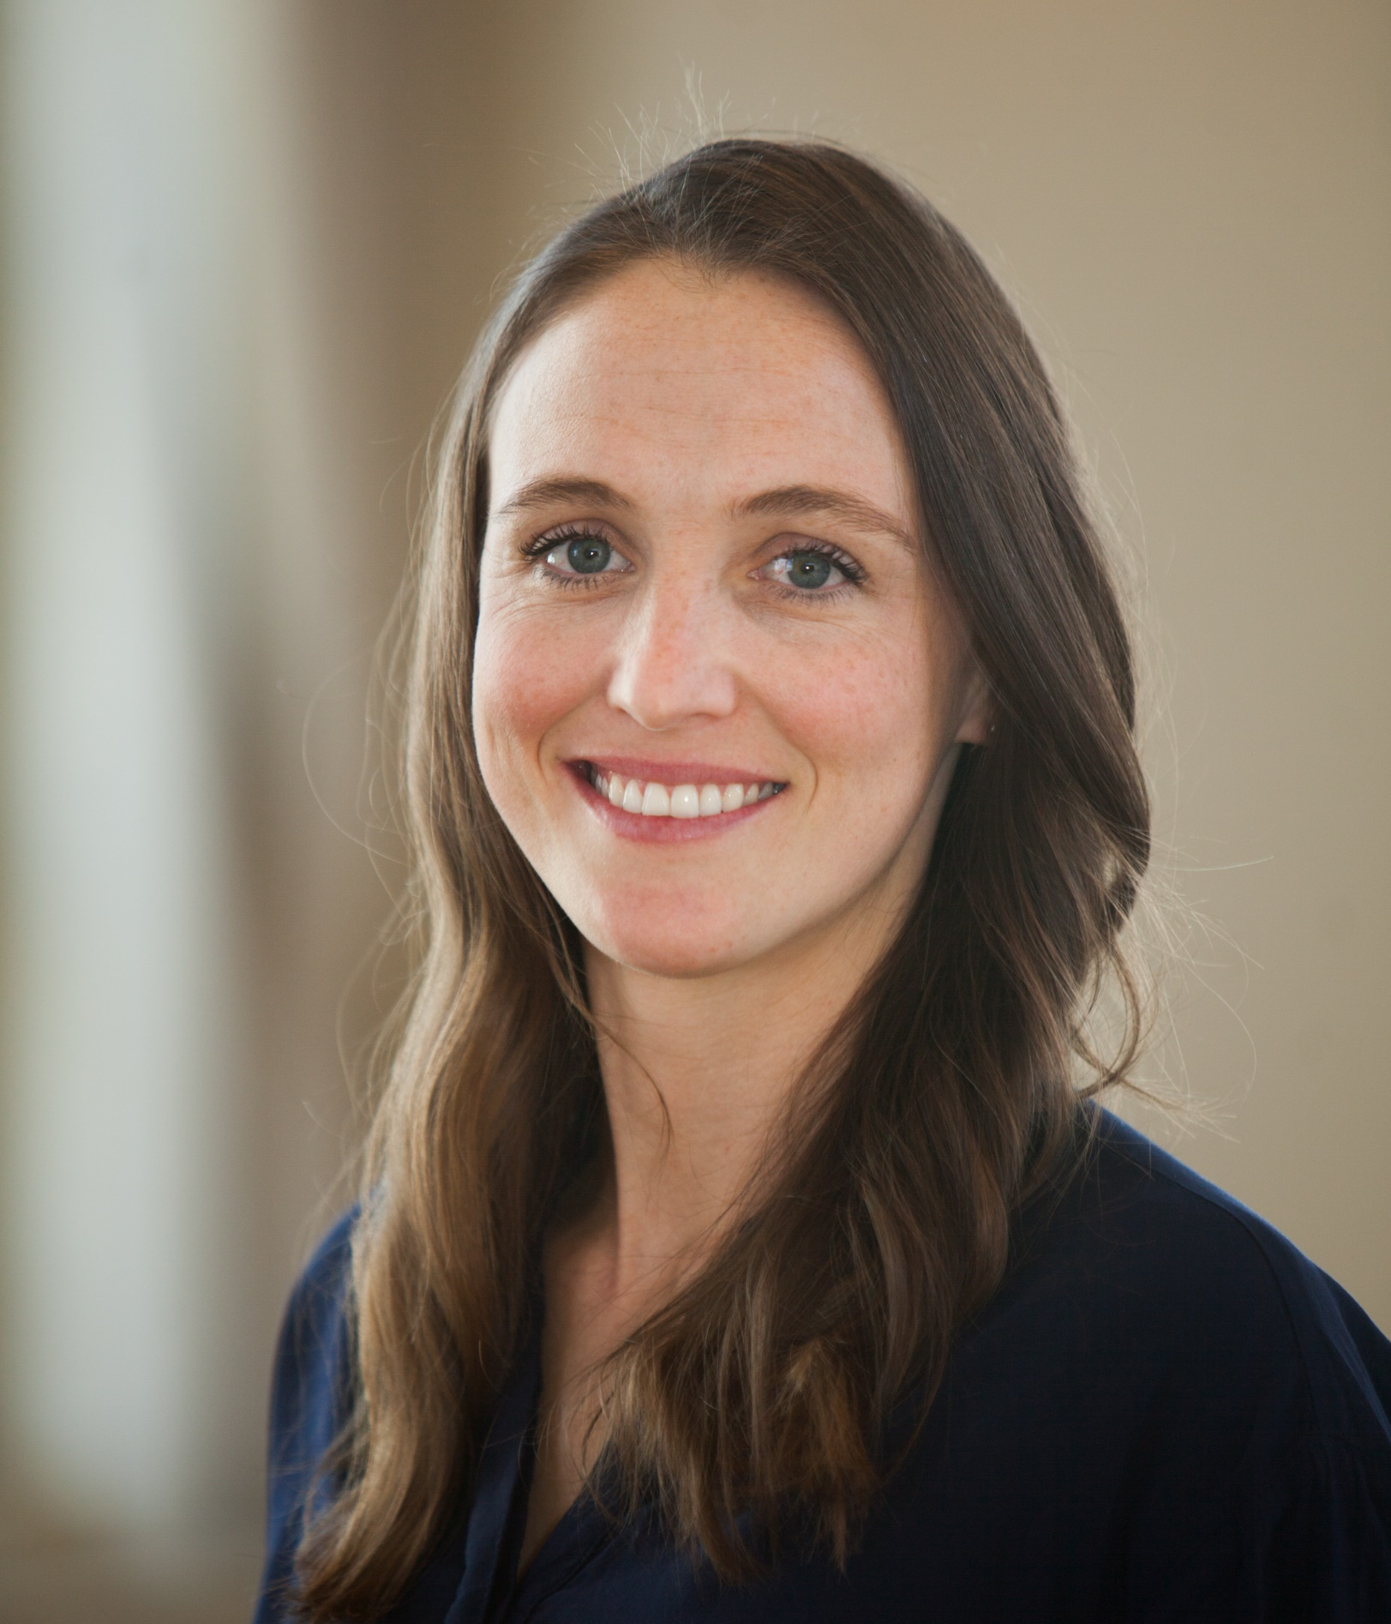
Presenters
Teresa Palomino, Education Programs Consultant
Emily Smith, Education Programs Assistant
Alex Leguizamo, Education Programs Consultant

Slide 3
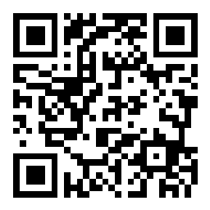
Ice Breaker
Share a goal (big or small) that you have set, worked towards, and achieved?
Scan the QR Code or use this link to enter your response: www.tinyurl.com/GrantAppGoal #3382946
3

Slide 4
Housekeeping
Microphones have been muted to minimize background noise.
Please use the Q&A Zoom feature for questions. You can upvote questions in the Q&A; we will address questions with the most votes first.
The slides and recording will be posted to the Los Angeles County Office of Education MEP Online Systems website.
4

Slide 5
Learning Objectives
Participants will:
Understand how to navigate the online eMEP system.
Name the various user roles and explain what each role can do (e.g., submitter, editor, approver, read-only, etc.).
Explain how to begin a 2024–25 Migrant Education Program (MEP) grant application.
Describe how to complete each section of the application.
Describe how to provide feedback and approve a plan (*Region Directors only).
Explain how to utilize the new 2024 Summer Waiver form to request an exemption (staff responsible for summer waivers only).
Describe the elements of a clear and coherent application.
Evaluate an application for coherence and clarity.
5

Slide 6
Learning Objectives – Self Assessment
On a scale of 1 – 5, how would you rank yourself for each of these learning objectives?
Please anonymously rank your knowledge using the Zoom poll.
We will self-assess again at the end of the training.
1
I don’t know how to do this yet.
3
I know some aspects, but not all.
5
I’m a pro at this. I could teach it to someone else right now!
I don’t understand what this means.
6

Slide 7
Agenda
Review Process
Application Components
Accessing the System
Getting Started
Adding Users to a Plan
Navigating a Plan
Application Sections
Submitting a Plan
Is Your Application ACE? – Practice Session
Resources & Support
Summer Waivers
7

Slide 8
Regional, Direct-Funded Districts and Reimbursable District Staff
Directors, Fiscal Staff, Program Coordinators, Program/Area Managers
Target
Audience

Slide 9
Review Process

Slide 10
Terminology
RA:
Regional Application
DFD:
Direct Funded District
DSA:
District Service Agreement
MOU:
Memorandum of Understanding (District)
10

Slide 11
Levels of Review
California Department of Education (CDE)
Migrant Education Office
RA
DSAs
MOUs
DFD
11

Slide 12
Application Components

Slide 13
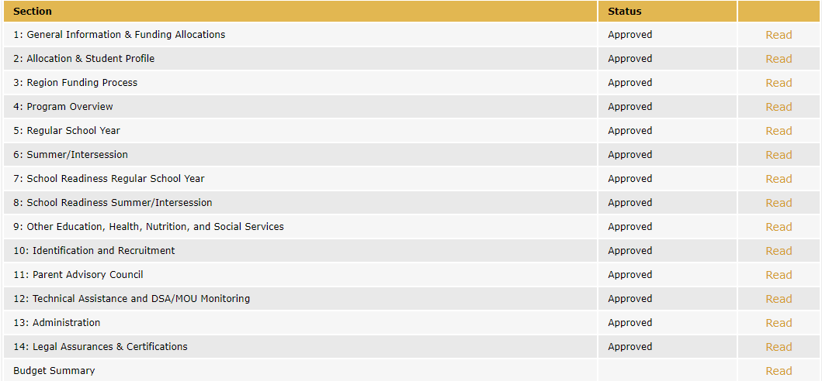
Application Sections

Slide 14
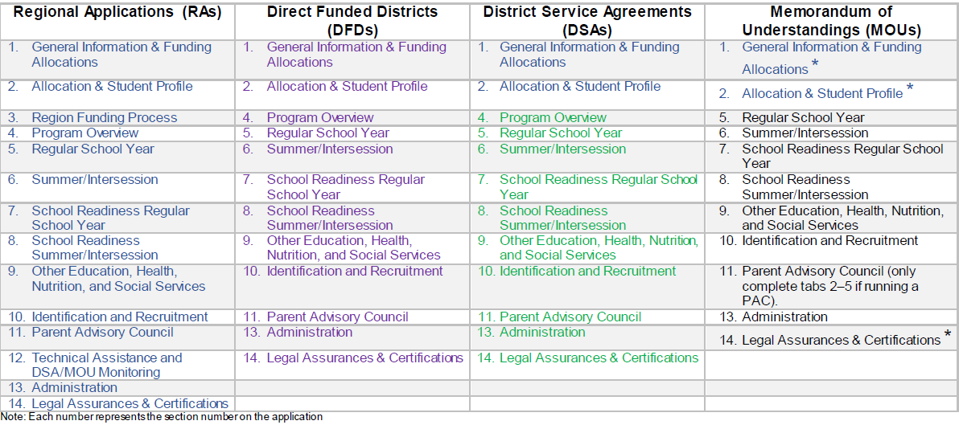
Application Components for RAs, DFDs, DSAs & MOUs

Slide 15
User Roles
Approver
Region Director (or designee) will approve DSA/MOU plans
CDE Consultant (for regions) will approve region and DFD plans
Submitter
DSA/MOU Director (or designee) will submit to their region
Editor
Directors
Program Specialist
Program Coordinators
Assistant Administrator
Fiscal Staff
Identification & Recruitment (I&R) Coordinators
Data Entry Specialist
Read Only
Commenters
Region staff
Assign this role to anyone that needs access to view the plan without having to make edits or comments
Assign this role to anyone you think will provide helpful comments
Region or DFD Director (or designee) will submit to CDE

Slide 16
Accessing the System

Slide 17
Sign Up for an Account
2024–25.
http://cdemep.lacoe.edu/mep

Slide 18
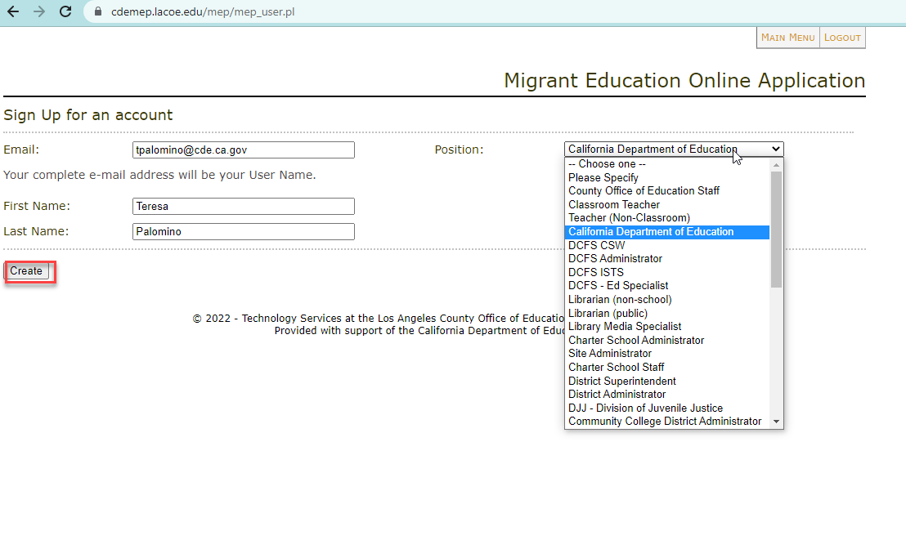
Create Your Account

Slide 19
Logging In
2023–24.

Slide 20
Getting Started

Slide 21
2024–25 Allocations
Will be using final 2023–24 allocation amounts
CDE will share estimated allocation when received from OME
Allocation will be adjusted in BR 1
Recommendation for Regions and DFDs:
Create a placeholder for 15% of your allocation to be adjusted in BR 1 if necessary
Reimbursable districts:
Check with your regional director for further instructions on managing your allocation

Slide 22
Three Ways to Get Started
Rollover a Plan (for Regions & DFDs)
DFDs and Regions will rollover their own plans.
Regions will rollover their DSA/MOU plans.
Locate a Plan (for DSAs & MOUs)
DSAs and MOUs will locate their plan after the Region has created it or rolled it over (see slide 30).
Create a Plan (for Regions)
Regions may create a plan for new DSAs or MOUs.
22

Slide 23
First Steps for RAs, DFDs and DSA/MOUs
Region
Create or rollover DSA & MOU plans
Input DSA/MOU information in Sections 1 and 2
DFD
Rollover their own DFD plan
*Do not update Section 1: Funding Allocation for DFD Plan
DSA & MOU
Region will notify DSAs/MOUs when their plan has been created
*Do not update Sections
1 & 2 for DSA/MOU Plan (Region will complete)
Rollover their own
RA plan
*Do not update
Section 1: Funding Allocation for RA Plan
Begin editing their
RA plan
Begin editing their
DFD plan
Locate their DSA/MOU plan and begin editing
23

Slide 24
Rollover a Plan
Regions are responsible for rolling over plans for their districts (to create a new district plan, see slide 27).
Regions and DFDs will rollover their own plans.

Slide 25
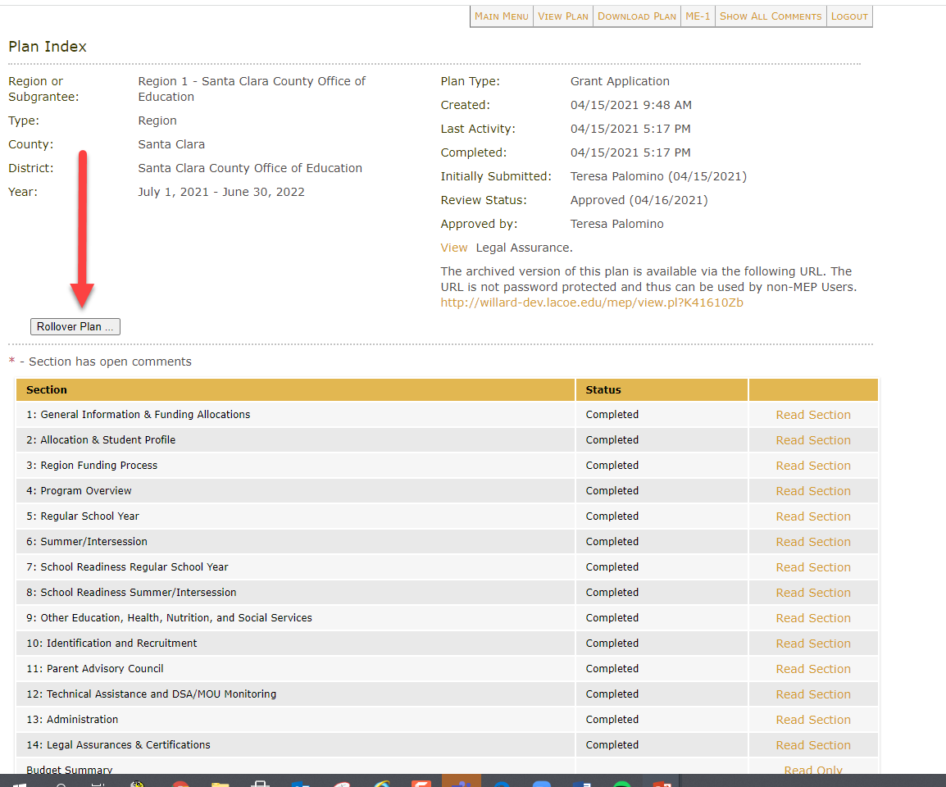
Rollover a Plan (2)

Slide 26
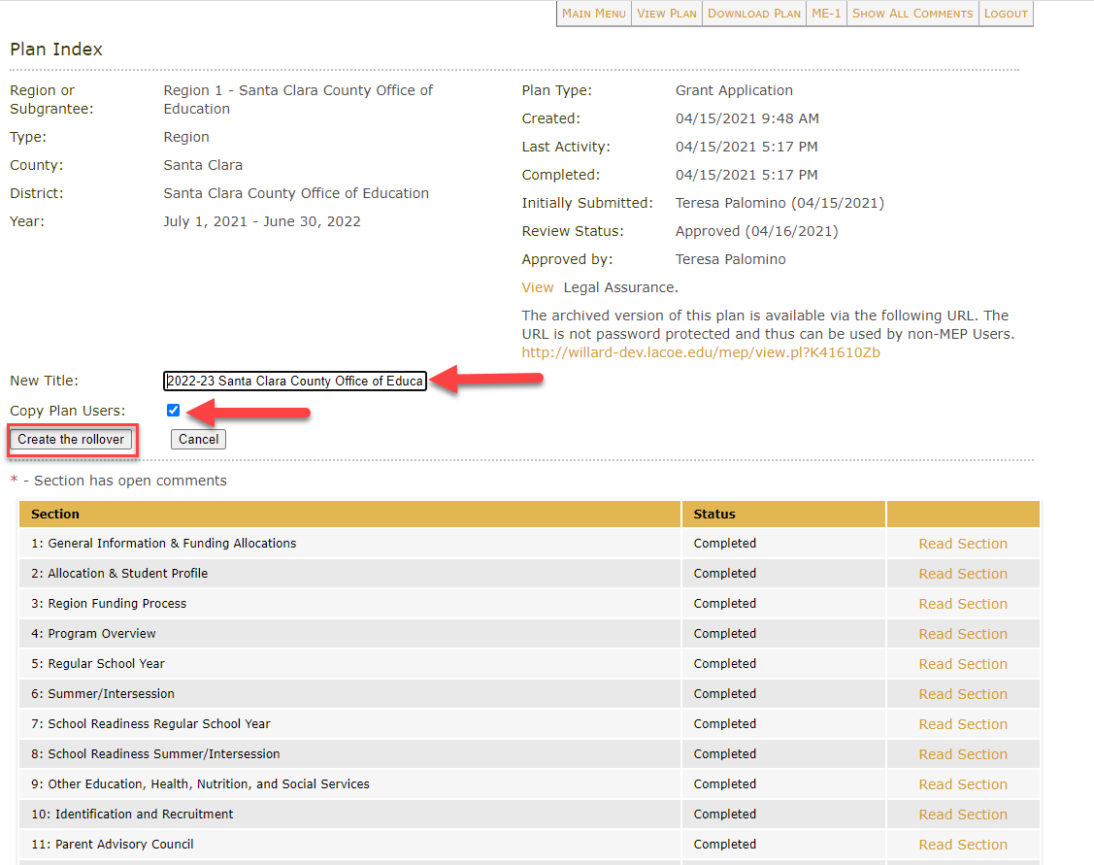
Title a Rollover Plan
Make sure to update the title of the new plan. Use the following naming convention:
“Year and District”
For example:
“2024–25 Sacramento Unified School District”
*Don’t forget to remove the word “copy” from your new plan’s title!

Slide 27
Create a New Plan
Regions will create DSA/MOU plans for new reimbursable districts or districts that did not submit applications during the prior fiscal year.
All other subgrantees will rollover their plan from the prior year.

Slide 28
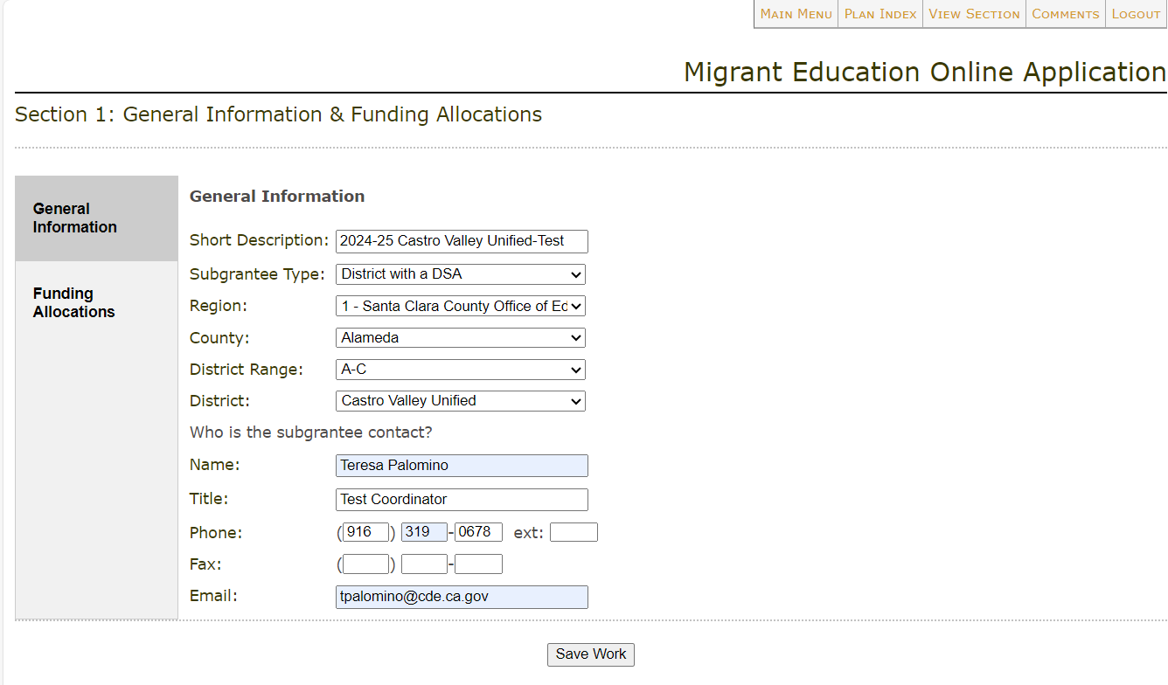
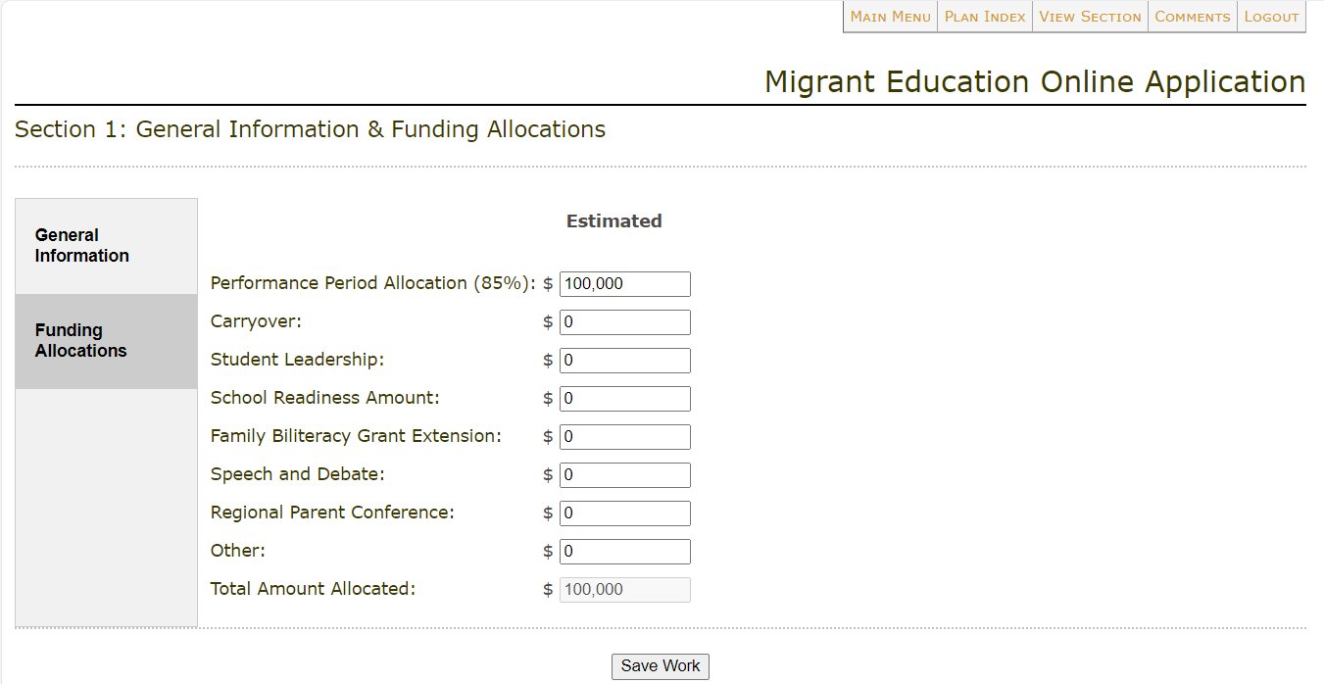
Regions Input DSA/MOU Information & Allocation in Section 1
After Regions rollover their DSA/MOU plans, they must fill out the information in Section 1 (including the DSA/MOU’s allocation).
Reminder: Regions/DFDs will not be able to edit Section 1: Funding Allocation of their own plans; this information will be pre-populated.
Please see slides 45-46 for more information on completing Section 1.

Slide 29
Regions Input DSA/MOU Allocation in Section 2
Regions enter DSA/MOU allocation amounts in Section 2.
Student counts are pre-populated based on MSIN reports and cannot be changed.
Please see Navigating a Plan: Section 2 for more information on completing Section 2 for Regions and DFDs.

Slide 30
Locate 2024–25 Plan
After the plan has been created or rolled over and users have been added, select “Read or Edit an Existing Grant Application” to locate the plan for the current fiscal year.

Slide 31
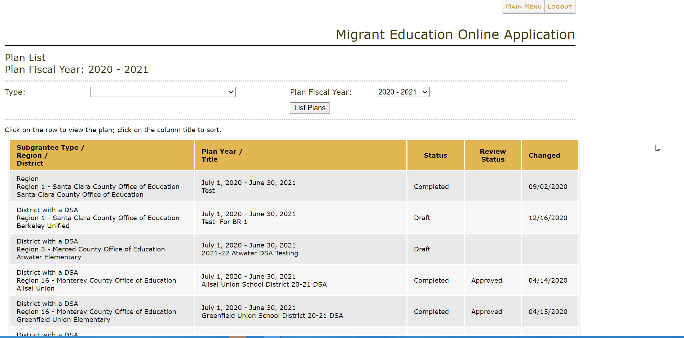
Locate 2024–25 Plan (2)
Users should ensure they have selected the correct plan fiscal year from the drop down.
Click on the 2024–25 draft plan to begin editing.

Slide 32
Adding Users to a Plan

Slide 33
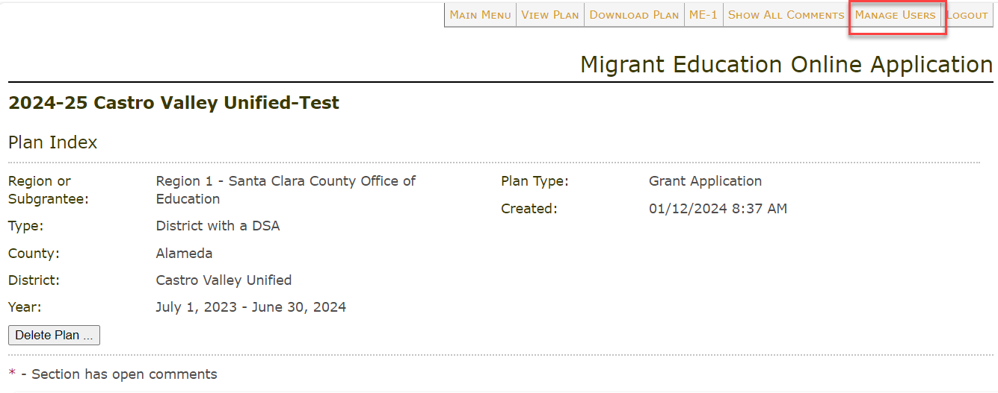
Manage Users Tab
Only users with submitter status will see the “Manage Users” tab.

Slide 34
New Plan User

Slide 35
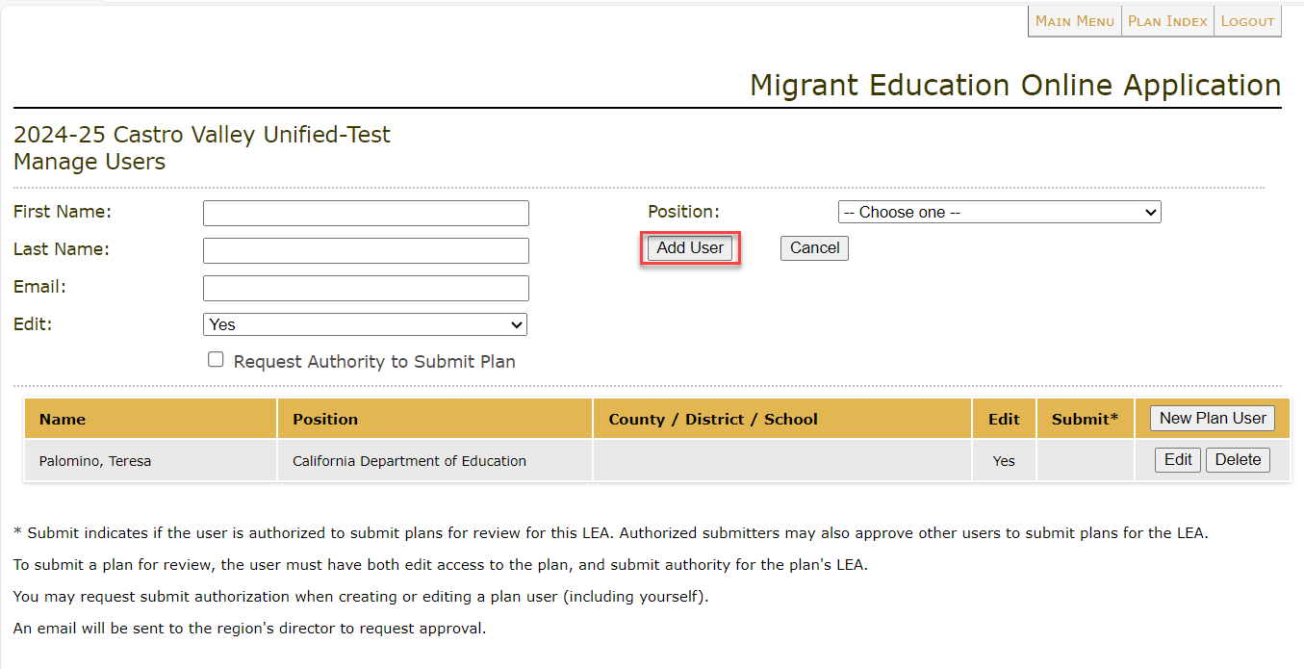
Assigning a User Role
Select the user role: editor, comments only, or read-only.

Slide 36
Assigning a Plan Submitter
Directors can add Submitters to a plan.
Submitters can add other users to a plan.
Submitters can request other users be granted the Submitter role. The Director will receive an automated email for all Submitter requests and must approve all Submitters.

Slide 37
Reminder: Region Responsibilities Before DSA/MOUs Begin
The region will create or rollover new plans for their DSAs and MOUs.
The region will update Sections 1 and 2 for DSA/MOUs.
The region will assign a submitter to the DSA/MOU plan (see slides 35-36).
37

Slide 38
Check for Understanding – Zoom Poll
I understand how to navigate the online eMEP system.
I can name the various user roles and explain what each role can do (e.g., submitter, editor, approver, read-only, etc.).
I can explain how to begin a 2024–25 grant application.
38

Slide 39
Questions & Answers

Slide 40
Navigating a Plan

Slide 41
Navigate the eMEP System Toolbar

Slide 42
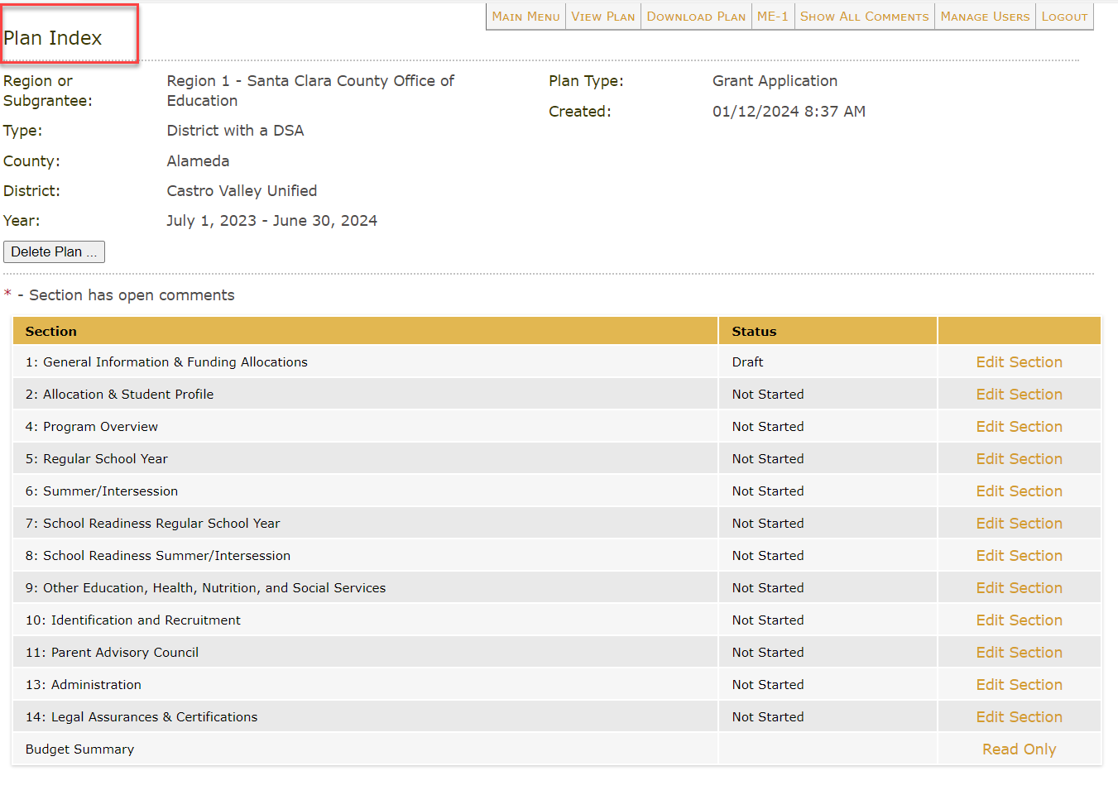
Plan Index Page

Slide 43
Update Status & Save Buttons
Make sure that after entering any information into your plan you click one of the “Save” buttons at the bottom of the page.
After you have finished editing all tabs, change the status from “Draft” to “Completed.”

Slide 44
Application Sections

Slide 45
Section 1: General Information
Reminder: Regions complete Section 1 for their DSAs and MOUs.

Slide 46
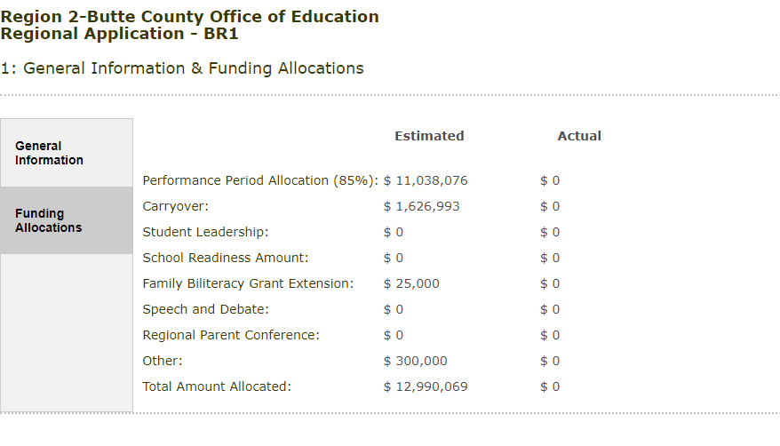
Section 1: Funding Allocations
Reminder: Regions complete Section 1 for their DSAs and MOUs.

Slide 47
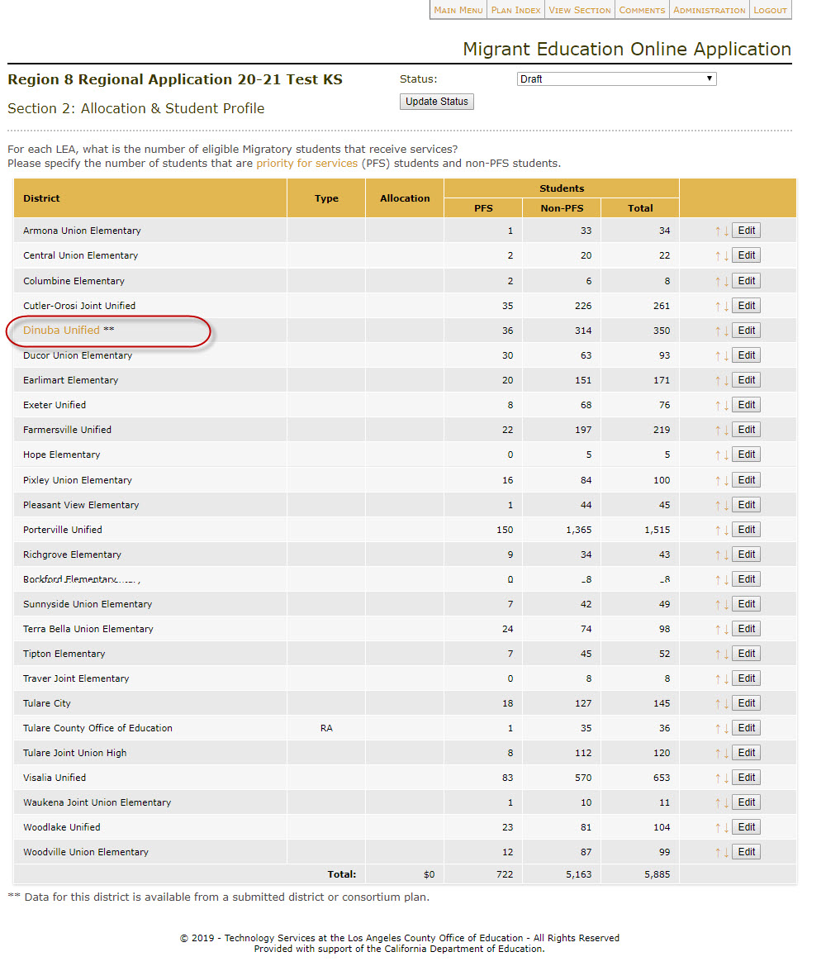
Section 2: Allocation and Student Profile
Updating DSA/MOU allocations for Regions.

Slide 48
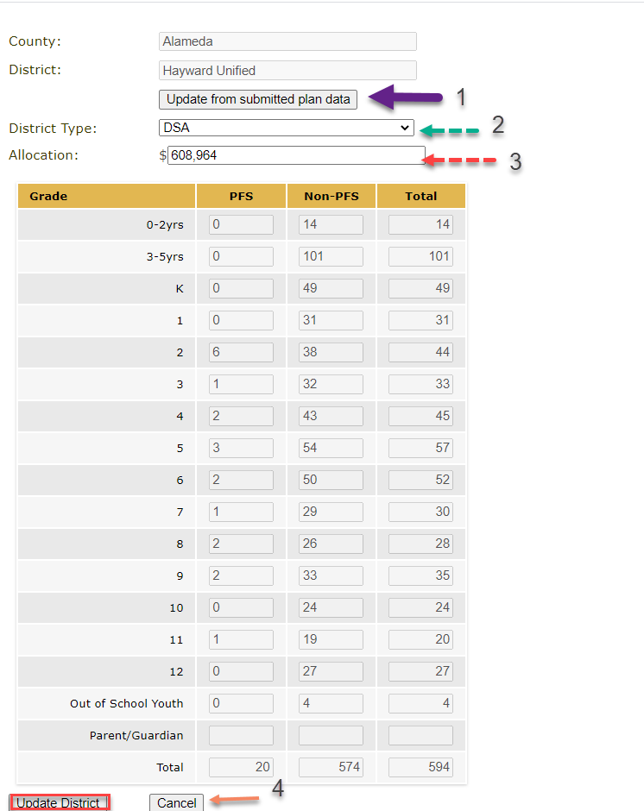
Section 2: Allocation and Student Profile
Updating DSA/MOU allocations (for Regions).

Slide 49
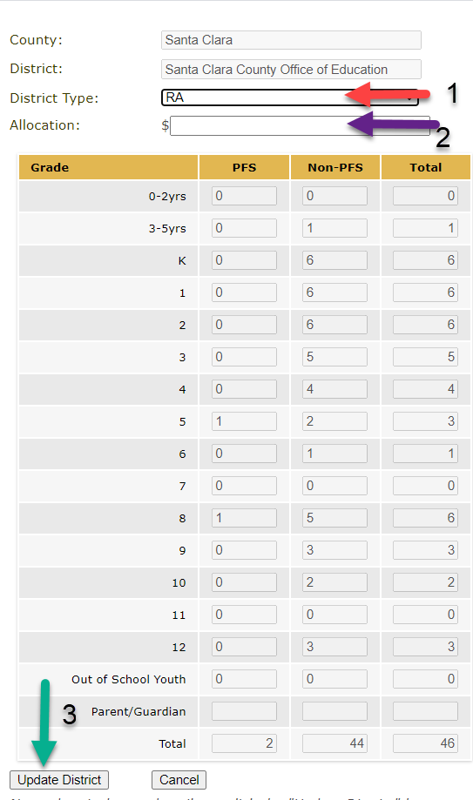
Section 2: Allocation and Student Profile
Updating the COE (Region) allocation.

Slide 50
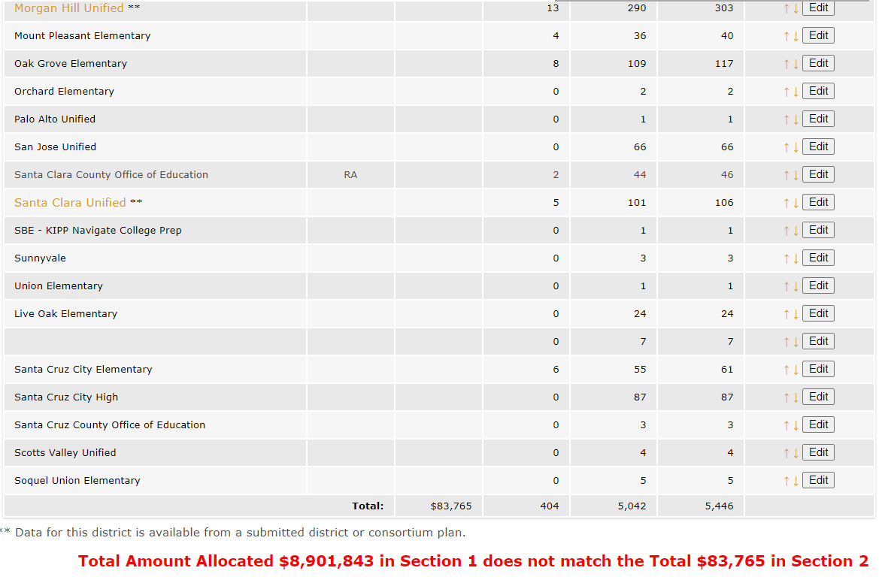
Section 2: Checking for Allocation Errors
Regions should ensure that the total allocations for all reimbursable districts + COE equals the allocation from Section 1.

Slide 51
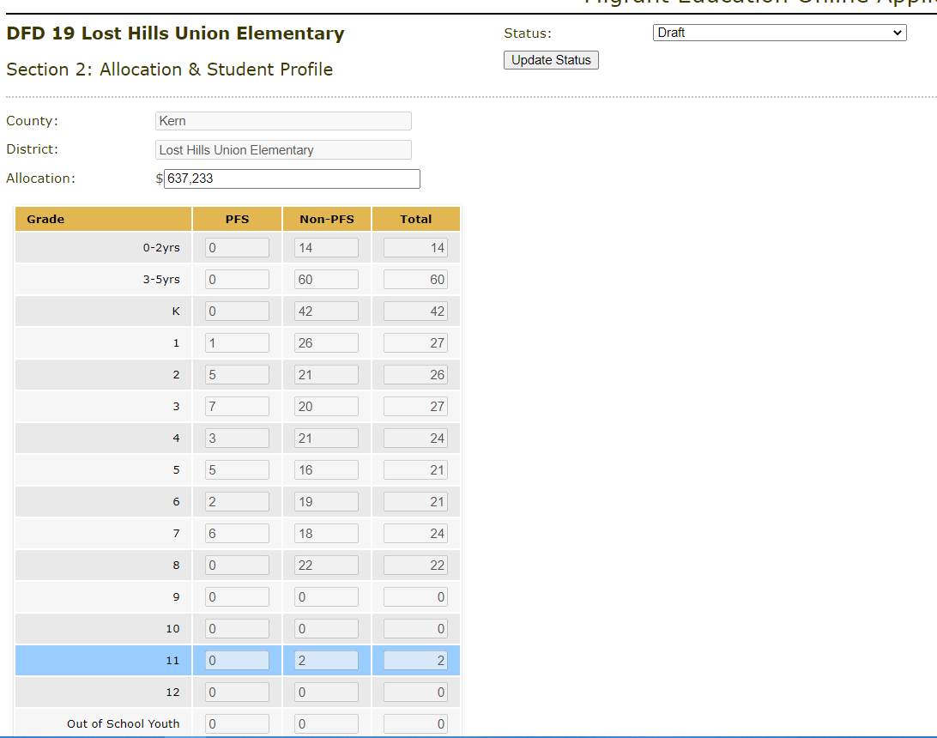
Section 2: Allocation and Student Profile for DFDs

Slide 52
Section 3: Region Funding Process
Reminder: only Regions complete Section 3.

Slide 53
Section 3: Tips for Drafting a High-Quality Funding Process
Write out the funding formula utilized, especially if it differs from the state formula. Then, explain any variations from the formula.
Explain how you decided the amounts allocated to each reimbursable district.
Ask: could a new reader follow your calculations to come up with the allocation amounts for each district listed in Section 2?

Slide 54
Section 3: High Quality Model
Region X established district allocations based on the State funding model and used the student numbers from the Subgranting Report with the following variations:
Districts were offered allocations as described below. The Region took into consideration that all I&R is provided through the Region, as is most of the Other Health Services. The Region provides College Tutor services to DSA and MOU districts. In addition, regional staff often assist districts with parent communication and program recruitment.
1. DSA districts were offered 50% of the funding calculation
2. Apple Unified School District (USD) was offered 52% of the funding calculation because the district receives few regional services.
3. MOU districts were offered 35% of the funding calculation.
The following districts chose not to accept a sub allocation: Fruit USD; Vegetable USD.

Slide 55
Break

Slide 56
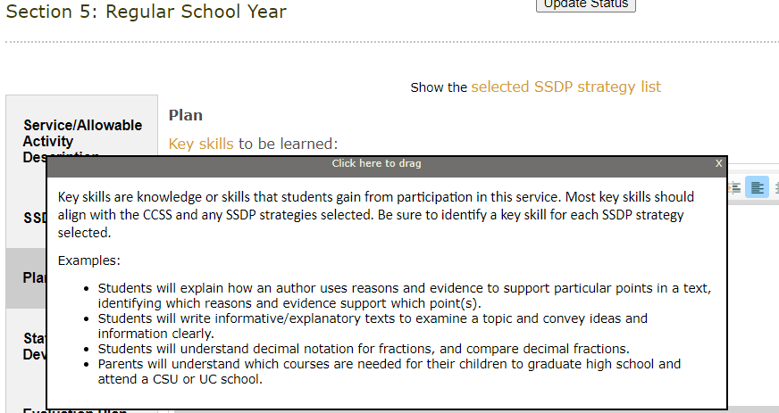
Helpful Tip: Sample Links

Slide 57
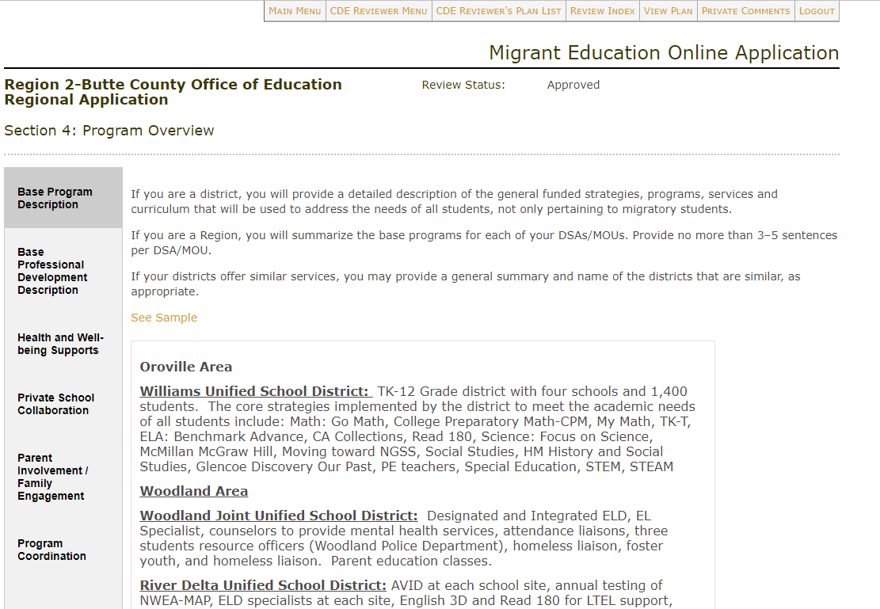
Section 4: Program Overview
Reminder: MOUs do not need to complete Section 4.

Slide 58
A Clear Application is ACE
Aligned
Do calculations add up?
Are all tabs within a service aligned with the same information?
Does narrative text specifically address selected State Service Delivery Plan (SSDP) strategies?
Current
Has all information from a rollover (prior year) plan been updated?
Has outdated information been removed?
Is the application titled correctly (no “copy” in title)?
Are org charts and duty statements up-to-date?
Easy to Understand
Would this application paint a clear picture (to a new reader) of what is being offered in your program?
Are there many spelling or grammatical errors?

Slide 59
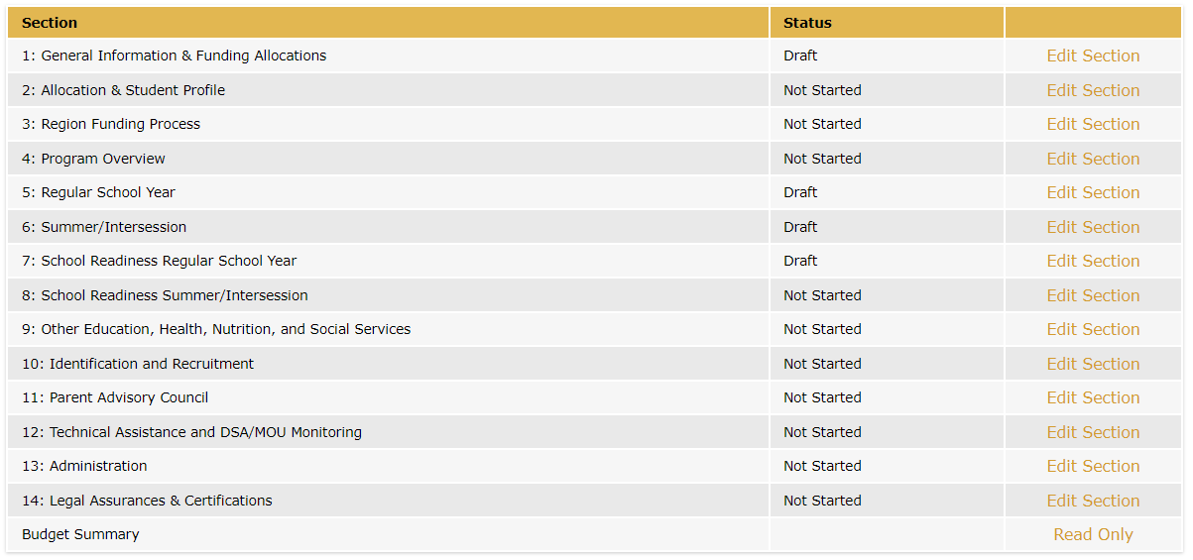
Sections 5-9: Overview

Slide 60
Sections 5-9: Adding or Editing Services/Activities

Slide 61
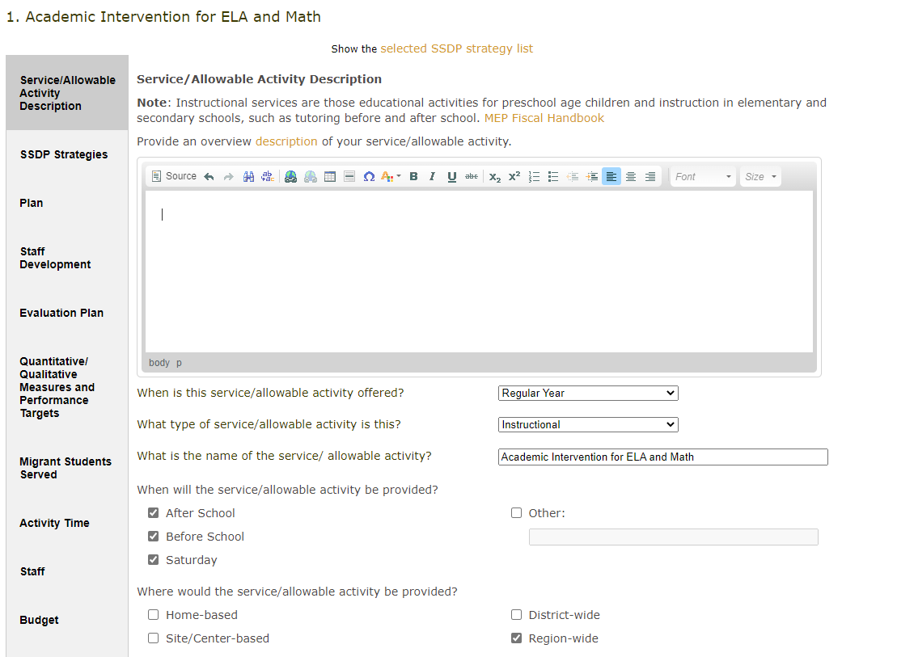
Sections 5-9: Description Tab

Slide 62
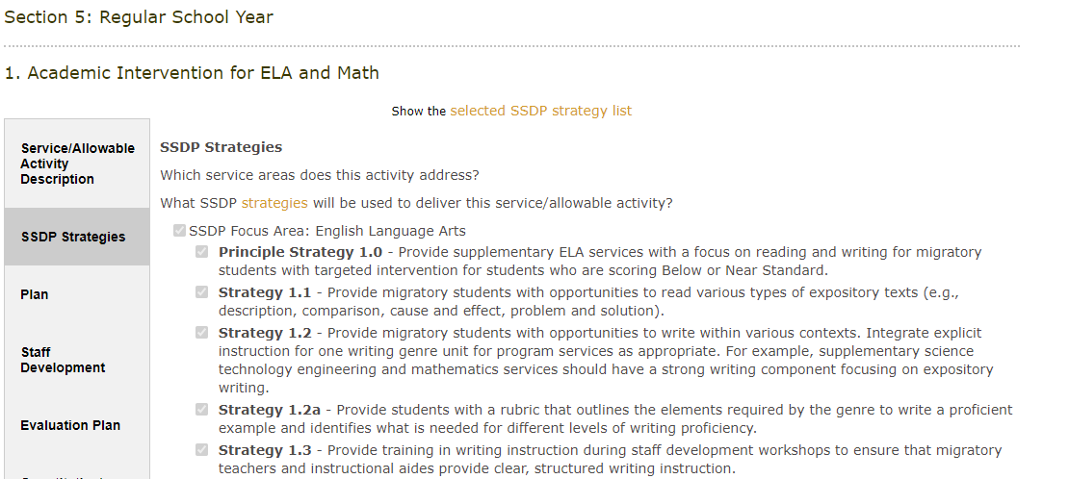
Sections 5-9: SSDP Strategies Tab

Slide 63
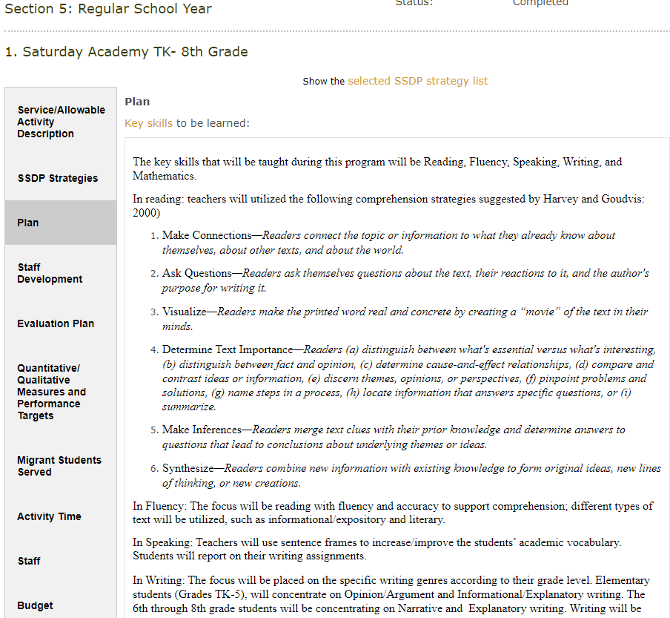
Sections 5-9: Plan Tab

Slide 64
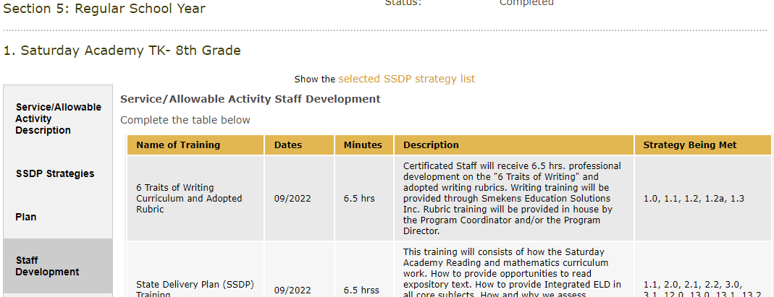
Sections 5-9: Staff Development Tab

Slide 65
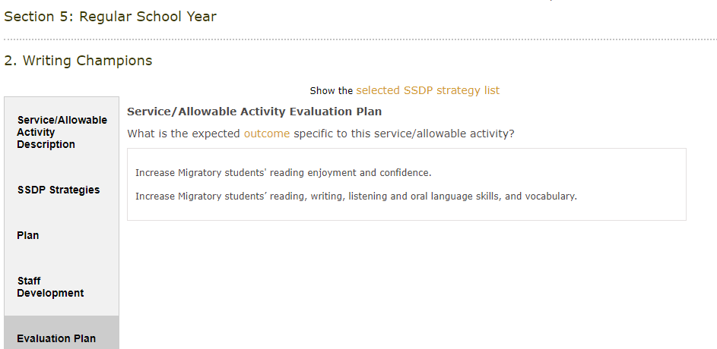
Sections 5-9: Evaluation Tab

Slide 66
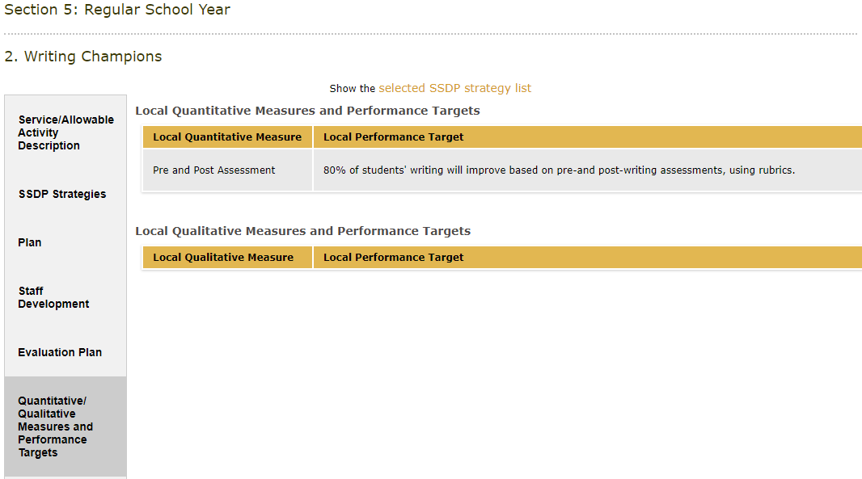
Sections 5-9: Measures & Performance Targets Tab

Slide 67
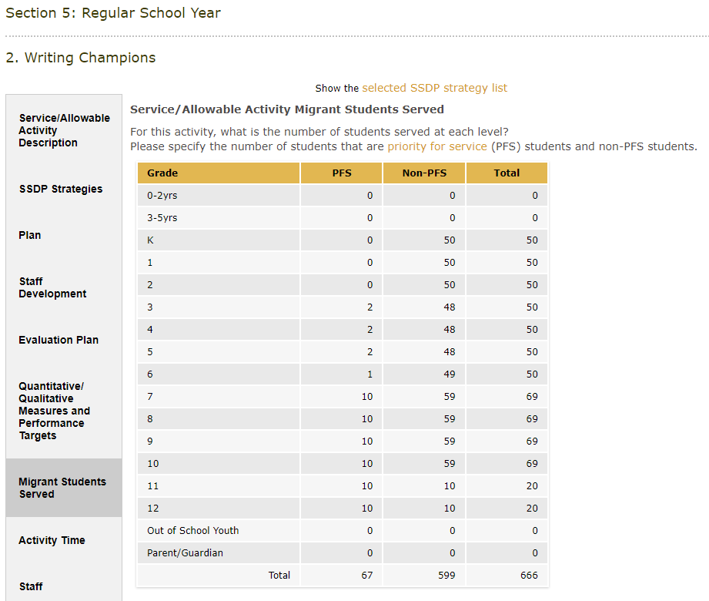
Sections 5-9: Students Served Tab

Slide 68
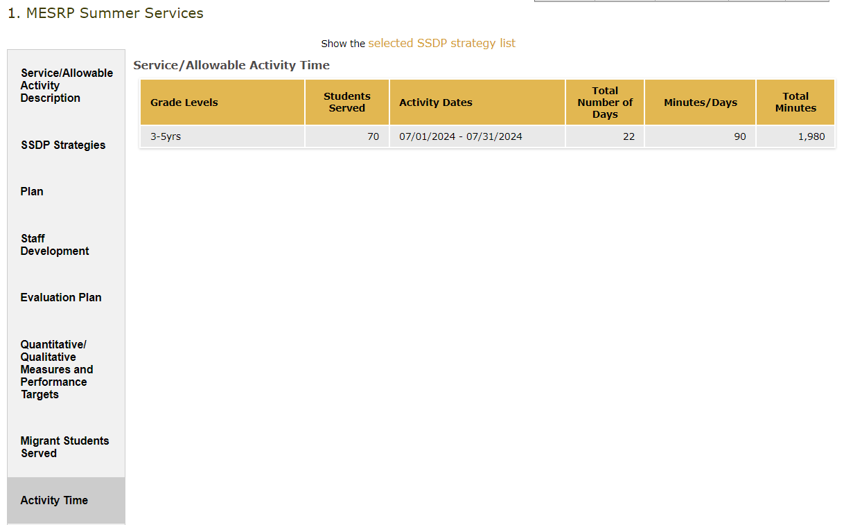
Sections 5-9: Activity Time Tab

Slide 69
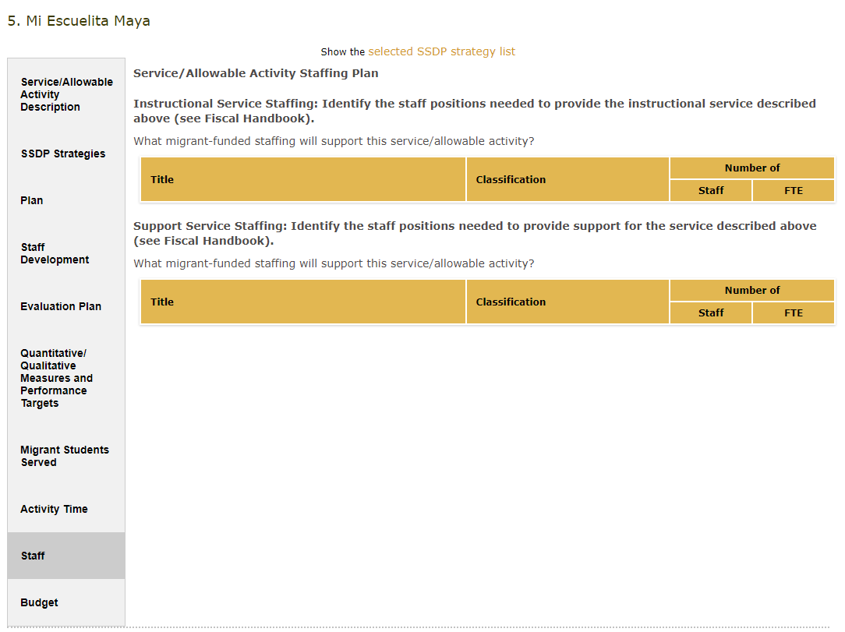
Sections 5-9: Staff Tab

Slide 70
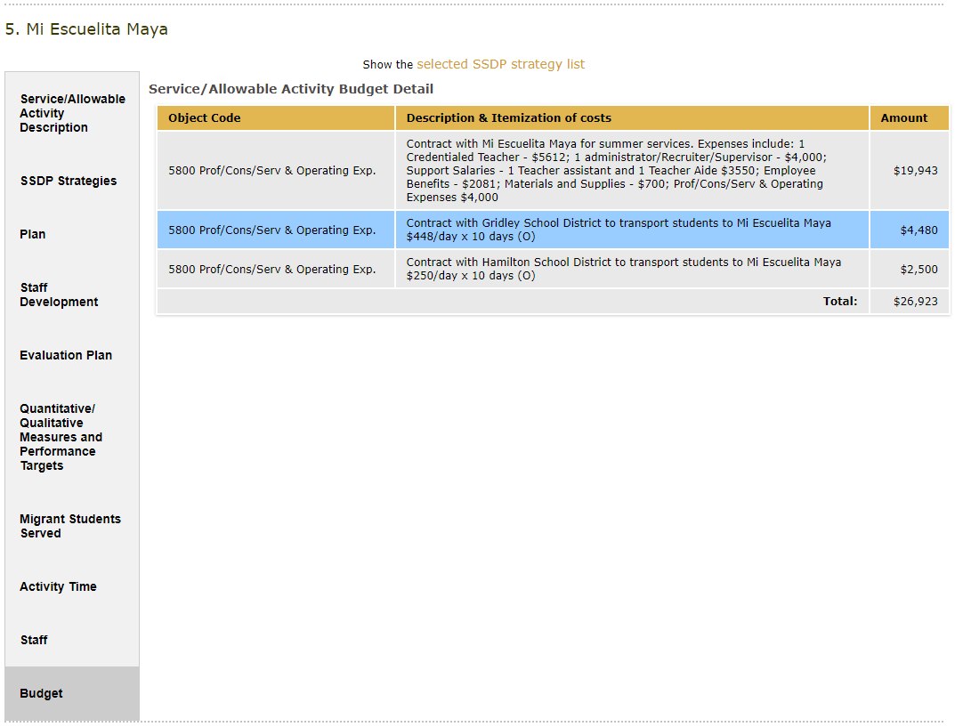
Sections 5-9: Budget Tab

Slide 71
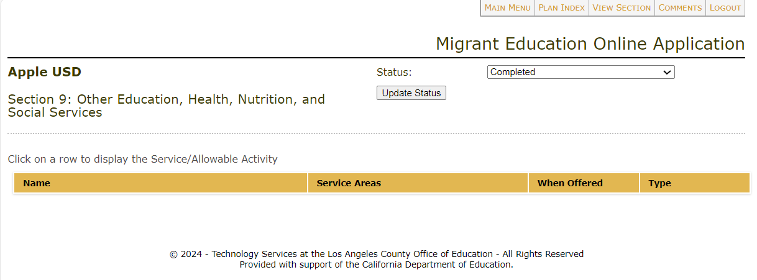
What If There Are No Services?
If there will be no services offered in a certain section, leave the section blank and set the status to “Complete.”

Slide 72
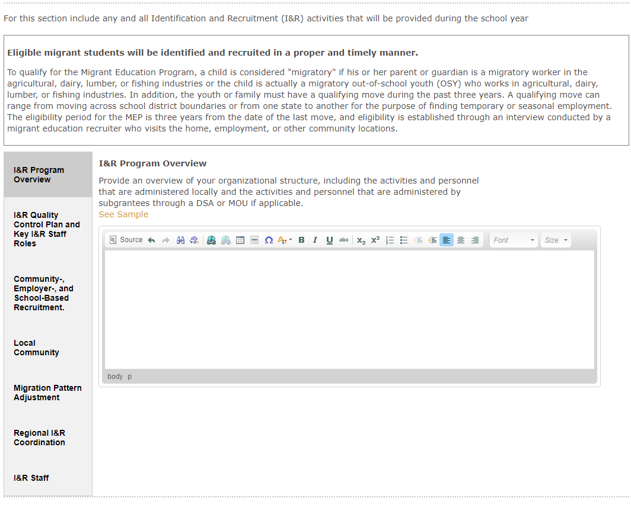
Section 10: Identification & Recruitment

Slide 73
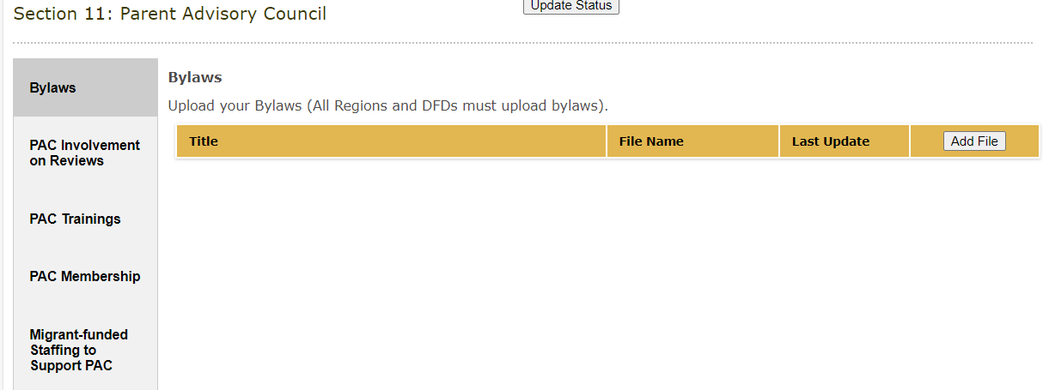
Section 11: Parent Advisory Council

Slide 74
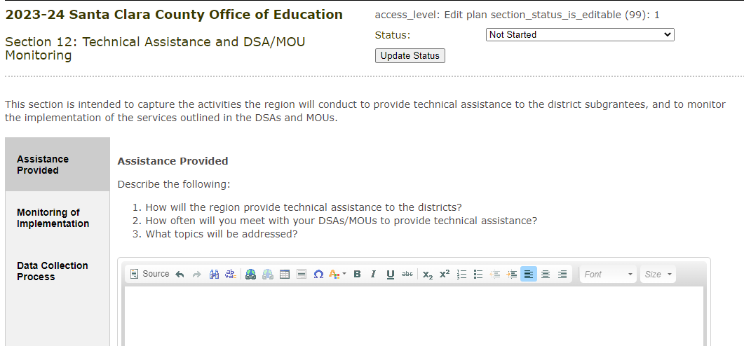
Section 12: Technical Assistance & DSA/MOU Monitoring for Regions
Reminder: only Regions complete Section 12.

Slide 75
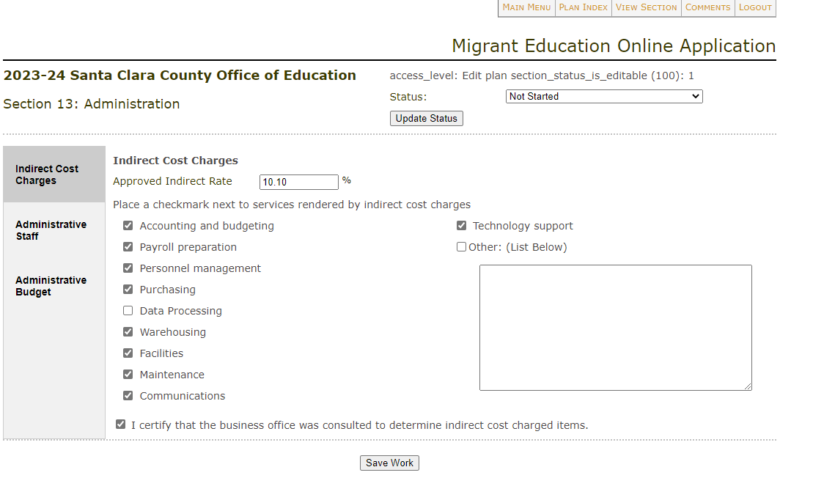
Section 13: Administration

Slide 76
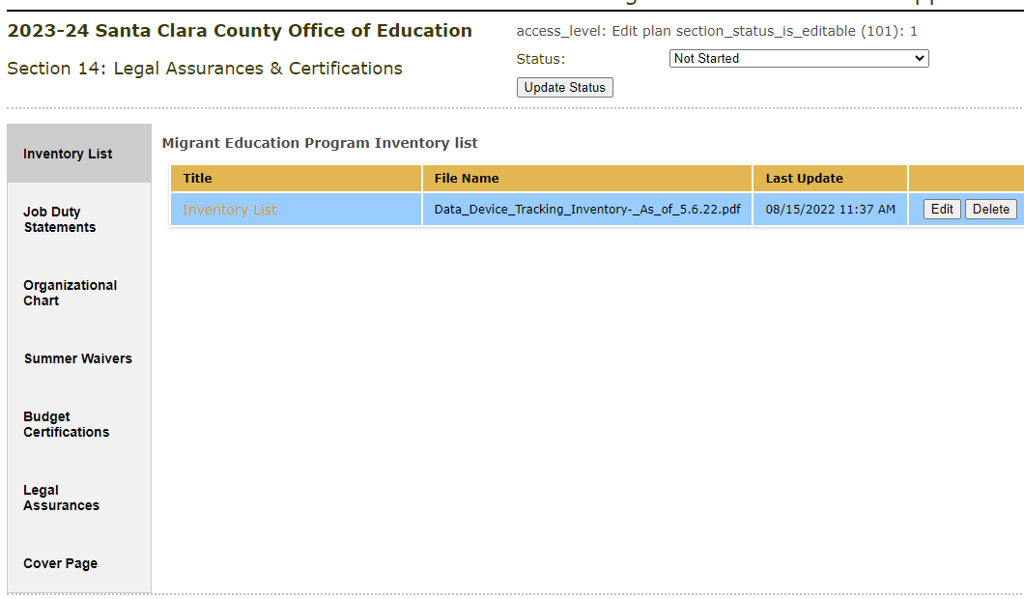
Section 14: Legal Assurances & Certifications

Slide 77
Submitting a Plan

Slide 78
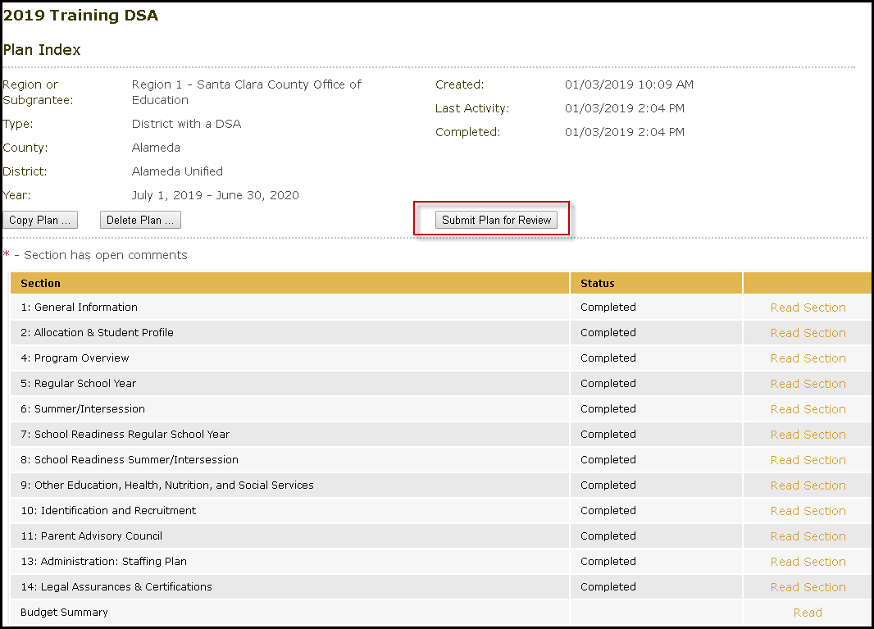
Submit Your Plan
Reminder: only the submitter user role will have access to the “Submit Plan for Review” button.

Slide 79
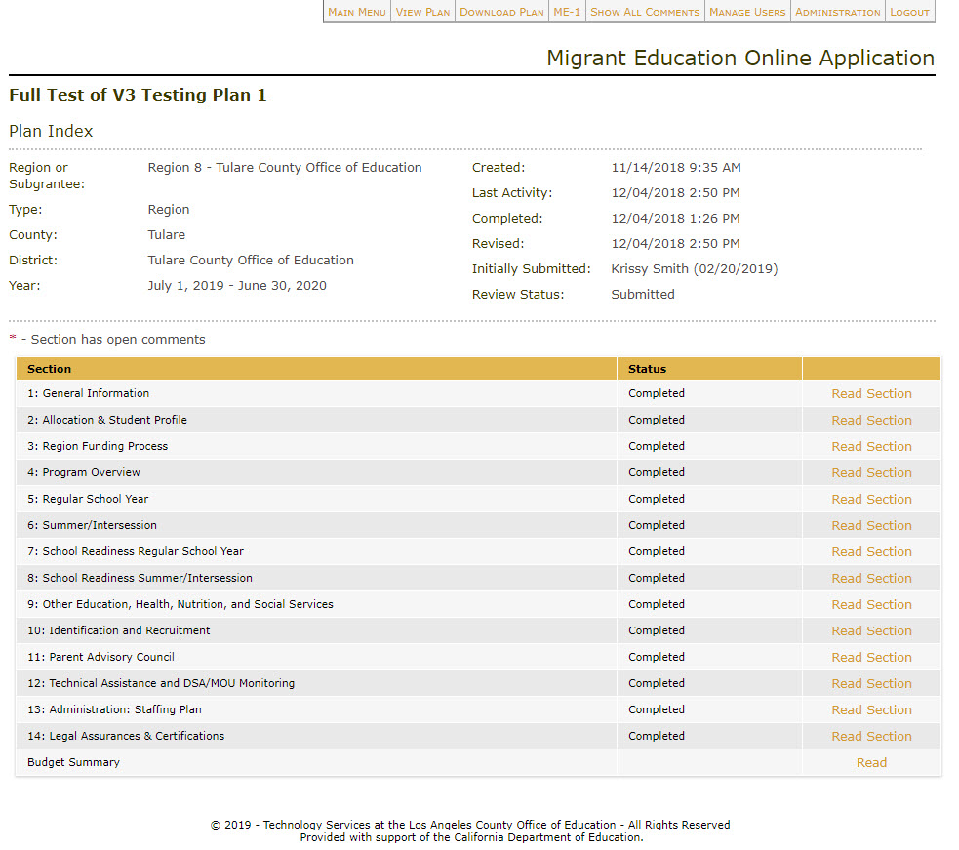
Submit Your Plan (2)

Slide 80
Review Process & Scoring
Reminder: Regional Directors review DSA/MOU applications. CDE staff review Region/DFD applications.

Slide 81
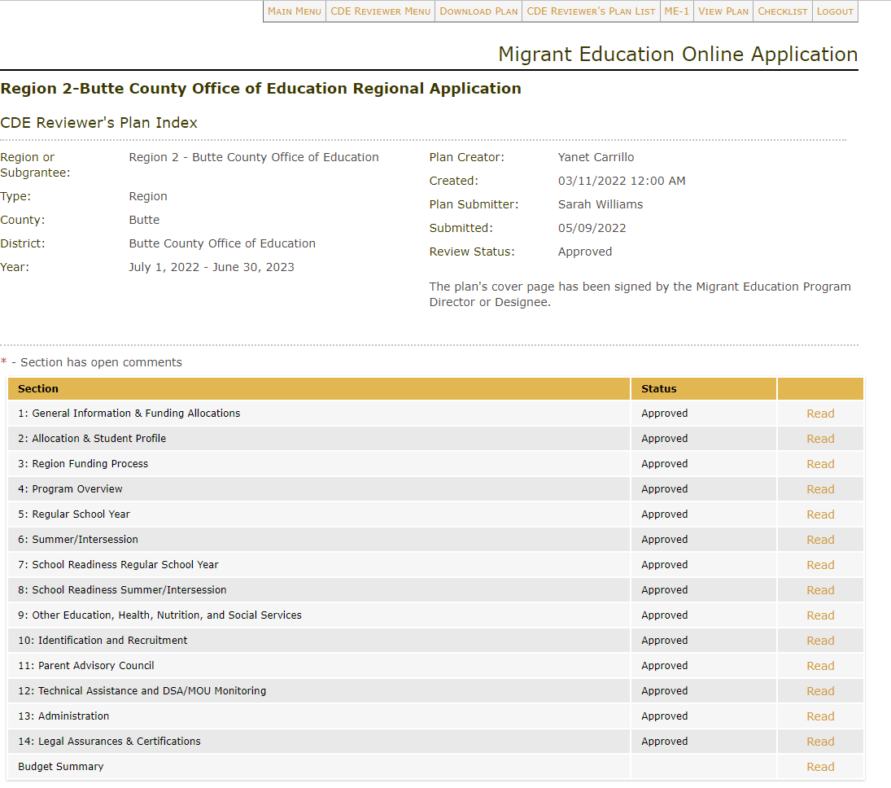
Plan Approval

Slide 82
After Plan Approval: Next Steps
The plan’s submitter will upload their Cover Page, legal assurances, and ME-1 (Regions & DFDs only) with the appropriate signatures.
The action of uploading all signed required documents will complete the process of archiving the application.

Slide 83
Check for Understanding – Zoom Poll
I understand how to navigate the online eMEP system.
c. I can describe what is required for each section of the application.
d. I can describe how to provide feedback and approve a plan (*Region Directors only).
83

Slide 84
Questions & Answers

Slide 85
Is Your Application ACE?

Slide 86
A Clear Application is ACE
Aligned
Do calculations add up?
Are all tabs within a service aligned with the same information?
Does narrative text specifically address selected SSDP strategies?
Current
Has all information from a rollover (prior year) plan been updated?
Has outdated information been removed?
Is the application titled correctly (no “copy” in title)?
Are org charts and duty statements up-to-date?
Easy to understand
Would this application paint a clear picture (to a new reader) of what is being offered in your program?
Are there many spelling or grammatical errors?
86

Slide 87
Application Evaluation Practice
Learning Objectives:
2. Describe the elements of a clear and coherent application.
3. Evaluate an application for coherence and clarity.
Instructions:
Read the sample Migrant Education School Readiness Program summer service.
Is it aligned, current and easy to understand (ACE)? Does it paint a clear picture of what students and staff are doing, where, and when?
Meet in breakout rooms to discuss what you would change about this service. (10 minutes)
Use the note catcher to guide your discussion.
Whole-group share out and debrief. (5 minutes)
87

Slide 88
Learning Objectives - Self-Assessment
Participants will:
Understand how to navigate the online eMEP system.
Name the various user roles and explain what each role can do (e.g., submitter, editor, approver, read-only, etc.).
Explain how to get started for their user role.
Describe what is required for each section of the application.
Describe how to provide feedback and approve a plan (*Region Directors only).
Explain how to utilize the new 2024 Summer Waiver form to request an exemption (*District & Region Directors only).
Describe the elements of a clear and coherent application.
Evaluate an application for coherence and clarity.
88

Slide 89
Learning Objectives – Self Assessment
On a scale of 1 – 5, how would you rank yourself for each of these learning objectives?
Please anonymously rank your knowledge using the Zoom poll.
What do you need more practice with? Where can you get support?
1
I don’t know how to do this yet.
3
I know some aspects of this, but not all.
5
I’m a pro at this. I could teach it to someone else right now!
I don’t understand what this means.
89

Slide 90
Resources & Support

Slide 91
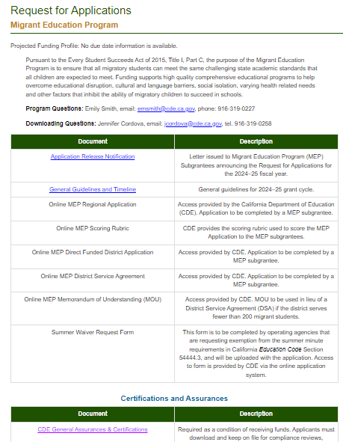
MEP Request for Applications Website
https://www.cde.ca.gov/fg/fo/r28/migrant24rfa.asp

Slide 92
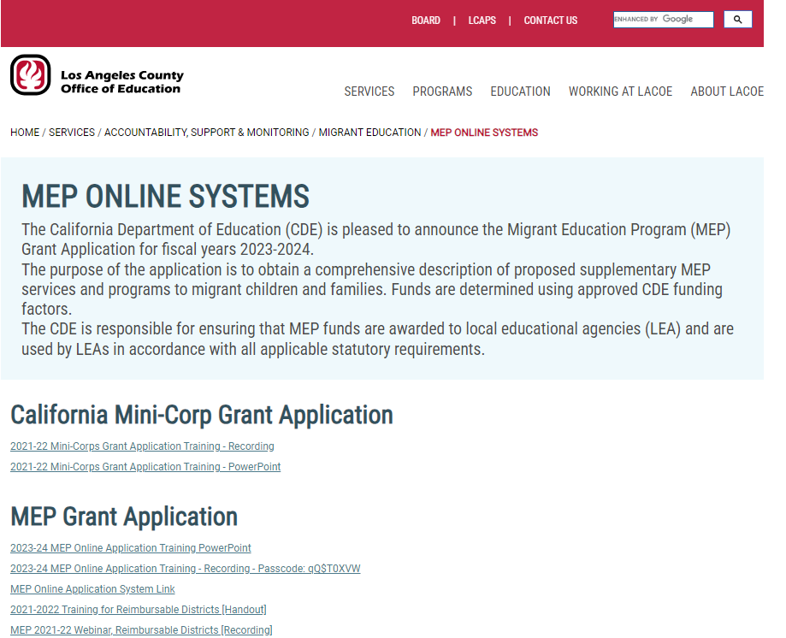
eMEP System Resources
www.lacoe.edu/services/accountability/migrant-education/online-systems

Slide 93
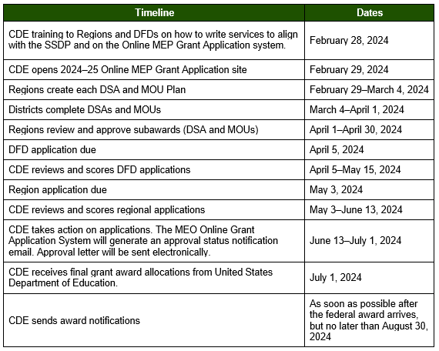
Application Timeline for Regions & DFDS
DSAs/MOUs will be provided an application due date by their Region.

Slide 94
Frequently Asked Questions (FAQs)
Q: Can I edit the allocation tab of Section 1 for my regional or DFD application?
A: The allocation tab in Section 1 for Regions and DFDs are not editable.
Q: What allocations should we use for the 2024–25 grant application?
A: You will use the preliminary allocations that have been inputted into the eMEP system. As in previous years, you will make revisions during Budget Revision 1 to adjust your budgets to align with your 2024–25 grant award notification amounts. Please remember that the allocations will be prepopulated in section 1 of the application for regions and direct funded districts. Regions will enter the allocations for DSAs and MOUs.

Slide 95
FAQs (2)
Q: Is it possible to add multiple documents to the legal assurances tab?
A: The system only allows you to submit one document to the legal assurances tab. Make sure you merge all the required documents as one PDF file or word document. The document must include the 2024–25 Legal Assurances and the Family Biliteracy Program Assurances (if applicable).
Q: May I add users to the approved plan?
A: Once plans have been approved, you are no longer able to add users. You must contact the LACOE helpdesk to add users to an approved plan.

Slide 96
eMEP System Support
DSA/MOU staff can contact their Region for support.
Contact LACOE Technology Services staff via the “Contact Us” button on the eMEP Main Menu.
Contact LACOE Technology Services staff via the support email. This option is best so that you can send screenshots of the issue.
mepsupport@lacoe.edu

Slide 97
Migrant Education Office Staff Contact Information
Alex Leguizamo Education Programs Consultant (EPC), CDE ALeguizamo@cde.ca.gov 916-327-4408 | Lizette Rocha EPC, CDE LRocha@cde.ca.gov 916-323-2241
Jamie Contreras EPC, CDE JContrer@cde.ca.gov 916-319-0391 | Melissa Mallory EPC, CDE MMallory@cde.ca.gov 916-319-0730
Monica Nepomuceno EPC, CDE MNepomuceno@cde.ca.gov 916-323-2212 | Teresa Palomino EPC, CDE TPalomino@cde.ca.gov 916-319-0678
Emily Smith EPA, CDE EmSmith@cde.ca.gov 916-319-0227 | Sal Arriaga EPC, CDE SArriaga@cde.ca.gov 916-323-5549

Slide 98
Feedback Form
If you are not responsible for summer waivers, you may leave the meeting at this time.
Please fill out a brief feedback form
for this training:
Thank you for your attendance and engagement!
www.tinyurl.com/MEPtrainingFeedback

Slide 99
Summer Waivers

Slide 100
Education Code Section 54444.3
California Education Code (EC) Section 54444.3 states that:
Each operating agency receiving Title I Migrant Education funding shall conduct summer school programs for eligible migratory children in kindergarten and grades 1 to 12, inclusive. The summer school programs shall respond to the individual needs of participating pupils and shall build on and be consistent with the instructional programs offered to these pupils during the regular school year. Each summer school program shall be funded, to the extent that funds are available, by federal funds earmarked for migrant education programs, and shall meet the following criteria:
(1) That summer school programs meet the following time requirements:
(A) For kindergarten classes, not less than 180 minutes per day, based upon the full apportionment day of 240 minutes, including recesses, for not less than 20 teaching days.
(B) For grades 1 to 8, not less than 200 minutes per day, based upon the full apportionment day of 240 minutes, including recesses and passing time but excluding noon intermissions, for not less than 20 teaching days.
(C) For grades 7 to 12, not less than 240 minutes per day, including passing time but excluding noon intermissions, for not less than 30 teaching days.

Slide 101
Do I need to submit a summer waiver?
EC Section 54444.3(a) (1) further provides:
Exemptions from the requirements of this paragraph may be made by the Superintendent of Public Instruction upon petition submitted to him by the district. The basis for the exemption shall be agricultural labor factors, climatic conditions, specialized educational programs, and other conditions appearing to the superintendent to warrant exemption.
If your program will not meet the minutes requirements outlined in EC Section 54444.3(a) (1) for any grade level, you must complete the Summer Waiver Request Form.

Slide 102
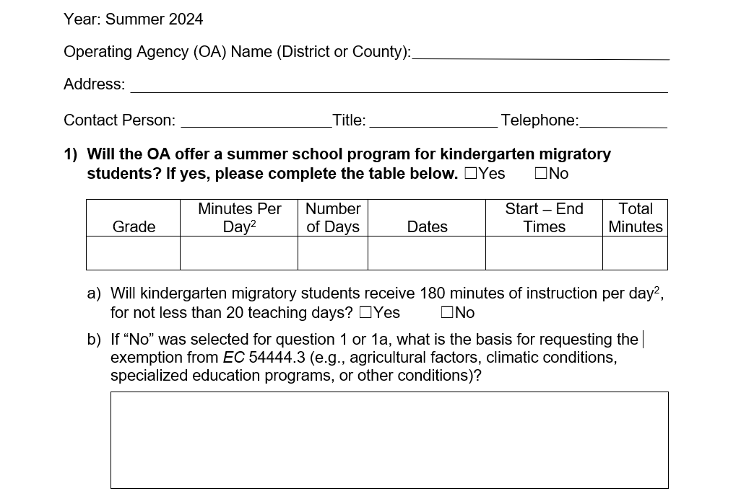
2024 Summer Waiver Request Form
x
K
180
20
7/1/24-7/29/24
9am-12pm
3600
x
102

Slide 103
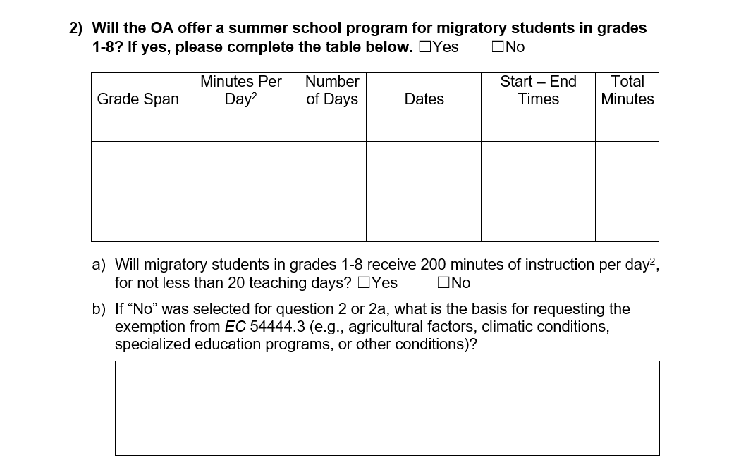
2024 Summer Waiver Request Form (2)
103

Slide 104
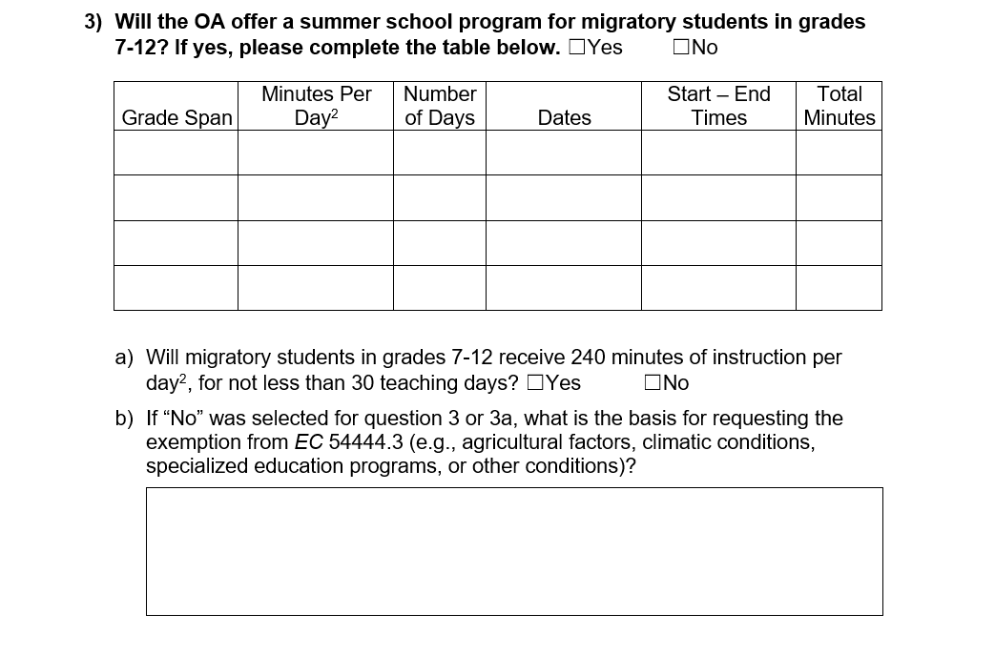
2024 Summer Waiver Request Form (3)
x
7-8
240
20
7/1/24-7/29/24
9am-1pm
4800
9-12
300
20
7/1/24-7/29/24
9am-2:30pm
6000
x
The core regular school year has been extended; it ends in late June and begins in early August. Only 20 teaching days are available during the summer months.
104

Slide 105
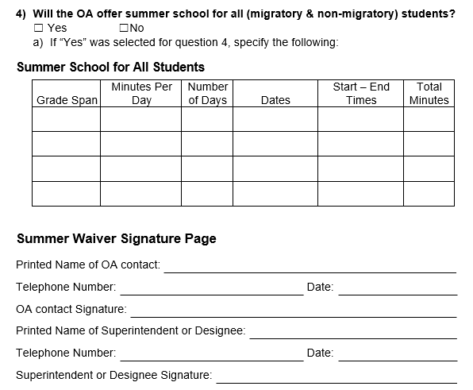
2024 Summer Waiver Request Form (4)
105

Slide 106
2024 Summer Waivers FAQ
Q: When are summer waivers due?
A: DFD waivers must be uploaded by April 5th. Region, DSA and MOU waivers must be upload by May 3rd.
Q: Where do I submit the waivers?
A: Waivers must be uploaded to Section 14 of the application. Regions must upload their approved DSA and MOU waivers as well (if applicable).
Q: Do Regions need to review their DSA/MOU waivers before they are submitted to CDE?
A: Yes, Regions should confirm waivers are completed correctly. Regions should also verify that waivers are only submitted if they are required. If their DSAs/MOUs are meeting the requirements, they should not be submitting a waiver. Also, regions should support the waiver request if submitted to CDE. If it is not supported by the region, there should be a discussion between the region and the district to increase summer minutes.

Slide 107
2024 Summer Waivers FAQ (2)
Q: Can my summer waiver be denied?
A: Yes, summer waivers can be denied if they are incomplete or if they do not provide a valid exemption as listed in EC Section 54444.3.
Q: What are the consequences if my waiver is denied?
A: A condition will be included in your approval letter.
Q: Will my application approval be denied if I do not complete the waiver correctly or if it’s denied?
A: No, however, waivers are part of the application approval process. Incomplete applications including summer waivers can prolong the application approval process.

Slide 108
Questions & Answers

Slide 109
Learning Objective - Self-Assessment
I understand how to navigate the online eMEP system.
e. I can explain how to utilize the new 2024 Summer Waiver form to request an exemption.
109

Slide 110
Thank you for attending!
Please fill out a brief feedback form: www.tinyurl.com/MEPtrainingFeedback
on this training:
If you have additional questions, contact Emily Smith at EmSmith@cde.ca.gov | 916-319-0227

