Slide 1
Migrant Education Program Expenditure Reporting Webinar
Welcome back! We will begin shortly.
While we wait, please complete the brief Google Form to confirm your attendance (link provided in the chat).
Notes:
Facilitator: Alex
Time: Slide will be up 15 min prior to start time.
Notes:
Stand-by slide
This slide will be on display as participants log in.
Do a few sound-checks prior to starting.
Ask participants to follow the roll call instructions.

Slide 2
Migrant Education Program Expenditure Reporting Webinar
Alex Leguizamo, Education Programs Consultant
Emily Smith, Education Programs Consultant
August 1, 2024
Notes:
Facilitator: Alex
Say the following:
Good morning and welcome to the 2024–25 Migrant Education Program, Expenditure Reporting Webinar. I am Alex Leguizamo, education programs consultant and fiscal lead in the migrant education office and I am joined by my colleague Emily Smith, EPC, and we will be providing this training for you today.

Slide 3
Agenda
Overview of the expenditure review process
Navigating the online expenditure reporting system
  Reviewing expenditure reports
  Submitting expenditure reports
Timelines and Document Submission Guidelines
Notes:
Facilitator: Alex
Say: First, we have the agenda. This webinar’s focus is to provide step-by-step guidance to MEP subgrantees on how to navigate the MEPEX system.
In today’s webinar we will cover the following:
An overview of the expenditure review process
Navigating the online expenditure reporting system which includes
Reviewing expenditure reports and
Submitting expenditure reports
And Finally, timelines and document submission guidelines

Slide 4
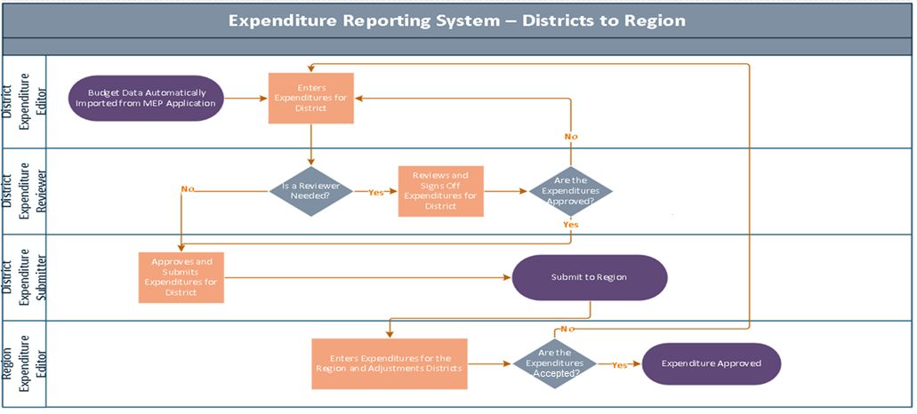
Expenditure Process Flow – Districts to Region
Notes:
Facilitator: Alex
Say:
First we have the flow chart for an expenditure report for a district to a region.
The flow begins with the district expenditure editor (1st level) who enters the initial expenditure information directly into the MEPEX System.
Next (2nd level), the district expenditure reviewer reviews the reported expenditures for completeness, accuracy, and compliance, with the CDE Fiscal Handbook and, if appropriate, approves the request at the district level.
Once the expenditure report is approved by the district expenditure reviewer, then the next step is for the district expenditure submitter to submit the expenditure report (3rd level) to its respective region as appropriate.
The final step (4th level) is for the region district expenditure approver to review and approve the district’s expenditure report.

Slide 5
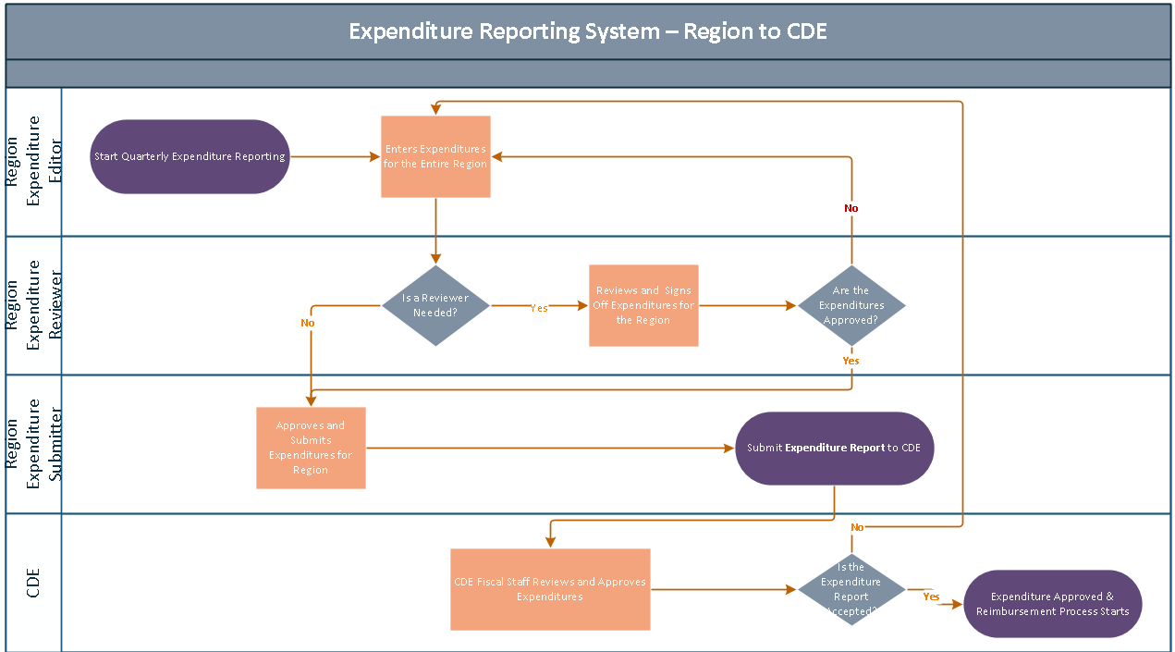
Expenditure Process Flow – Region to the CDE*
*California Department of Education (CDE)
Notes:
Facilitator: Alex
Say:
Now for the Region flow to CDE:
The expenditure reporting process flow for a region is very similar as for a district (it goes from editor, to reviewer, to submitter) except for the final step where the region submits the expenditure reports to the CDE.

Slide 6
System Roles
Expenditure Editor Accountant
Account Clerk
Accounting Technician
Expenditure Required Reviewer Accountant
Fiscal Manager
Program Manager
Expenditure Optional Reviewer Designee
Expenditure Submitter Director
Deputy Superintendent
Designee
Notes:
Facilitator: Alex
Say: Here is an example of the roles I just mentioned and if you are a new user who is creating an account, you must select one of these roles when requesting an account. You can see user roles assigned to the online system and some sample job titles for the designated user roles.
To-do: Read slide

Slide 7
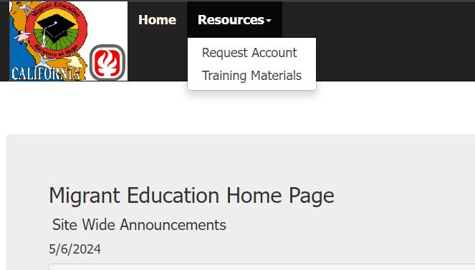
Account Role Inquiry Form
Notes:
Facilitator: Alex
Say: Now I wanted to show you a new form that was added this year. As you may know, you used to be able to see your own roles when you went into the account form. Ever since an update to the form, you can no longer do that.
To get to the new form click down on resources, and request account.

Slide 8
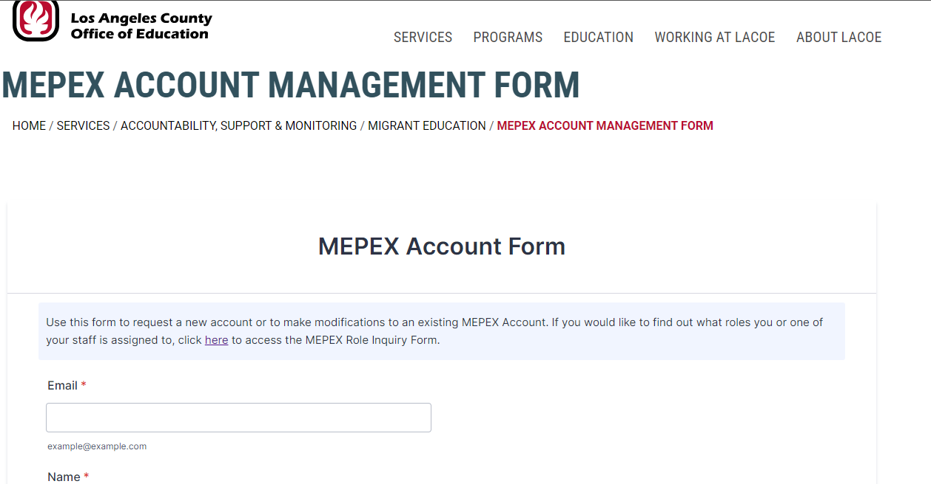
Account Role Inquiry Form (2)
Notes:
Facilitator: Alex
Say: It will take you to the normal account form and there is this new sentence at the top “If you would like to find out what roles you or one of your staff is assigned to, click here to access the MEPEX Role Inquiry Form.
You can see it where the red arrow is pointing.

Slide 9
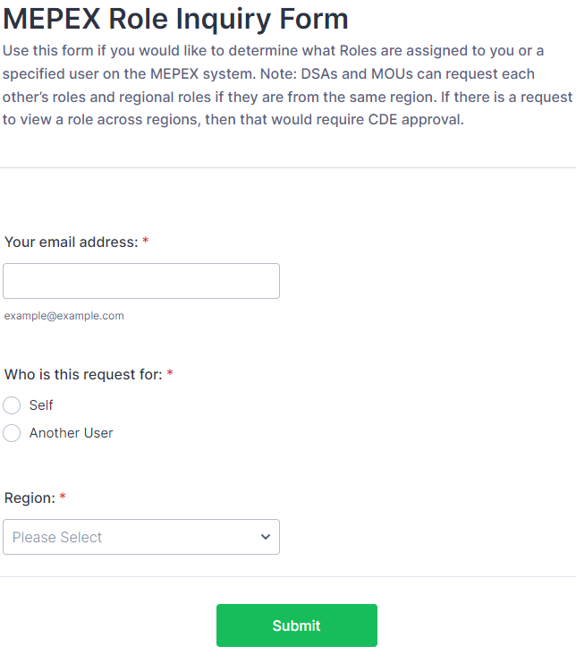
Account Role Inquiry Form (3)
Notes:
Facilitator: Alex
Say: Once you click on there this screen will appear. Here you can enter the information for the user who’s roles you are requesting. Please note, this is a manual process, so you will receive an automated email letting you know the form went through but it can take up to 24 hours to receive the role information.

Slide 10
Recording Monthly Expenditures
Notes:
Facilitator: Alex
Say: Next, we are moving on to an overview of how to input monthly expenditures.

Slide 11
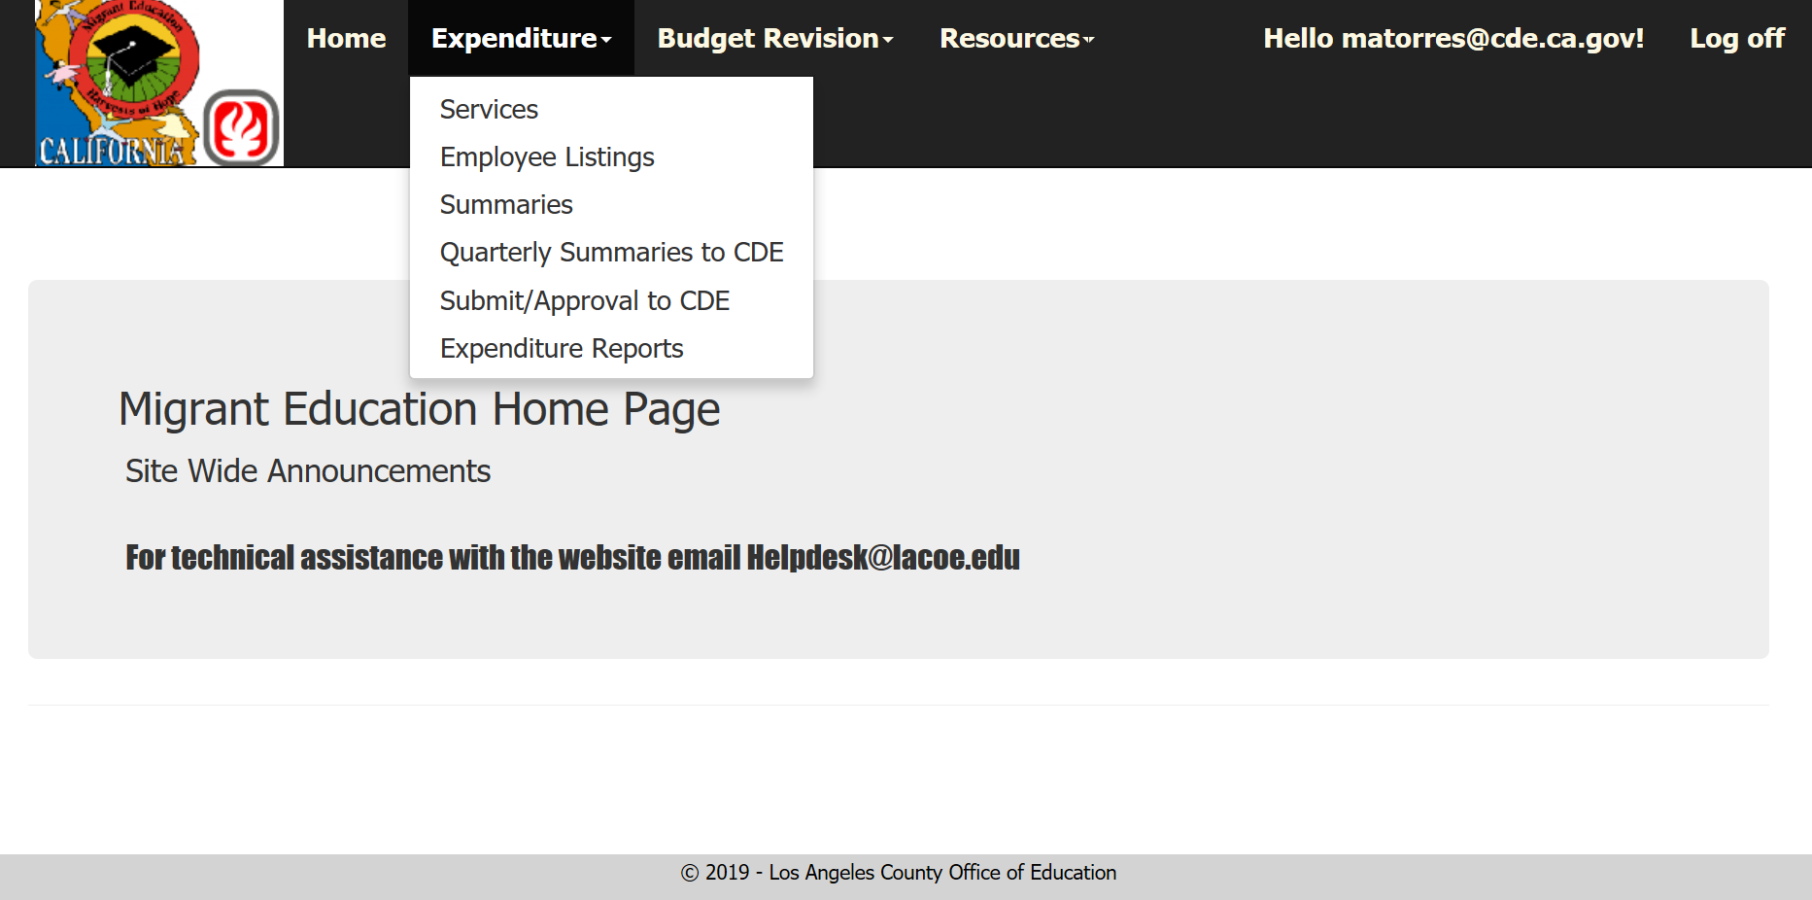
Initial Steps
Notes:
Facilitator: Alex
Say: After logging in, click on the expenditure dropdown tab and then select the services link.
Here regions and DFDs can see or edit the monthly expenditures for their districts, depending on the user role.

Slide 12
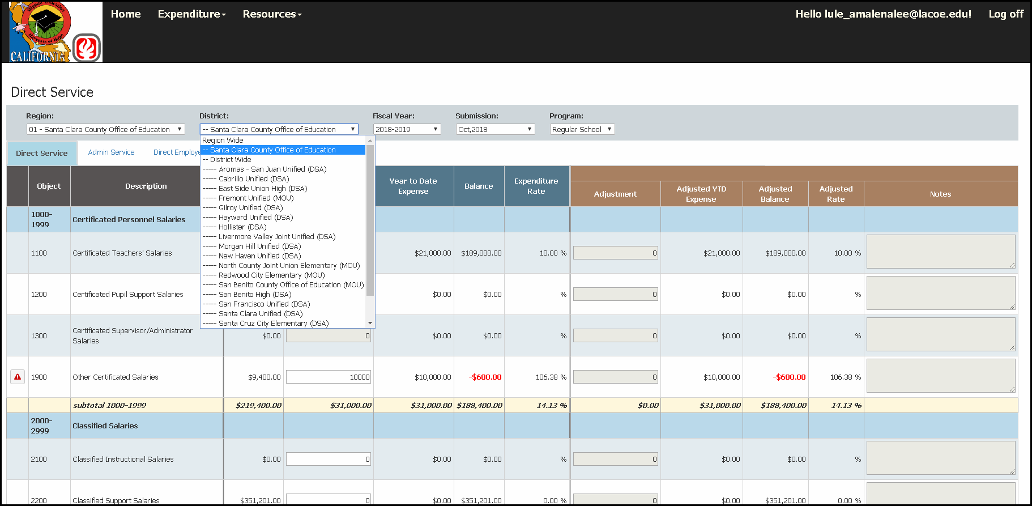
Expenditure Entry Screen
Notes:
Facilitator: Alex
Say: Please note that the expenditure reporting data entry screens are the same with subtle differences for a region, a direct-funded district and a DSA and MOU district. One difference is as follows: using the “district” drop-down menu navigation tool, a region selects its county office of education, a direct-funded district select its specific district name and a DSA/MOU district selects its specific district name.
Once you select “Services” you will be on the expenditure reporting entries page as shown on the slide
To begin the expenditure reporting process there are 5 general steps:
First – Select the district or county office of education
Second – Select the fiscal year
Third - Select the submission month (e.g., July, August, September)
Fourth - Select the Program Component (e.g., Regular School Year, Summer Session, I & R)
Fifth - Enter the expenditure amount in the appropriate object code cell
Remember: Click “SAVE” after all entries are completed and prior to leaving the page. The system does not automatically save your information. So, if you leave the page without saving your entries you will lose all of the information that was entered. Please ensure all staff using the system are trained and understand the importance of saving prior to leaving the page.
Note: The years in the screenshots may not match the current year, they are just a reference. Please make sure you are working in the correct year for your expenditures.

Slide 13
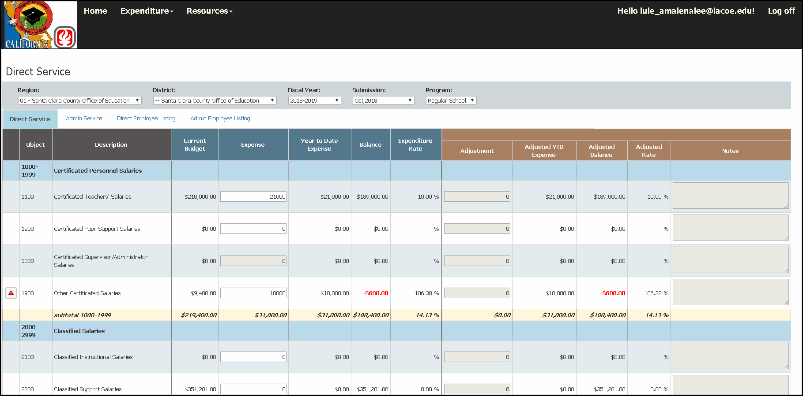
Direct Services Expenditure Example
Notes:
Facilitator: Alex
Say:
Example # 1
For October 2018, in the Regular School Year, the region reported expenditures in the “Direct Service” section of $21,000 for Object Code 1100 as denoted in the top left red box. As you can see in the top right red box, the balance is automatically updated once the expense is typed in.
Example # 2
Also in the Regular School Year, the region reported expenditures in the “Direct Service” section of $10,000 in Object Code 1900 as denoted in the center bottom red box. As you can see in the bottom right red box, the balance has updated to show an over-expenditure in red. There is also a red flag warning you of the overage on the left side.
While these red markers appear as warnings of the overage, justified overages of line items are allowed to be submitted for CDE review. The MEPEX system will not allow an object code series total of 10% or more of the total expenditures to be submitted to CDE for review. (that means in the yellow line here that says “subtotal 1000-1999” the expenditure rate cannot be 110% or above). The system also does not allow the reporting of any expenditures in cells where there is not an approved budget amount. (so if you look at object code 1200 in this example, the current budget is $0, so the system will not allow any expenditures in that line item)
Repeat the steps outlined in the above examples to report additional expenditures in Direct Service.

Slide 14
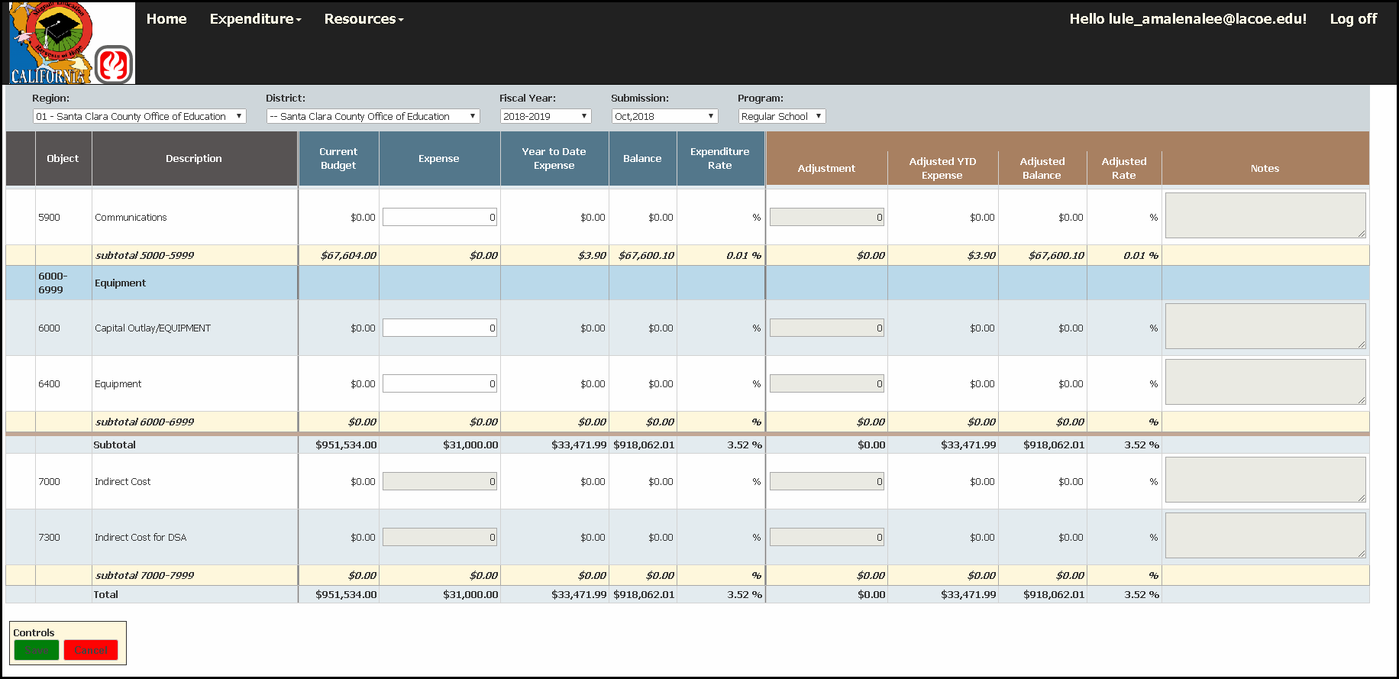
Direct Services Expenditure Example (2)
Notes:
Facilitator: Alex
Say:
The region expenditures reported for Direct Service will update at the bottom of the screen, as well as give a Total summary of all reported expenditures within that program component as seen here on the right red box.
Once you hit save, the screen will update the cells as necessary. You will see an updated total at the bottom of each column where you entered expenditures. See the updated totals in the “Direct Service” column and the “Total” column.
Please remember to click SAVE after all entries are completed and prior to leaving the page since the system does not automatically save your data.

Slide 15
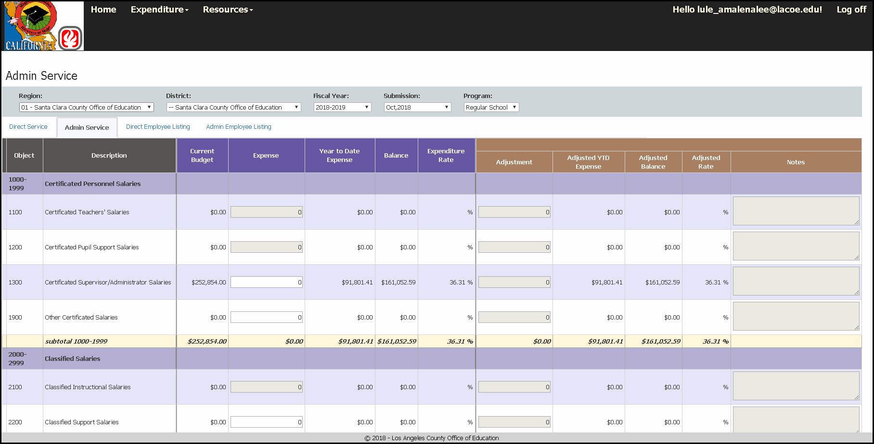
Admin Services Expenditure Example
Notes:
Facilitator: Alex
Say: After you complete the direct services section, you do the same for the Admin Service tab. You click on the “admin services” tab to get to the section and you repeat the same steps as in the direct services tab.
Make sure top ribbon is completed. (District/COE, FY, Submission month, program)
Fill in expenses
Remember to click SAVE after all entries are completed.

Slide 16
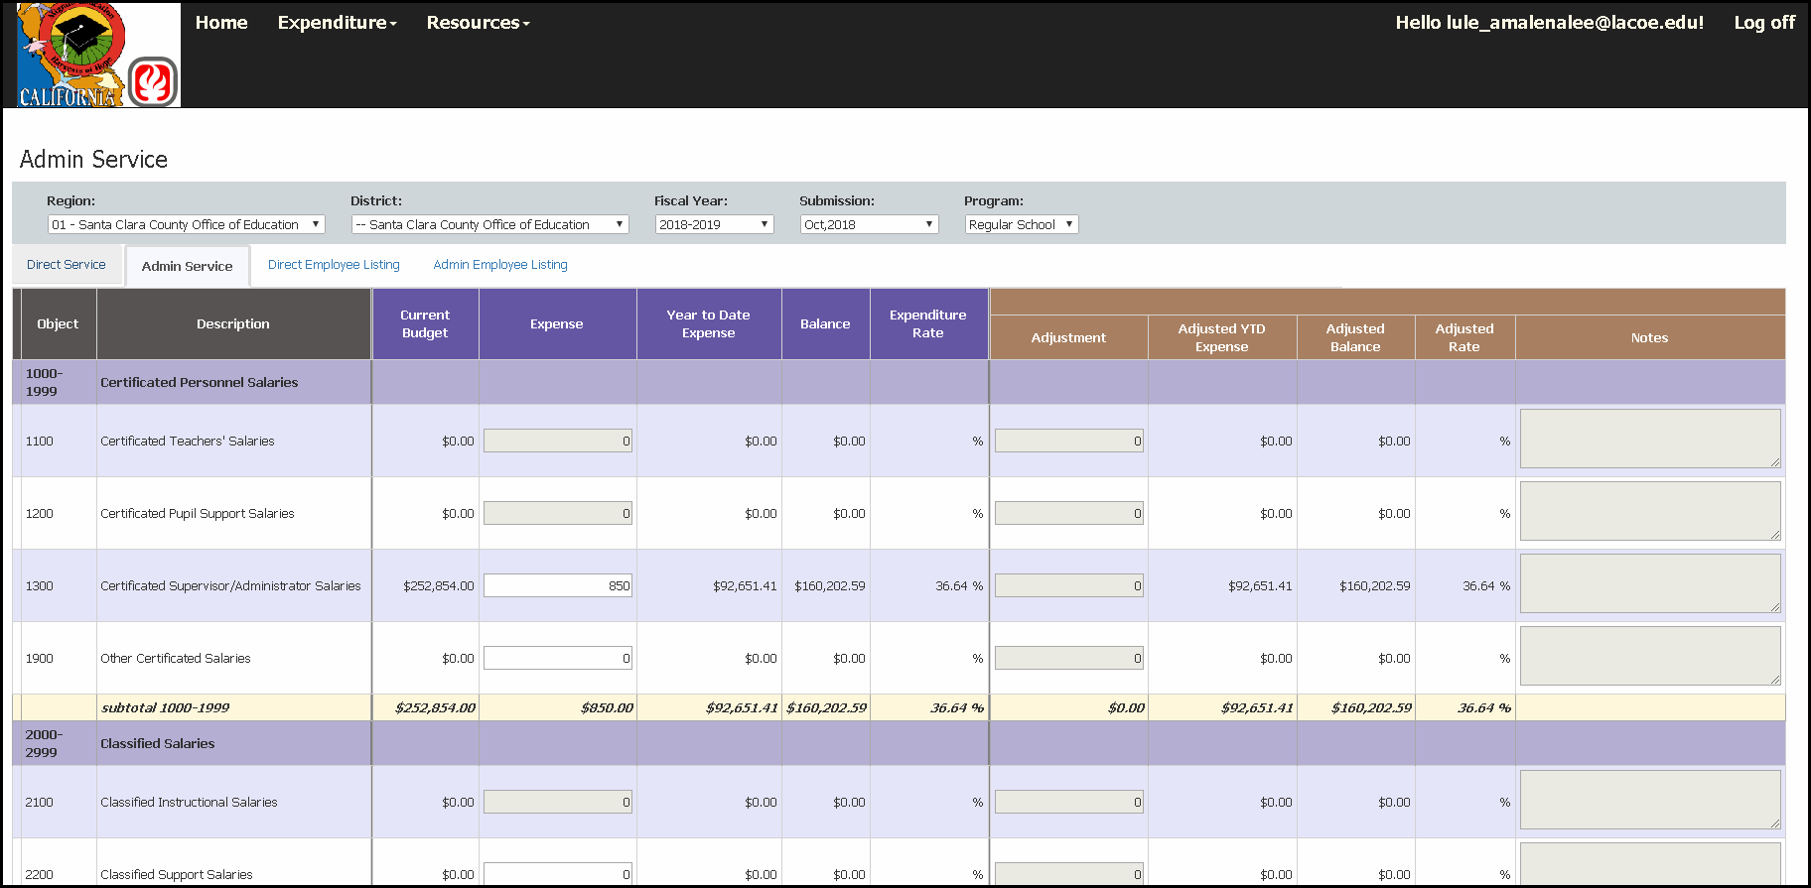
Admin Services Expenditure Example (2)
Notes:
Facilitator: Alex
Say: Similar to the direct service section, when you put in the expense, the balance will automatically update.
Here you can see for October 2018, in the Regular School Year, the region reported expenditures in the “Admin Services” column for $850 for Object Code 1300.

Slide 17
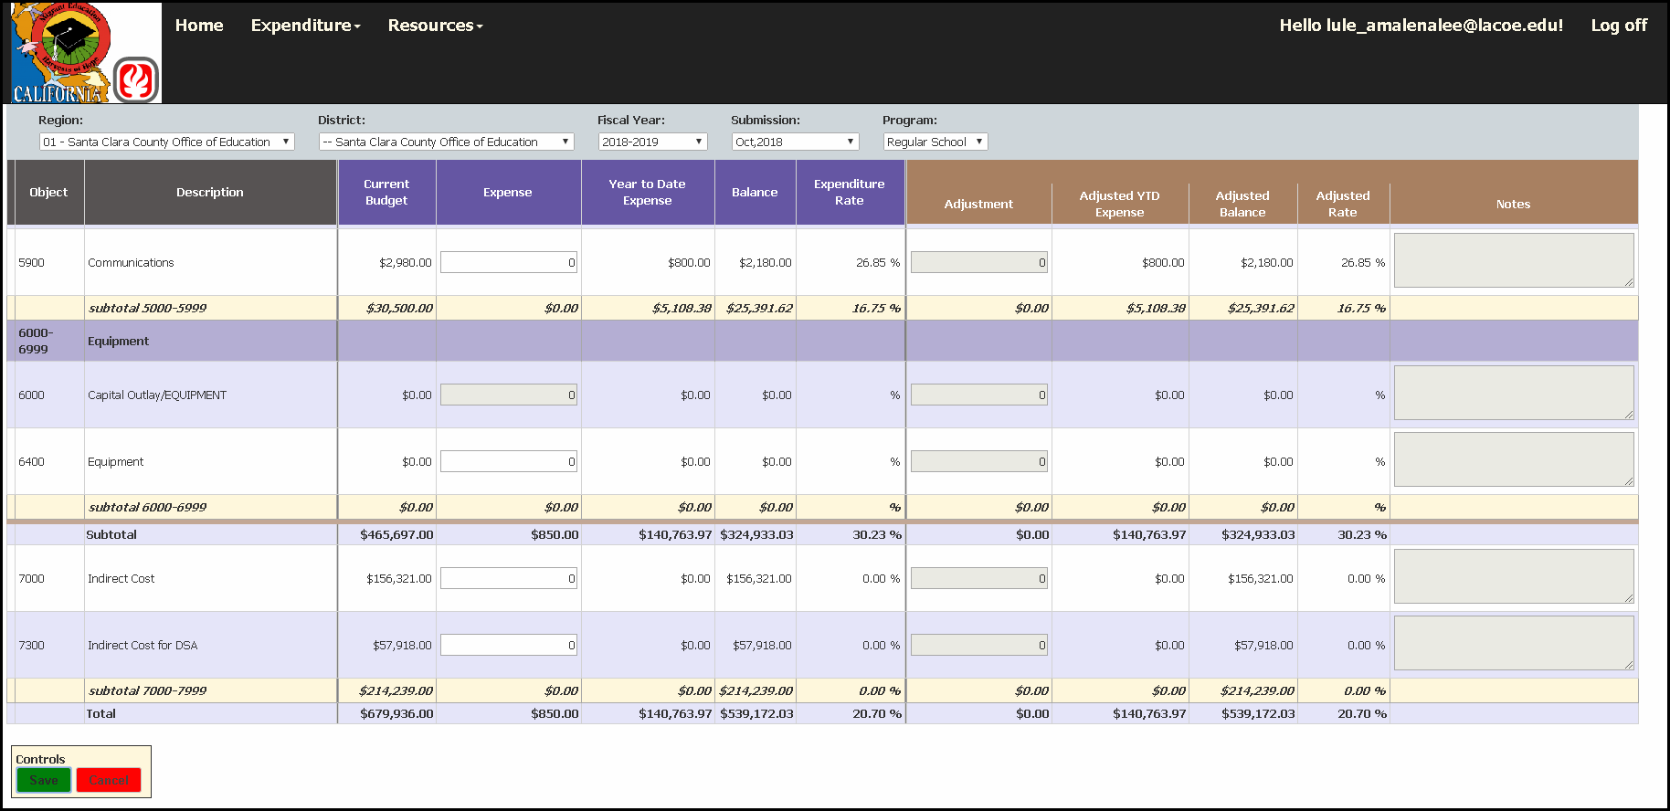
Admin Services Expenditure Example (3)
Notes:
Facilitator: Alex
Say: As before, the region expenditures reported for Admin Services will update at the bottom, as well as give a Total summary of all reported expenditures within that program component.
Once you hit save, the screen will update the cells as necessary. You will see an updated total at the bottom of each column where you entered expenditures. (here you can see the updated expense column matches the $850 that was entered in the previous slide.
Once everything is entered, don’t forget to click that save button.

Slide 18
Expenditure Reporting
Reminder:
The system does not allow the reporting of expenditures in cells where there is not an approved budget amount or where the budget series is 10% or more of the budgeted total for that series. This applies per each program.
Notes:
Facilitator: Alex
To-do: Read slide

Slide 19
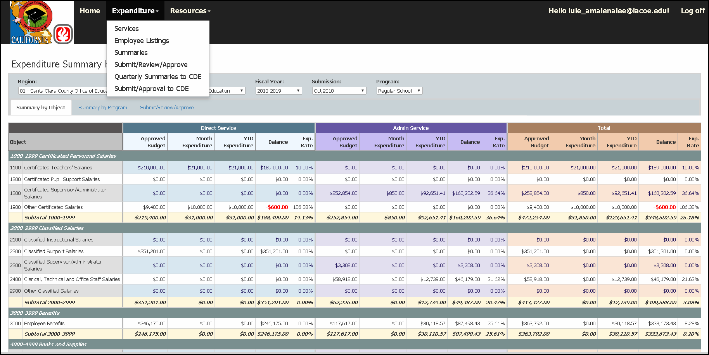
Summary by Object Code Example
Notes:
Facilitator: Alex
Say: The expenditure reviewer will review the expenditure summaries by object code component to ensure accuracy and completeness of the expenditure information. Using this screen you are able to see both direct services and admin services on the same page.
To get to this page:
Select Summaries from the drop-down menu at the top of the page
Select Expenditures Summary by Object (selected here)
Select Fiscal Year
Select Submission Month
Select Program
As you can see in the red boxes, the expenses that were placed in the services section are now reflecting here in the Summary by Object section. This is possible because we remembered to press the save button after we entered the expenditures.

Slide 20
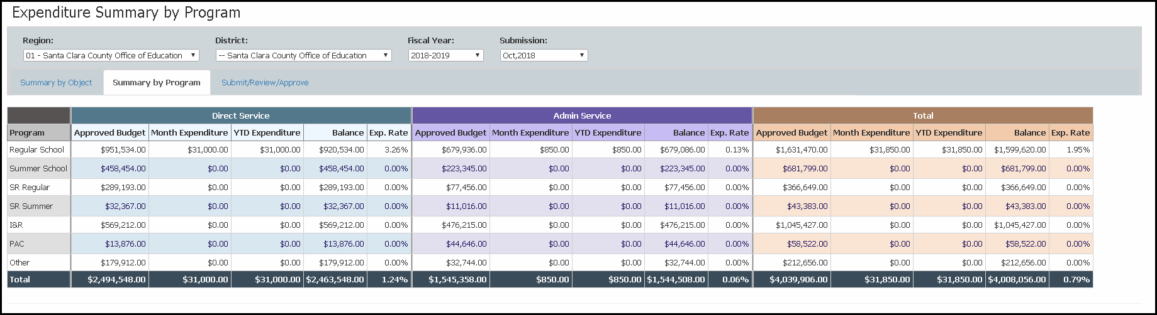
Summary by Program Example
Notes:
Facilitator: Alex
Say: The expenditure reviewer will also have the ability to review the expenditure summaries by program component to ensure accuracy and completeness of the expenditure information.
To do so :
Select the Summary by Program tab from the Summary by Object selection
Select your district or county office of education
Select Fiscal Year
Select Submission Month
No need to select program, since that is how you are reviewing
Since you are reviewing by program, here we see $31,000 under RSY Direct services in the red box instead of the $10,000 and $21,000 that were entered in the beginning.

Slide 21
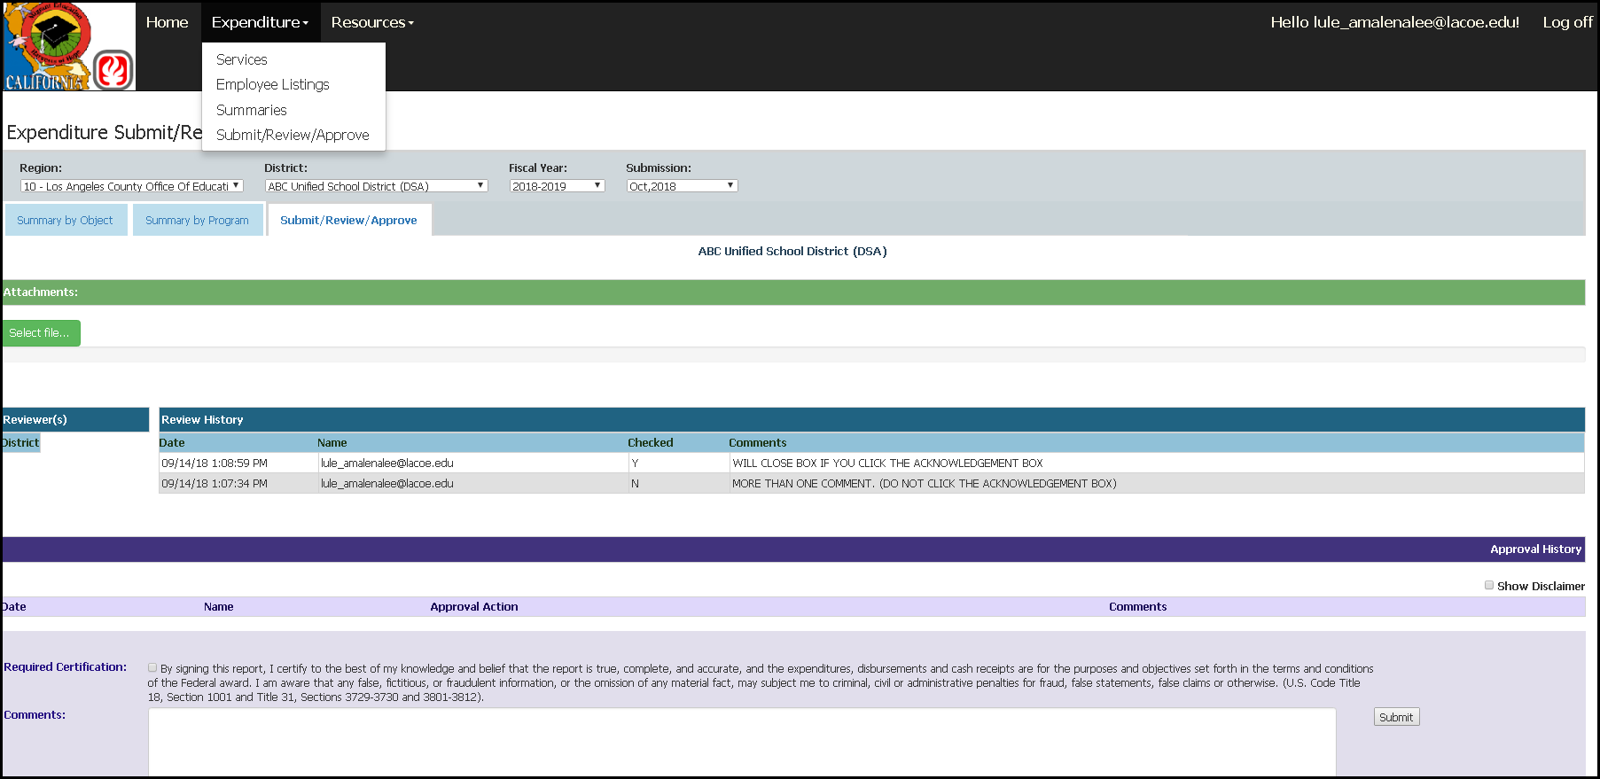
District Submitter Acknowledgment
Notes:
Facilitator: Alex
Say: Once the District Expenditure Reviewer has finished reviewing the Monthly Expenditure Report then it is ready for submission to the Region.​
The District Expenditure Submitter will follow all the steps that the District Expenditure Reviewer does with their review and then they will need to submit it to the region.​
To submit, they will need to select the tab labeled Submit/Review/Approve under the expenditure section​.
In this section the reviewer will:​
Add any comments in the purple submission box that are applicable to the district and that the district considers informative to the region​
Attach any necessary backup documentation in the green section
Select the Required Certification box​
Click the Submit button​
If the Expenditure Report is not ready to be submitted to the Region, ”do not” select the acknowledgement box and submit
​
Once this is done, the Approval History Log will record the Expenditure Report with the date and time it was submitted to the Region for review.

Slide 22
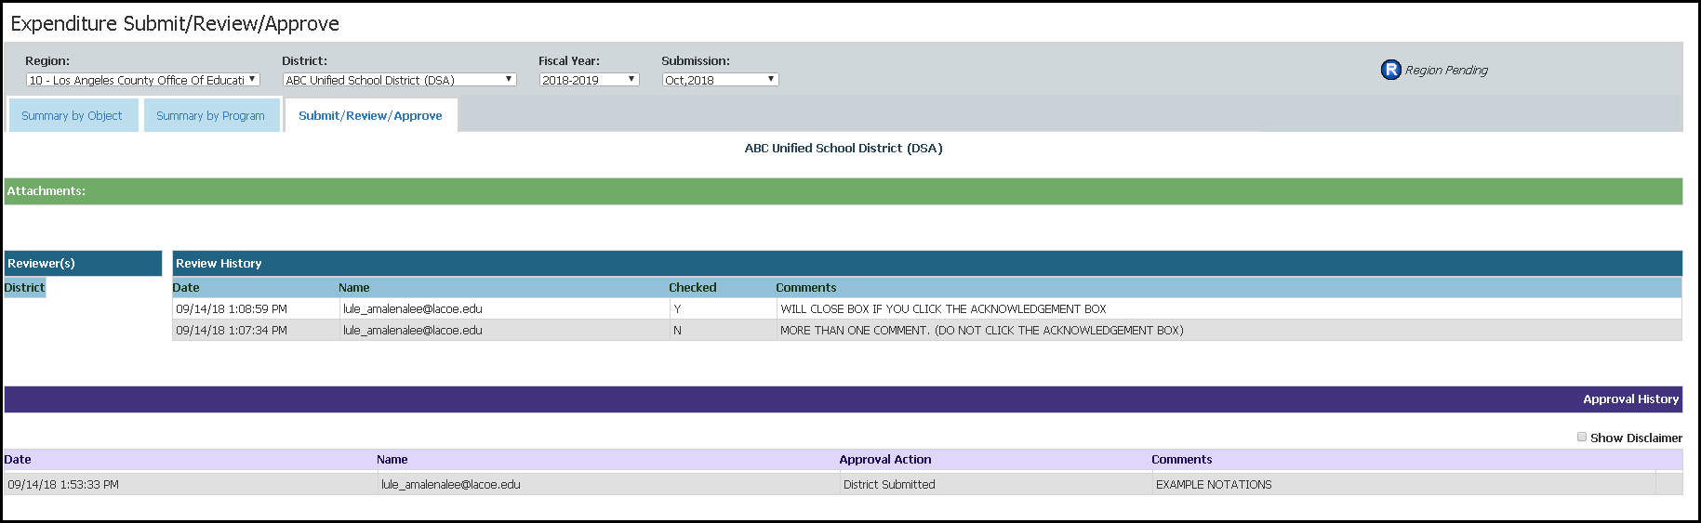
Successful Submission
Notes:
Facilitator: Alex
Say: This slide illustrates the screen that is displayed once the district’s expenditure report has been submitted to the region. The Approval History Log will record the Expenditure Report with the date and time it was submitted to the region for review and approval and the indicator at the top will now say Region Pending which means the expenditure is pending region approval.

Slide 23
Pop Quiz (1)
Please answer in the chat:
True or False:
The system automatically saves expenditure entries.
Notes:
Facilitator: Alex
To-do: Read slide
Answer: False, you must select the save button for the system to save your expenditure report entries.

Slide 24
Pop Quiz (2)
Please answer in the chat:
True or False:
The system will allow you to enter expenditures 10% or over of the total object code budgeted line item.
Notes:
Facilitator: Alex
To-do: Read slide
Answer: True, the key word here is line item. The system will not allow you to enter expenditures 10% or over of the total budgeted Object Code Series.

Slide 25

Questions?
Notes:
Facilitator: Alex
To-do: Read slide, wait for questions.
I’ll pass it over to Emily for the next section.

Slide 26
District Expenditure Report Review
Notes:
Facilitator: Emily
Say: Next, we will go over reviewing a district submitted expenditure report.

Slide 27
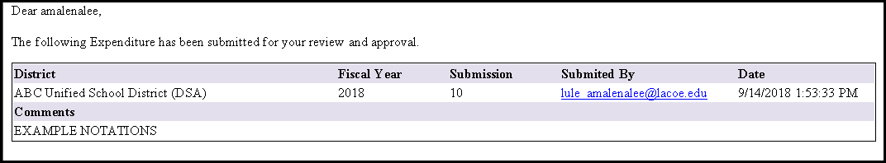
Region Review of District Reports
Submission – Email Example
Notes:
Facilitator: Emily
Say: Once the district has submitted its expenditure report to the region, the region's District Expenditure Approver will receive an email notifying them that the district has submitted the district expenditure report. This means the report is now available for the region’s review and approval.
The system email will include:
District Name
Fiscal Year
Who was it Submitted By – This section will include the District Expenditure Submitter’s email .
The Date – which will include the time and date that the District Expenditure Submitter submitted the expenditure report.
And lastly, the Comments – here you will see any comments provided by the district

Slide 28
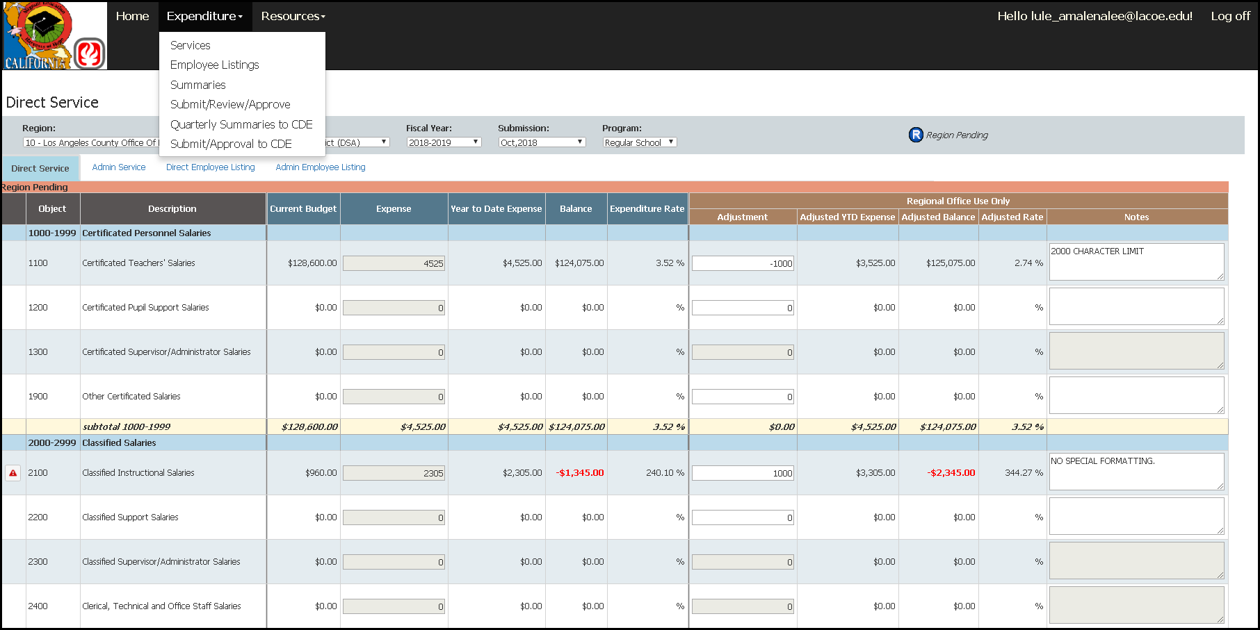
Region Review of District Reports (2)
Notes:
Facilitator: Emily
Say: This slide shows the Services screen view once the district submits its expenditure report to the region. Here you can see the report is pending approval as seen on the top red box. This slide also highlights the “Regional Office Use Only” section of the screen, whereby a region can make adjustments or add notes to a district’s report as necessary. The Region’s District Expenditure Approver must review both the direct service and admin service tab.
Please remember to select the SAVE button once you complete any adjustments or notes.
Please note: The Region’s District Expenditure Approver will repeat this process for all programs and districts.

Slide 29
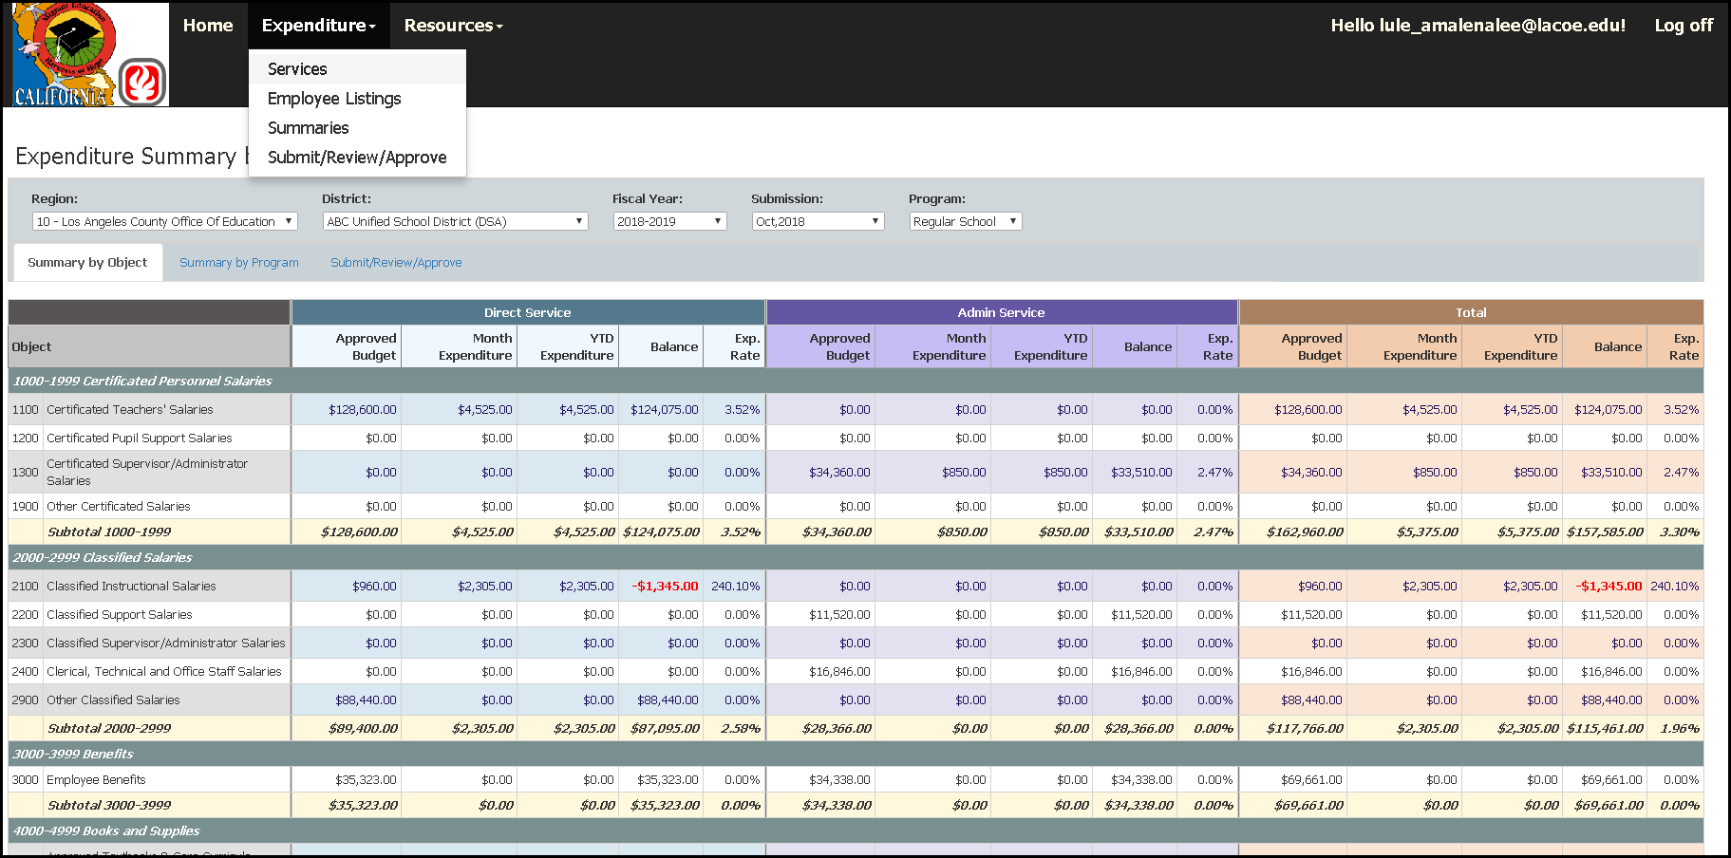
Region Review of District Reports (3)
Notes:
Facilitator: Emily
Expenditure Summary by Object Code
Say:
The District Expenditure Reviewer will subsequently review the expenditure entries in the “Summaries” page for completeness and to ensure accuracy.
To do so:
Select Summaries from the drop-down menu at the top of the page.
Select either Summary by Object (e.g., selected here) or Summary by Program.
Select Fiscal Year
Select Submission month
Select Program component
Review expenditures for Direct Services and Admin Services reported in the applicable object code
On this screen is a complete summary of the district’s expenditures by object code (monthly and year-to-date). This information is also available by program component and by the total of all programs.
The summary is composed of:
The Approved Budget from the most recently approved budget revision
Month Expenditures (which are current expenditure entries for the current submission month, (e.g., Sept 2024)
Year-To-Date (YTD) Expenditures (beginning with the first month of the fiscal year, which is July and reported through the current month)
The Balance (which is the amount available in unspent grant funds)
And, the Expenditure Rate Percentage (which is the percentage of actual expenditures reported, divided by the total grant award)

Slide 30
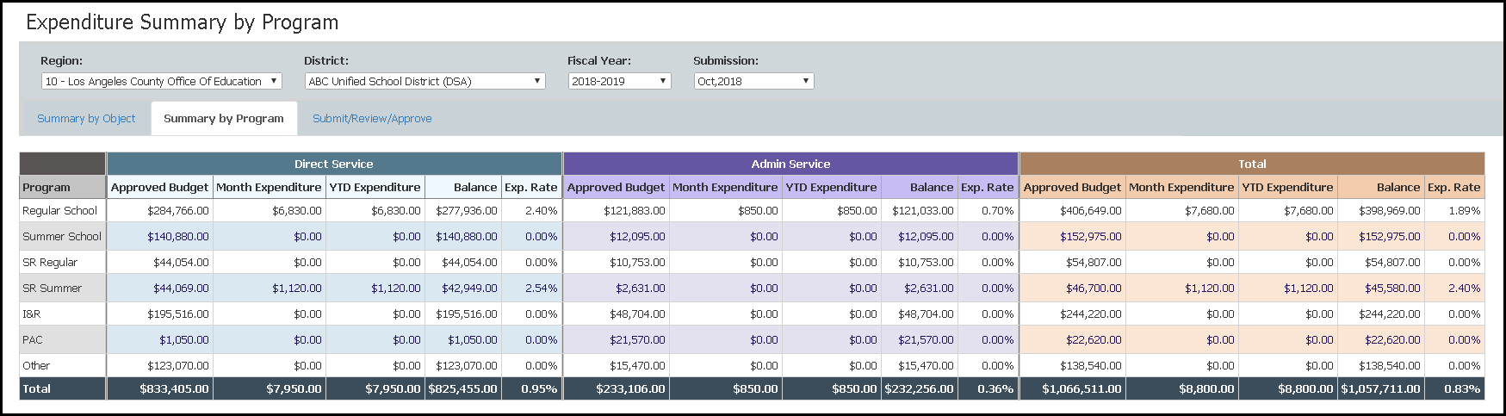
Region Review of District Reports (4)
Notes:
Facilitator: Emily
Say: Expenditure Summary by Program Component
The District Expenditure Reviewer will also review the expenditure entries in the “Summaries” page for completeness and to ensure accuracy.
To do so:
Select the Summary by Program tab from the previous screen
On this screen is a complete summary of the district’s expenditures by program component and by the total of all programs (monthly and year-to-date). This information is also available by object code (monthly and year-to-date) .
The summary is composed of:
The Approved Budget
Month Expenditures
Year-To-Date (YTD) Expenditures
The Balance
And, the Expenditure Rate Percentage

Slide 31
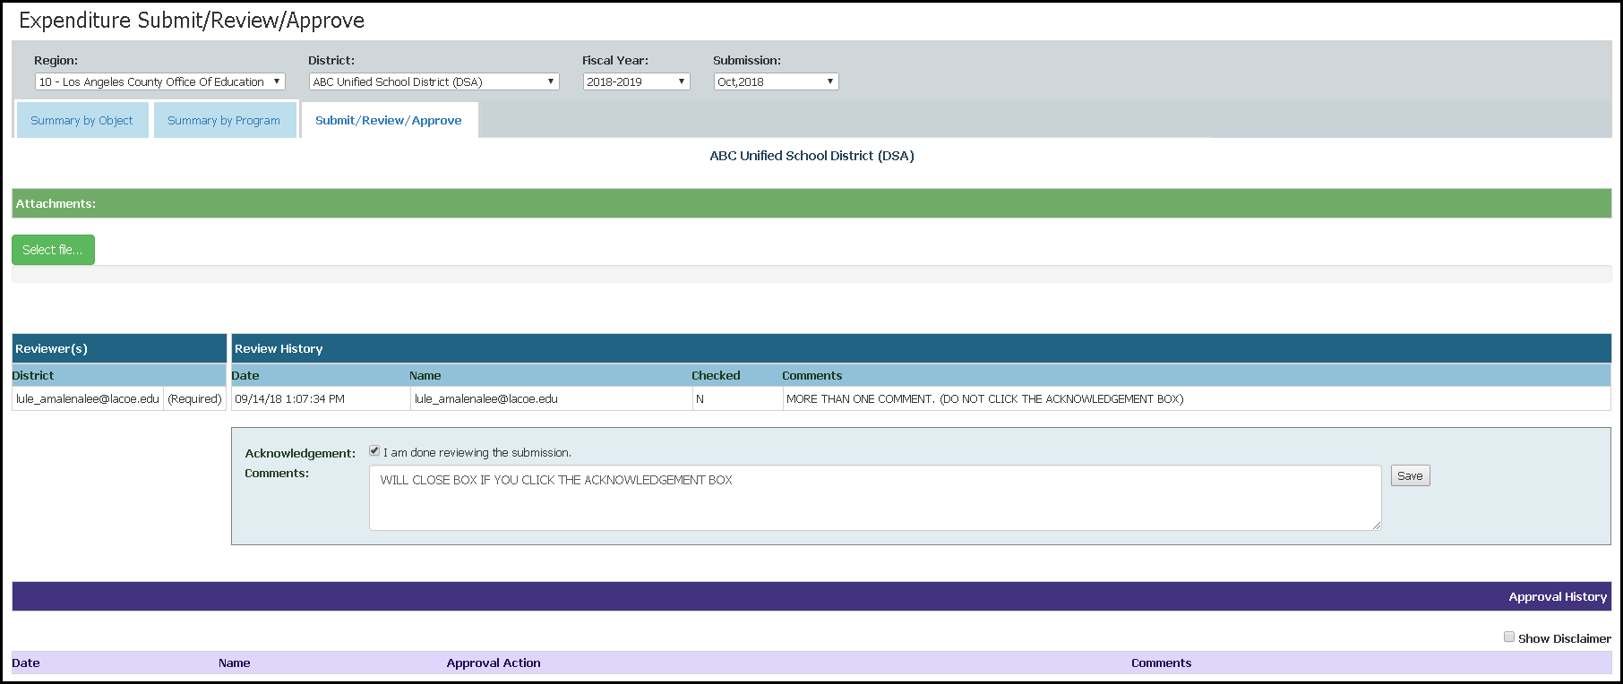
Region Review of District Reports (5)
Notes:
Facilitator: Emily
Say: This is the Submit/Review/Approve screen.
In this section the Reviewer will do the following:
Add any comments in the blue review box that are clarifying, supporting, or informative to the approving district submitter
Select the Acknowledgment box
Click the save button (only if approving the report)
If the district expenditure report is not ready to be approved by the district expenditure reviewer, please DO NOT select the acknowledgment Box **

Slide 32
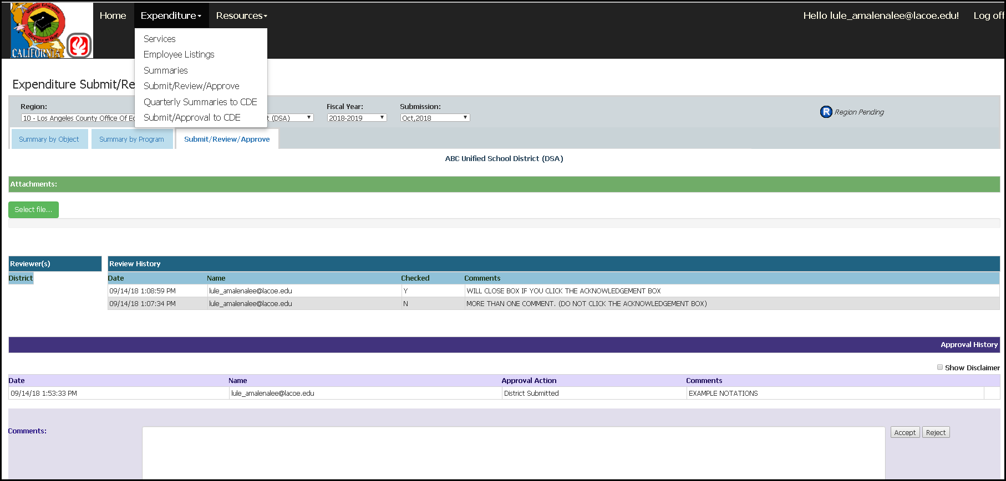
Region Review of District Reports (6)
Notes:
Facilitator: Emily
Say: This slide illustrates the screen that is reserved for the Region’s District Expenditure Approver to either approve or reject a district’s expenditure report. In the top red box you can see the section where the district could have attached backup documentation. Once the Region’s District Expenditure Approver is ready to either reject or approve, they will enter a comment in the box below and press the accept or reject button. This action may take a minute, so please do not refresh your page while you wait for the action to take place.
Please note: The Region can only complete this process if every previous monthly expenditure report has been completed. This promotes accurate Year-To-Date accrual and reporting of expenditures. The online system displays a disclaimer that impedes the approving or rejecting of a district’s expenditure report if the Region does not do this process in consecutive order. ​

Slide 33
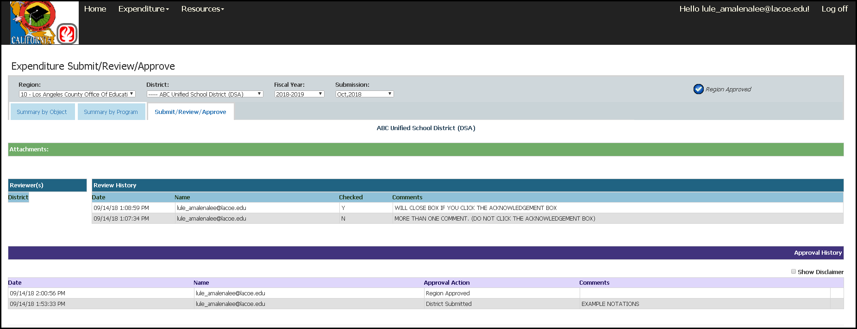
Region Review of District Reports (7)
Notes:
Facilitator: Emily
Say: Once the region approves a district’s expenditure report, the system will record the expenditure report with the date and time it was Approved or Rejected. Now, the Expenditure Report should have a header on the top right hand corner stating – Region Approved. This means that the expenditure report approval for the district is complete. This monthly expenditure report will now reflect into the quarterly summaries to CDE−since this monthly expenditure report has been approved.

Slide 34
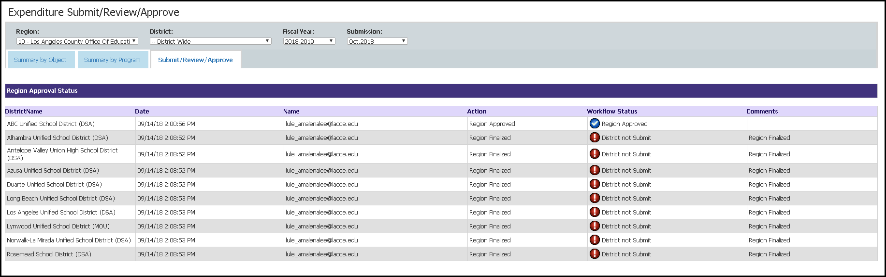
Region Review of District Reports (8)
Notes:
Facilitator: Emily
Say: This screen is for region use only. The region district expenditure approver is required to review and complete the district finalization screen.​
​The Finalize button is designed to facilitate the region’s submission of the district expenditure report to CDE. ​
A region’s quarterly expenditure screens only report approved or finalized expenditure data. A region must utilize the “finalization screen” any time that a district does not have an expenditure report to submit to a region.
The finalize button closes out the district for the current expenditure report period; meaning that once the Region District Expenditure Approver finalizes the district expenditure report(s), then the district will not be able to submit its saved data or edit any rejected expenditure transactions (please note, any saved but not submitted data will be erased). ​A district will not be able to receive reimbursement for this month if they do not submit per the region’s timelines.
​However, if a district expenditure report is “region pending," then the Region District Expenditure Approver will not be able to finalize and a disclaimer will appear. The Region will have to accept or reject any ‘Region Pending’ districts in order to Finalize. *
​Please Note: This Finalize screen only appears when the expenditure Submit/Review/Approve screen is set to “district wide.”.
Now I will pass it back to my colleague Alex to go over a reflection and continue the webinar.

Slide 35
Pop Quiz (3)
Please answer in the chat:
True or False:
Only region funded districts who do not have an expenditure report to submit must be “finalized”.
Notes:
Facilitator: Alex
To-do: Read slide
Answer: True, Only region funded districts who do not have an expenditure report to submit must be “finalized”. If they did submit a report, it must either be rejected or approved not “finalized”.

Slide 36
Region & Direct-Funded District
Expenditure Report Review
Notes:
Facilitator: Alex
Say: Next, we will go over reviewing a region or DFD submitted expenditure report.

Slide 37
Region/Direct-Funded District (DFD)
Expenditure Review
Notes:
Facilitator: Alex
Say: To review the region’s expenditure entries, the region required reviewer must log into the system and :
Select “Expenditures” from the drop-down menu
Select “Services”

Slide 38
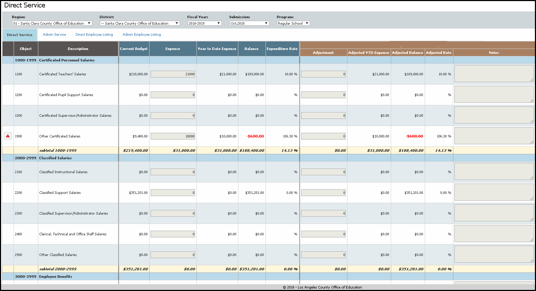
Review of Direct Services
Notes:
Facilitator: Alex
Say: On the Direct Service screen:
Select the COE or your district if you are a DFD
Select Fiscal year
Select the submission month
Select Program Component (ex: Regular School, Summer School, I&R)
Review the amounts in the Direct Service column in the applicable object codes
In this example we see there are expenditures reported in Direct Service of $21,000 for object code 1100 and $10,000 for object code 1900.
In this screen, the reviewer is no longer able to edit the numbers if there are any issues.
Please note: The region required reviewer will repeat this process for all program components included in the expenditure report.

Slide 39
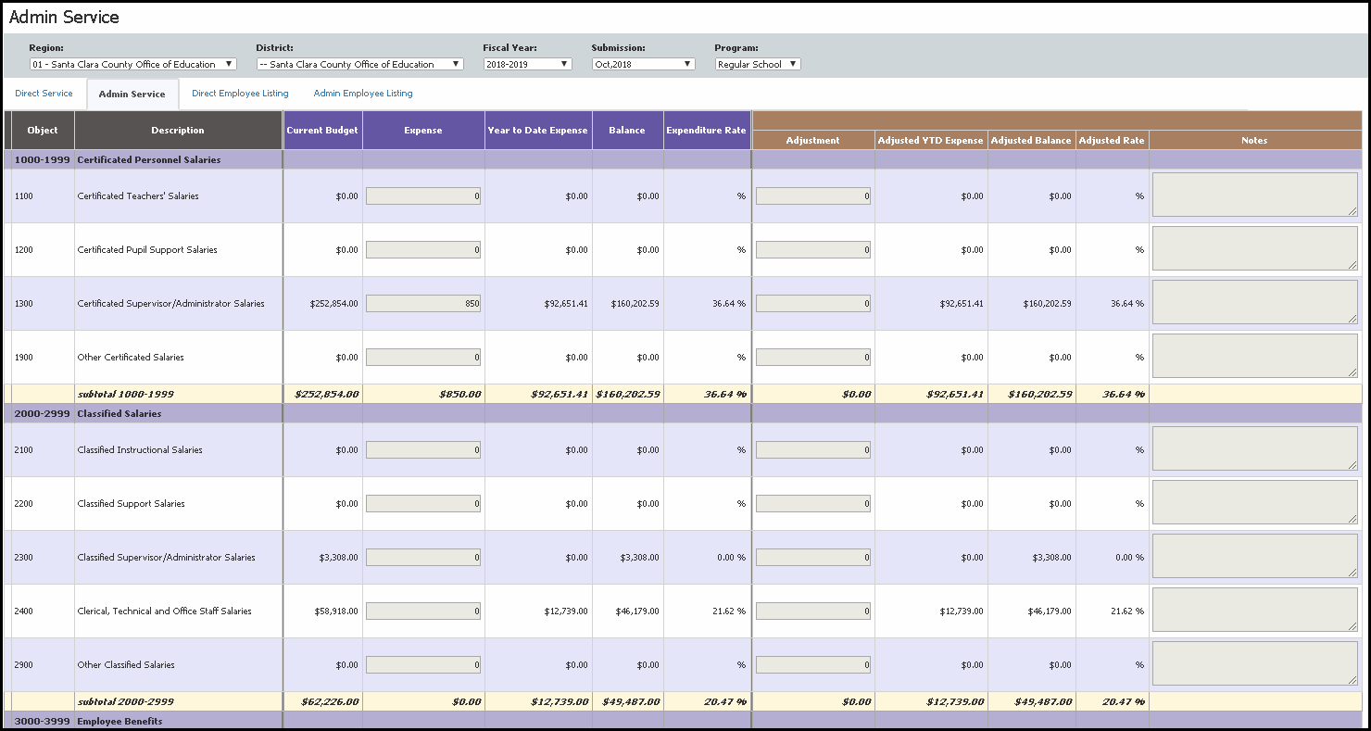
Review of Admin Services
Notes:
Facilitator: Alex
Say: On the Admin Service screen the review is very similar:
You can select the Admin Service tab from the previous screen to get to this screen
Review the amounts in the Admin Service column in the applicable object codes
In this example we see there are expenditures reported in Admin Services of $850 for object code 1300.
Please note: The district expenditure reviewer will repeat this process for all program components included in the expenditure report.

Slide 40
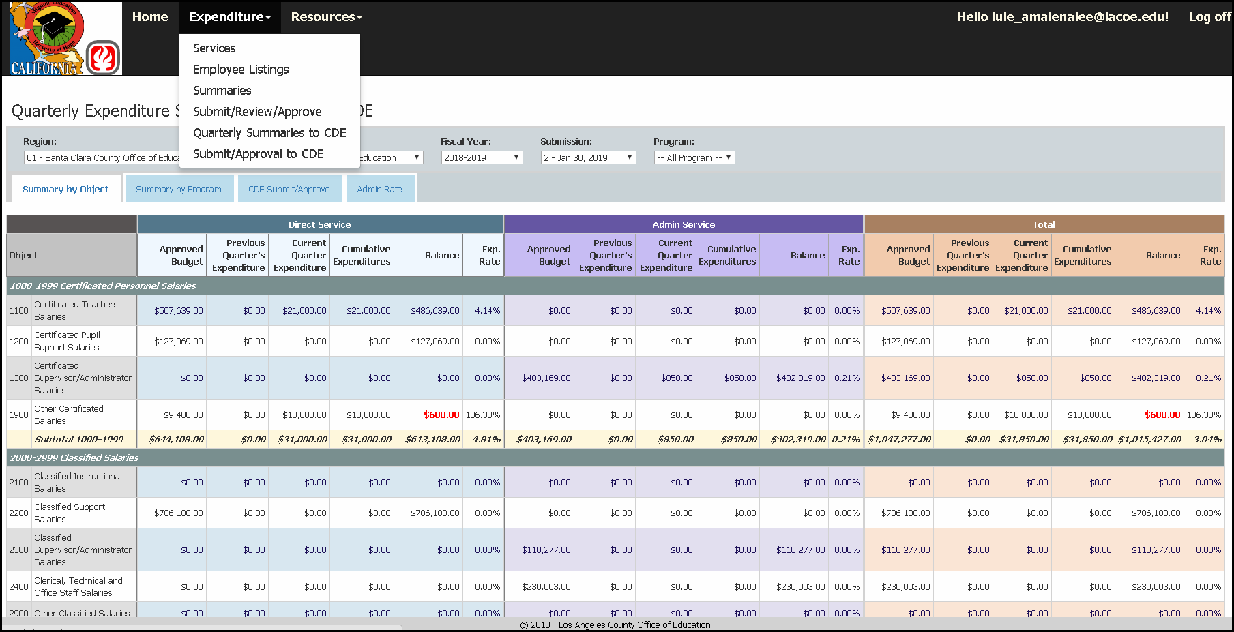
Quarterly Summaries to the CDE
Notes:
Facilitator: Alex
Say: Viewing the Expenditure Summary by Object Code will help you to ensure that all expenditures are reported in the proper object codes and that the expenditures also correspond to the approved budget amount for that specific object code.
Starting with Quarterly Summaries by Object Code, the region expenditure reviewer will:
Select Fiscal year
Select Submission Quarter
Select Region Wide (includes both region and district expenditures), District Wide (includes the expenditures for all districts only), or specific Districts (includes the expenditures for individual districts) to review
Review expenses for BOTH Services and Admin in the object codes applicable
Quarterly Expenditure Summary by Object Code:
Gives a complete summary for the quarter by object code
By each Program Component individually or by all programs
Summary is composed of:
Approved Budget (Latest)
Previous Quarter’s Expenditure
Current Quarter Expenditure
Cumulative Expenditure
Available remaining balance of budget of unspent grant funds
Please Note: Over expenditures will appear negative and in a red color
Expenditure Rate by Percentage
Summary is also broken down by Direct Service, Admin Service and a combined Total

Slide 41
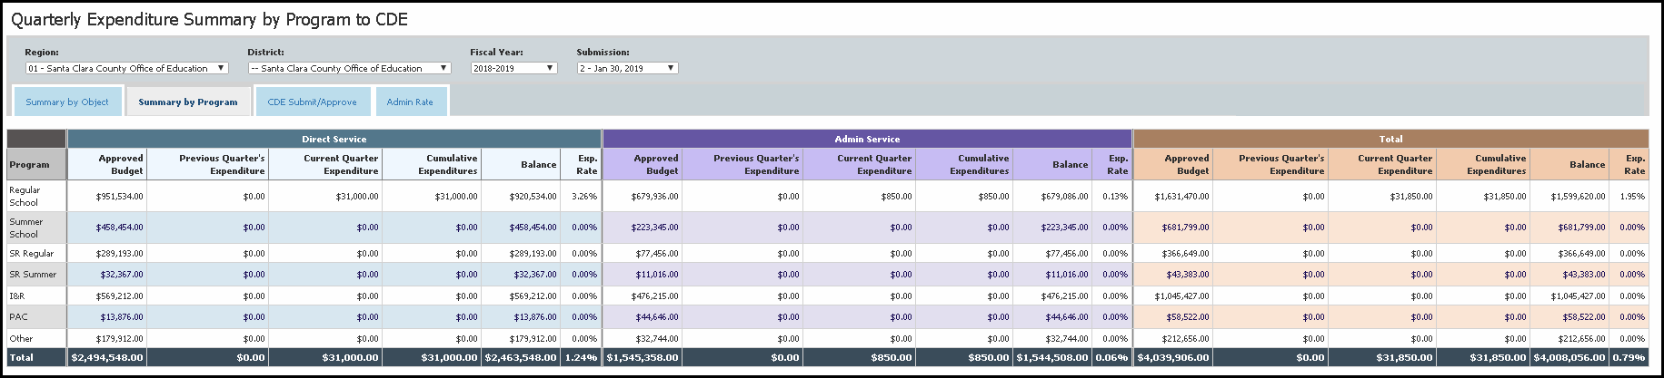
Review Summary by Program
Notes:
Facilitator: Alex
Say: Viewing the Expenditure Summary by Program Component will help you to ensure that all expenditures are reported in the correct program component and that the expenditures also correspond to the approved budget amount for that specific program component.
Quarterly Expenditure Summary by Program Component
The Region Expenditure Reviewer will subsequently review the expenditure entries in the “Summaries” page for completeness and to ensure accuracy.
To do so:
Select Summaries from the dropdown menu at the top of the page
Select Summary by Program Component
Select Fiscal Year
Select Submission Quarter
Select Region Wide (includes both region and district reported expenditures), District Wide (includes the expenditures for all districts only), or specific Districts (includes the expenditures for individual districts) to review
Review expenses for both Services and Admin and the Total in each program component (e.g., Regular School Year, Summer School, I &R)

Slide 42
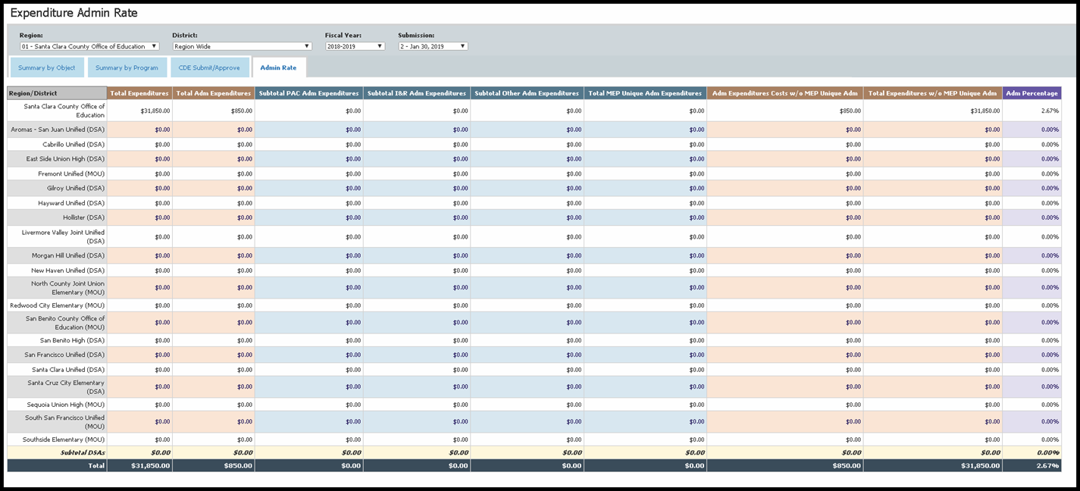
Review Expenditure Admin Rate
Notes:
Facilitator: Alex
Say: As a reviewer, you should also check the admin rate. The Expenditure Admin Rate Percentage is used to monitor admin expenditures and ensure you are within the approved admin limit on your region’s or direct-funded district grant approval letter.
To do so:
Select Fiscal year
Select Submission Quarter
Select Region Wide (includes both region and district reported expenditures), District Wide (includes the expenditures for all districts only), or specific Districts (includes the expenditures for individual districts) to review
Review reported expenditures and Admin Rate Percentage Calculation – this percentage is automatically calculated by the online system and is based on the CDE’s approved formula
Summary is composed of:
Current Quarter’s Expenditures
Administrative Percentage of Quarter Expenditures

Slide 43
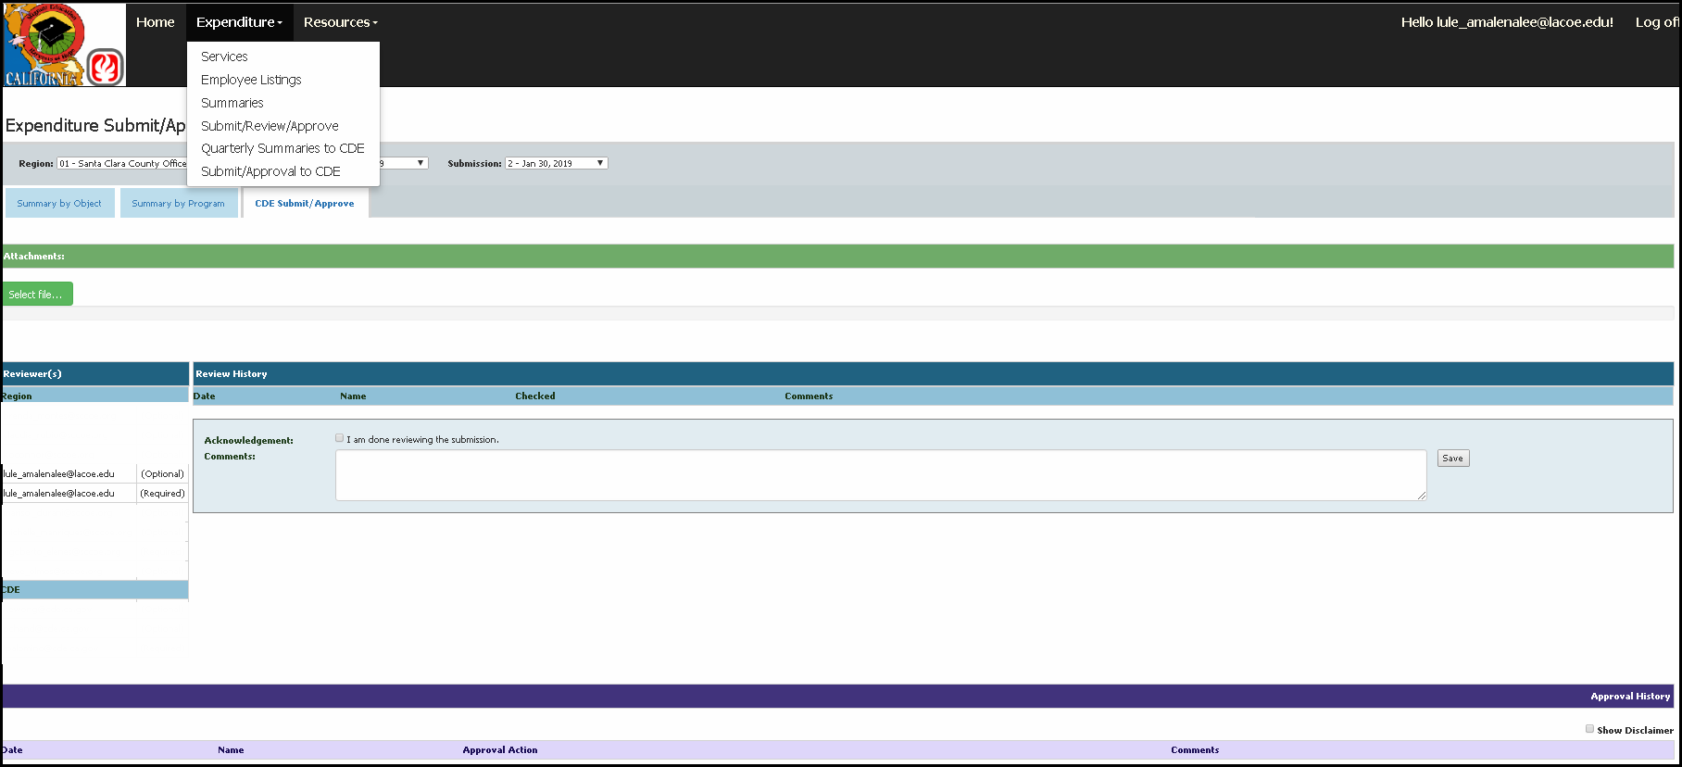
Reviewer Acknowledgment
Notes:
Facilitator: Alex
Say: This screen illustrates the role of the region expenditure reviewer in the review of the region’s quarterly expenditure report for submission to the CDE. The region expenditure reviewer will select the tab labeled Submit/Review/Approval to CDE.
In this section the region expenditure reviewer will do the following:
Add any comments in the blue review box that are clarifying or supporting or informative to the region submitter or to the region personnel
Select the Acknowledgment box
Click the save button
If the region expenditure report is not ready to be approved by the region expenditure required reviewer please DO NOT select the acknowledgment Box.

Slide 44
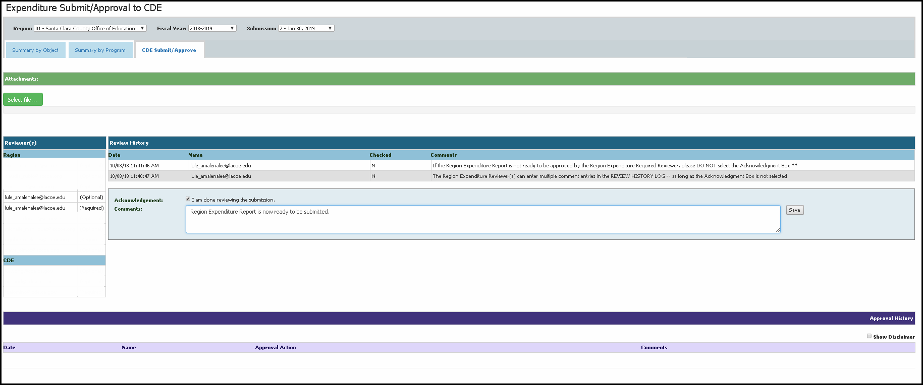
Reviewer Acknowledgment (2)
Notes:
Facilitator: Alex
Say: This is another example of the region expenditure required reviewer acknowledgment screen and it illustrates the Review History log and the Acknowledgment textbox.
If the review is compete and it is ready to be submitted, check the acknowledgment box and click the save button. Region Expenditure Required Reviewer can now see that they have acknowledged the expenditure reporting is accurate and the region expenditure report is ready to be submitted to CDE. Also, the Region Expenditure Required Reviewer must notify the Region Expenditure Submitter that the region expenditure report is ready to be submitted.
Please Note: The Region Expenditures Reviewer(s) can enter multiple comment entries in the Review History Log -- as long as the Acknowledgment Box is not selected. Additionally, if the expenditure report is not ready to be approved by the region expenditure required reviewer, please “do not” select the acknowledge box.

Slide 45
Pop Quiz (4)
Please answer in the chat:
True or False:
The system will not let you submit the expenditure report if your admin rate is over your approved amount.
Notes:
Facilitator: Alex
To-do: Read slide
Answer: False, the system will let you submit if your admin rate is over the approved amount. This is why it is very important to track your admin rate and to make sure it is below your approved amount.

Slide 46
Pop Quiz (5)
Please answer in the chat:
True or False:
If you check the acknowledgement box and click the save button it can easily be undone by clicking the “back” button on your browser.
Notes:
Facilitator: Alex
To-do: Read slide
Answer: False, do not click the back button on your browser when submitting or approving anything. Only check the acknowledgment box and click the save button if the expenditure report is approved and ready to be submitted. If you need to reset the acknowledgement box, please contact the LACOE help desk.

Slide 47
Questions? (2)
Notes:
Facilitator: Alex
To-do: Read slide, wait for questions.

Slide 48
Region/Direct-Funded District Submission to the California Department of Education
Notes:
Facilitator: Alex
Say: Next, we will go over submitting a region or DFD expenditure report to CDE.

Slide 49
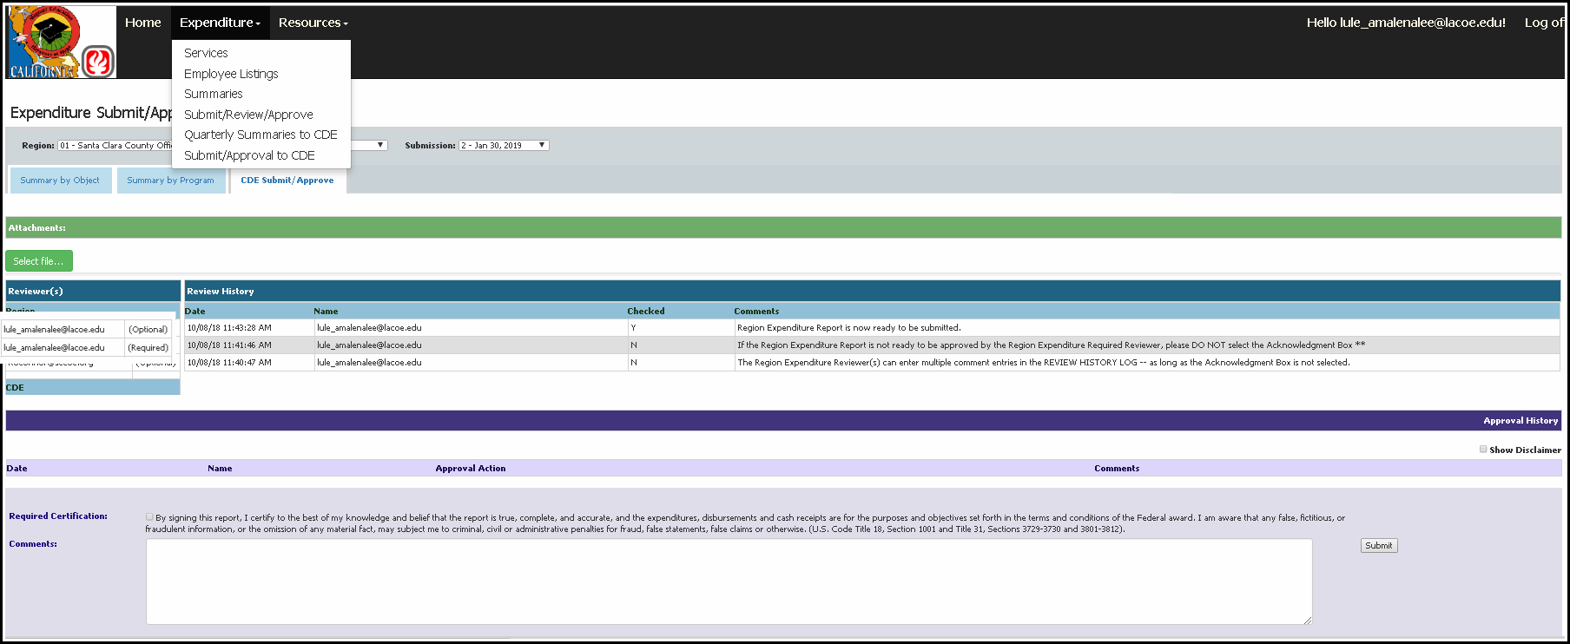
Submitter Acknowledgment
Notes:
Facilitator: Alex
Say: Once all region expenditure required reviewers have acknowledged reviewing the expenditure report then it is ready for submission to the CDE.​
The region expenditure submitter will follow all the steps that the region expenditure required reviewer does and then do the following:​
​
Select the tab labeled Submit/Review/Approve​
In this section the submitter will do the following:​
Add any comments in the purple submission box that are applicable and that the region considers informative to the CDE
Add any files as back up documentation
Select the required certification box​
Click the submit button​
If the expenditure report is not ready to be submitted to the CDE, do not select the acknowledgement box and submit*
​
Once this is done, the approval history log records the expenditure report with the date and time it was submitted to the CDE for review and approval.

Slide 50
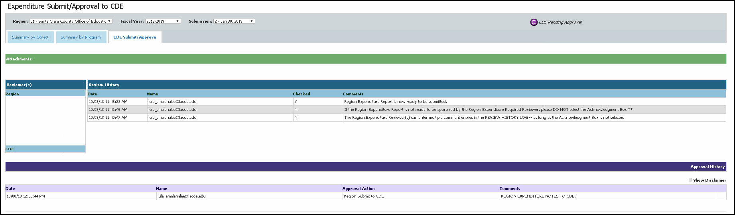
Submission Complete
Notes:
Facilitator: Alex
Say: This slide illustrates how the screen is displayed once the expenditure report is submitted to CDE, the screen reflected here shows the heading at the top right corner of the screen stating – CDE Pending. This means that the expenditure report is awaiting CDE review and approval.
Please note: The CDE has 14 business days to either reject, approve, or request further backup documentation to review the corresponding expenditure report.

Slide 51
Reminder
A district or region may not go back into prior submission months to report prior period (month or quarter) expenditures.
If a district or region needs to do this, it must request CDE approval. Remember, expenditures should be contemporaneous (when they happened).
Notes:
Facilitator: Alex
To-do: Read slide

Slide 52
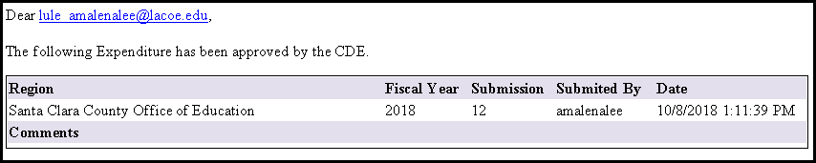
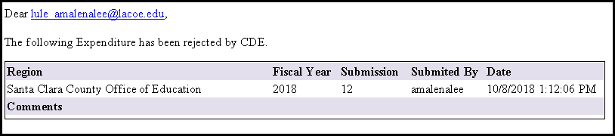
Approval/Rejection Email
Approval Email - Sample
Rejection Email - Sample
Notes:
Facilitator: Alex
Say: This screen is an example of the two emails (Approval email or Rejection email) that a region will receive once the CDE finishes its review and approval process for the quarterly expenditure report.
The “approval email” is an example of when CDE approves a region or DFD;s quarterly expenditure report.
The “rejection email” is an example of when CDE rejects a region or DFD’s quarterly expenditure report.
The system email includes:
Region Name
Fiscal Year
Submission #
Submitted By – This will be the name of the Region User that submitted the region’s quarterly expenditure report.
Date – The time and date that CDE approved or rejected the region’s quarterly expenditure report.
Comments - If there are any comments along with the Approval/Rejection, it will be in this section.

Slide 53
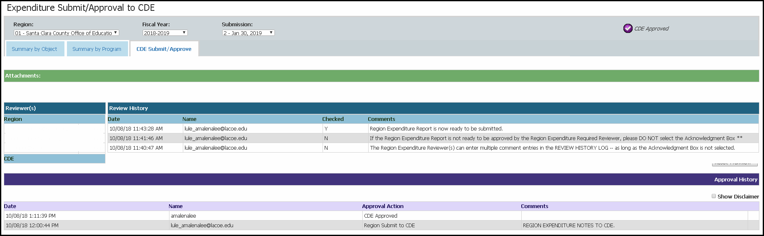
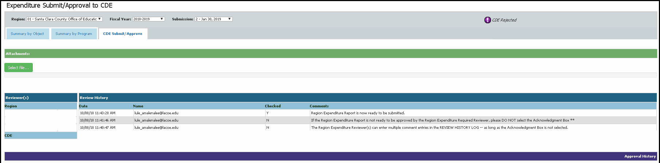
Approval/Rejection System Notice
Notes:
Facilitator: Alex
Say: Continued from the previous slide, the screen shots further illustrate the screen view once the CDE approves or rejects a region’s quarterly expenditure report.

Slide 54
Technical Assistance & Communication Plan
Sample program questions:
Can I put my expenditure in Object code 1200?
My districts submitted their BRs early, can I submit to CDE now?
Sample technical questions:
I need help with my password.
Can you help me?
The tab for the ME-1 is not visible, how do I resolve this?
Notes:
Facilitator: Alex
Say:
Technical Assistance and Communication Plan.
If a staff member at the district level has a question, this person will submit the inquiry to the District Lead. If the District Lead needs support to respond to the inquiry, the District Lead will contact the Regional Lead. The Regional Lead will share the inquiry among the regional Online System team members who have been trained by the state office to generate a response to the District Lead.
If the inquiry cannot be resolved at the Regional Level, it will be the Regional Lead who will contact the Level III Online Application System Help Desk for support. The Help Desk will be able to respond to basic inquiries. For complex inquiries, the Help Desk will forward them to either the system consultants at LACOE or program consultants at the state MEO. The consultants will directly contact the Regional Lead to provide technical assistance.

Slide 55
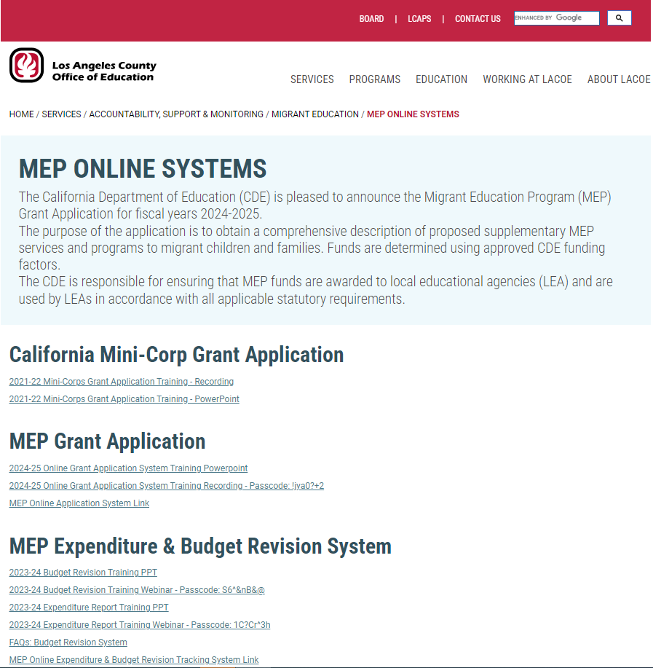
Presentation Materials
https://www.lacoe.edu/Technology/MEP-Online-Systems
Notes:
Facilitator: Alex
Say: This presentation as well as the recording will be posted at the LACOE’s website and will be posted within the next week. The link to the website is provided on this slide.
https://www.lacoe.edu/Technology/MEP-Online-Systems

Slide 56
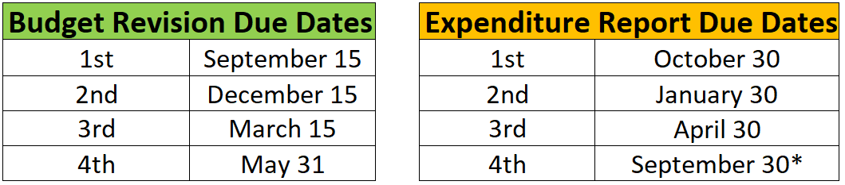
BR & Expenditure Report Due Dates
Notes:
Facilitator: Alex
Say: These are the dates of when the BRs and Expenditure Reports are due. As you can see, our first 2024–25 BR is due to CDE by September 15th and the final expenditure report for fiscal year 2023–24 is due September 30th.

Slide 57
Questions? (3)
Notes:
Facilitator: Alex
To-do: Read slide, wait for questions.

Slide 58

Annual Fiscal Trainings
August 1: Budget Revision Webinar
August 1: Expenditure Report
September 4: Brustein & Manasevit Webinar
February 2025: Grant Application Training
Notes:
Facilitator: Alex
To-do: Read slide

Slide 59
Contact Information
Alex Leguizamo
Education Programs Consultant
California Department of Education
aleguizamo@cde.ca.gov
916-327-4408
_____________________________
LACOE Help Desk
HelpDesk@lacoe.edu
562-922-6646
Notes:
Facilitator: Alex
Say: If you need to get in touch with the LACOE helpdesk or myself, you can contact us via email or phone. Be sure to keep in mind the communication plan outlined earlier when reaching out for assistance.

Slide 60
Thank you for attending!
If you have any additional questions, please contact Alex Leguizamo.
ALeguizamo@cde.ca.gov | 916-327-4408
Notes:
Facilitator: Alex
Say: Our webinar has come to an end. Thank you very much for attending. Have a great day!

