Slide 1
2024–25 Migrant Education Program
Budget Revision System
Training
Welcome! Please complete the Google Form to confirm your attendance (link provided in the chat).
August 1, 2024
Notes:
Facilitator: Emily
Say the following:
Good morning and welcome to the 2024–25 Migrant Education Program, Budget Revision Webinar. This training is a two-part training. Once the first part of the training on Budget Revisions is complete, there will be a second part that will cover Expenditure Reports.
Please register your attendance using the link the chat.

Slide 2
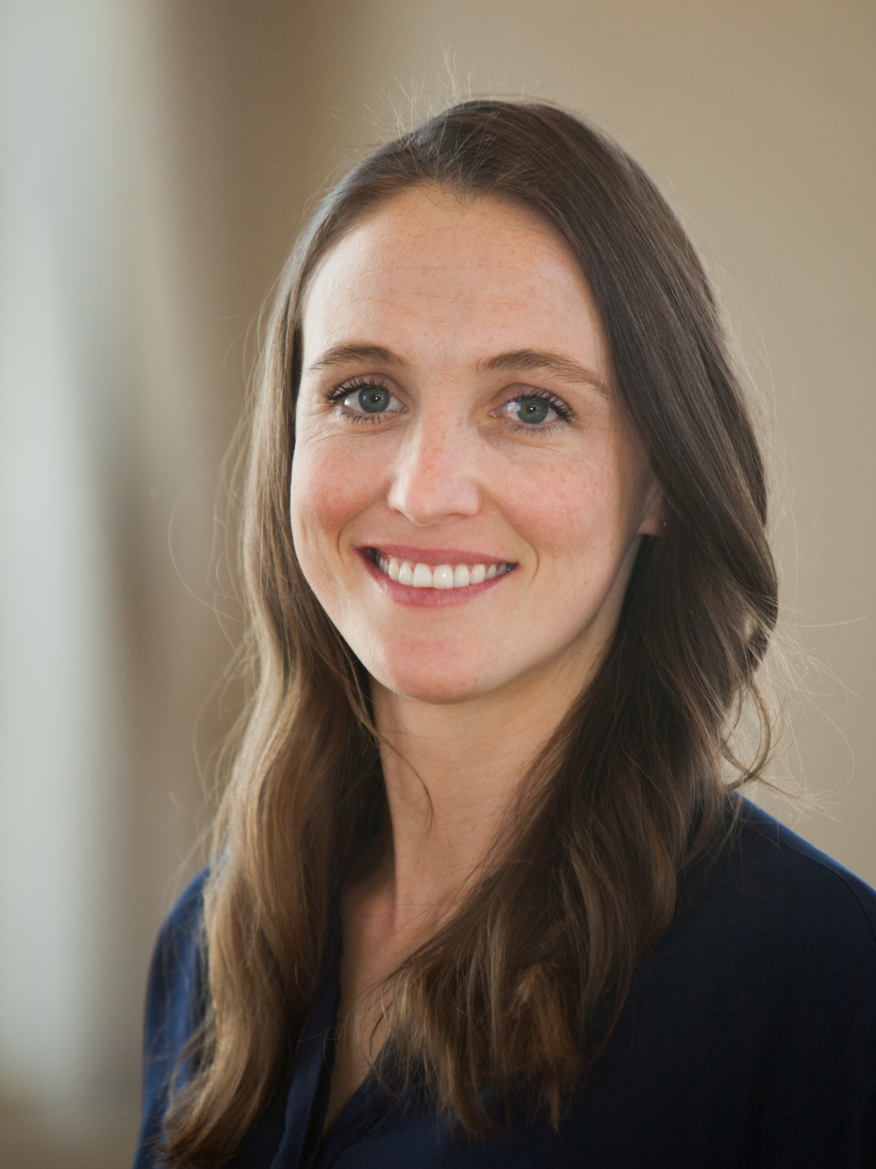
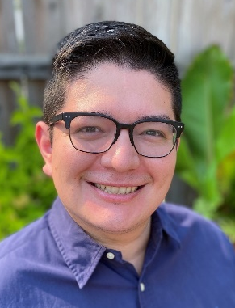
Presenters
Emily Smith
Education Programs Consultant
Alex Leguizamo
Education Programs Consultant
Notes:
Say: Once again, welcome! My name is Emily Smith, I am an Education Programs Consultant at the Migrant Education Office. I will be your main presenter today along with my colleague Alex Leguizamo who will be assisting with a portion of this presentation, and presenting on the MEPEX or expenditure system during part 2 of the training. We also have Mollie from our LACOE technology team assisting with the Q&A and providing support behind the scenes.
If you have not done so already, please make sure that you have completed the Google attendance form (link in chat) to confirm your attendance.

Slide 3
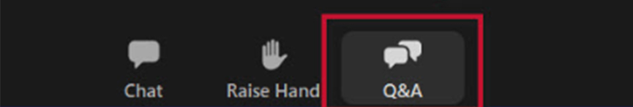
Housekeeping
Please use the Q&A Zoom feature for questions. You can upvote questions in the Q&A; we will address questions with the most votes first.
The slides and recording will be posted to the Los Angeles County Office of Education MEP Online Systems website.
3
Notes:
Read slide
If your question is not answered during the meeting today, the MEO will email you directly

Slide 4
Learning Objectives
Participants will be able to:
Login to the eMEP system and create a new budget revision.
Accurately revise the budget and other tabs to reflect changes to services/activities.
Review a budget revision and identify common budget mistakes [for reviewers].
Describe the process for approving budget revisions in eMEP and MEPEX [for approvers].
4
Notes:
Say: These are our learning objectives for today’s training. [Read learning objectives] Please identify the objective that applies to you think you know the least about, or that you are most looking forward to learning about today, and write the number in the chat (#1-4). [Read aloud some common numbers being placed in the chat].

Slide 5
Budget Revision Agenda
  System Access
  Creating a Budget Revision
      Section 2 Update
  Reviewing a Budget Revision
  Approving a Budget Revision in eMEP and MEPEX
5
Notes:
Facilitator: Emily
Say the following: As you can see, our agenda for today will offer step-by-step guidance for each of our learning objectives. [Read Agenda]
Please note that there has been one new update made to the eMEP system in Section 2 and we will go over this in detail during the “Create a Budget Revision” part of the training.

Slide 6
Regional and Direct-Funded District (DFD) Staff.
Directors, Fiscal Staff, or any staff who work with budgets.
Regions are responsible for training their reimbursable districts.
Target
Audience
Notes:
Facilitator: Emily
Say: I’d also like to remind you that the audience for this training includes staff at the Region and DFD levels. This could include directors, fiscal staff, program coordinators, or anyone else who is involved with budgets. Region staff, please remember that it is your responsibility to train your DSA/MOU staff on these topics, and to onboard any new DSA/MOU staff. The materials, including a recording of this presentation, will be posted on the LACOE website for your use.

Slide 7
Budget Process Overview
The eMEP system is comprised of the Grant Applications and Budget Revisions (BR).
Once the BR is approved in the eMEP system, the numbers are populated in the MEPEX system.
The original budget created during the grant application process is used to populate the first BR created by the subgrantee.
Notes:
Facilitator: Emily
Say the following: Let’s now take at the budget process overview.
eMEP is the system that we use for Grant Applications and Budget Revisions.
The original budget created during the grant application process is used to populate the first BR (or Budget Revision) in eMEP. The subgrantee will make edits to the original amounts from their application during their first BR creation.
Once the BR is approved in the eMEP system, the amounts are populated into the MEPEX expenditure system.

Slide 8

System Access
Notes:
Facilitator: Emily
Say the following:
Let’s start by talking about how to access the eMEP system.

Slide 9
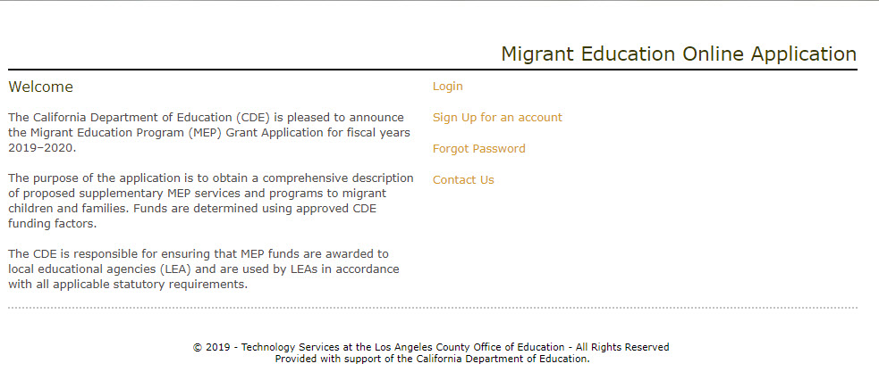
Create an Account
2024–25.
http://cdemep.lacoe.edu/mep
Notes:
Facilitator: Emily
Say the following:
To access the online Budget Revision System known as eMEP, you will use the same website as what you used to complete the MEP Grant Application.
The link to access the system is provided to you on this slide.
If you do not have an eMEP account, please ensure you sign up for an account by selecting the “sign up for an account” link as shown by the arrow. You will be promoted to enter your information, and once you have entered all of the necessary information, you will receive an automated email with a link to set your password.

Slide 10
Logging In
2024–25.
http://cdemep.lacoe.edu/mep
Notes:
Audience: Everyone
Say: Once your account has been created, you will visit the same website, then
Select the “Login” link
Enter your email and password.
Then select sign in
We recommend you bookmark this login page for easy finding.

Slide 11
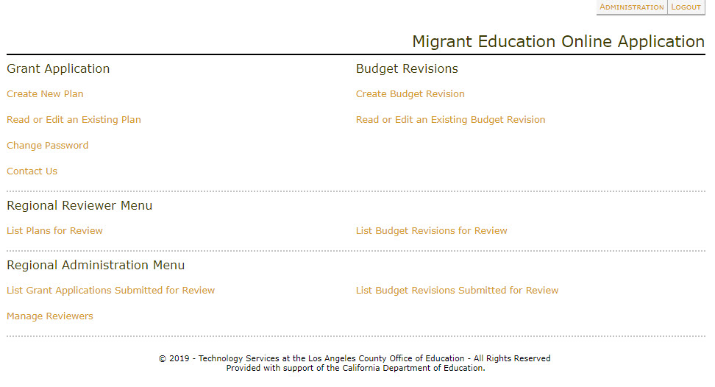
Budget Revision Menus
Reimbursable districts will only be able to see the “Create BR” or “Read or Edit a BR” links.
Region users should be able to see the “Review” links.
Notes:
Once you are logged in, you will be directed to the main menu, which looks like this. The view of the menu will vary depending on what level user you are in the system.
DSA/MOU users will only be able to see the Create Budget Revision and Read or Edit an Existing Budget Revision options in the top menu. [Click for animation]
If you are a Region or DFD, you will be able to see those options, as well as the links that apply to the review process down below.
[Click for animation] Please note that for Region/DFD users there are 2 different menus: the Regional Review Menu and the Regional Administration Menu.
Region users will utilize the links in the Administration Menu to assign BRs to staff. Not all Region users will have access to the Administration Menu.
Region users will use the links in the Reviewer Menu to score and leave comments on BRs that have been submitted to them.
If you have questions about your access, please contact your Regional Director, Emily or LACOE Technology Services (TS).

Slide 12

Creating a Budget Revision
Notes:
Facilitator: Emily
Say the following:
Now that you know how to log into the eMEP system, let’s go over how to create a budget revision. Please note, some of the examples/screenshots provided in this training pertain to previous fiscal years, please ensure you select the appropriate fiscal year when creating your budget revisions.

Slide 13
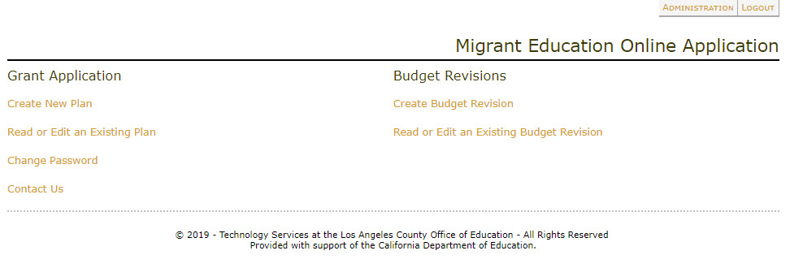
Creating a New Budget Revision
Notes:
Facilitator: Emily
Say the following:
To create a Budget Revision, all users—including DFD, Regional and DSA/MOU users--will start by selecting the Create Budget Revision link. This will take the user to the Create Budget Revision screen.

Slide 14
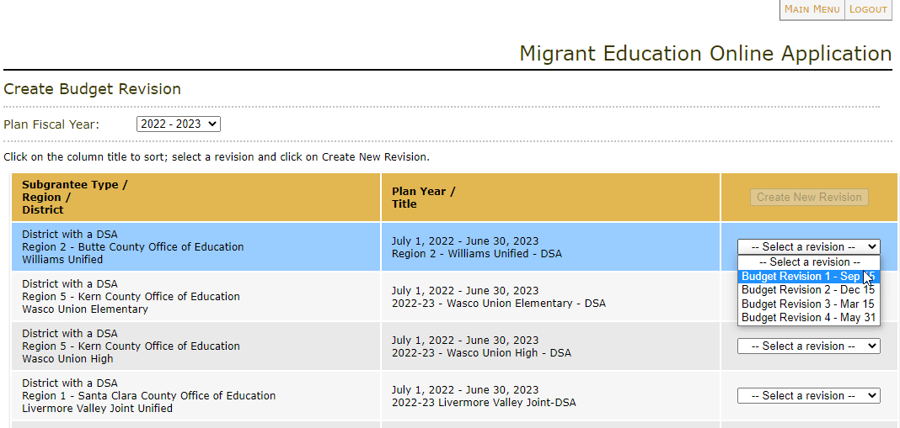
Creating a New Budget Revision (2)
2024-2025
Notes:
Facilitator: Emily
Say the following:
Only Grant Applications assigned to the user for the current fiscal year will be listed in the Create Budget Revision Screen. The user should select the Grant Application that they wish to make the revision for.
Important: The default setting of the “Plan Fiscal Year” drop down list may change so always make sure you double check the fiscal year to ensure that you are creating a BR for the correct fiscal year!

Slide 15
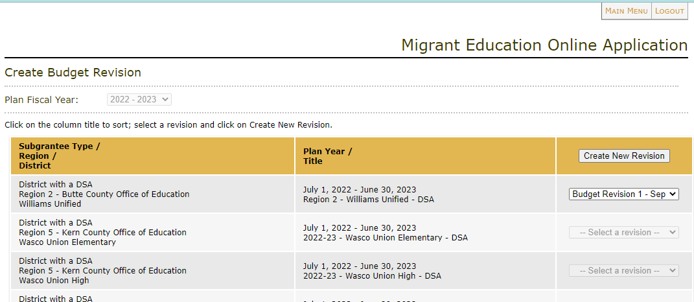


Creating a New Budget Revision (3)
Notes:
Facilitator: Emily
Say the following:
To start the creation of a Budget Revision, the user will do the following:
Find the application they wish to create a revision for. Select the appropriate Budget Revision Number and Date, either BR 1, 2, 3 or 4. You can see in this example they have selected Budget Revision 1-Sep 15.
Click the Create New Revision button. Once you select the Create New Revision button, you will be automatically directed to the Plan Index Page.

Slide 16
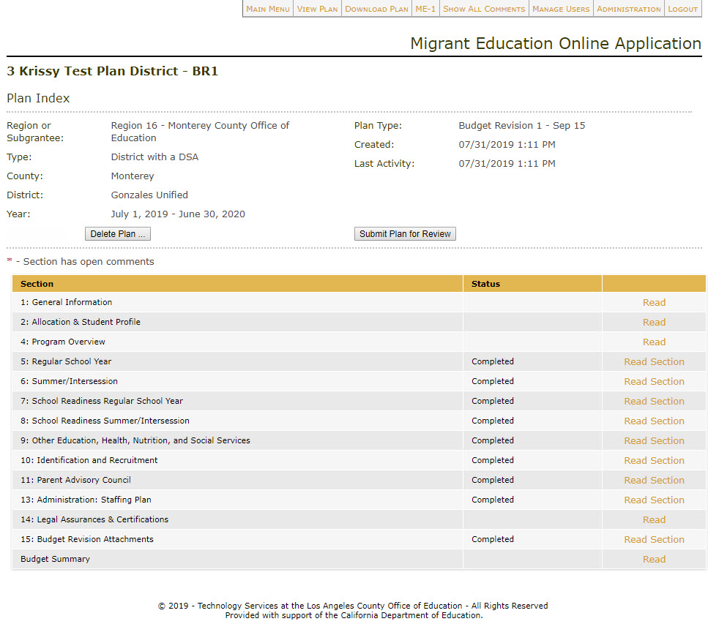

Plan Index Page
Notes:
Facilitator: Emily
Say the following:
Once you’ve created your new BR you’ll be directed to that BR’s Plan Index page, which looks remarkably similar to your application! Let’s take a few moments to discuss the important components for BRs.
Arrow #1 is the Delete Plan button. Only select this button if you wish to delete your newly created BR.
The red rectangle in the middle shows all the sections that are editable during a Budget Revision. These sections will say Completed/Read Section as their status. The sections that are labeled “Read” cannot be altered during a BR. As you can see, for this specific subgrantee they cannot edit sections 1, 2, 4, 14 and the Budget Summary. For Regions, Section 3 will also be “Read” only.
Arrow #2 is Section 15- Budget Revision Attachments. Here subgrantees will upload supporting documentation which we will cover later on in the training.
And lastly, arrow #3 is the Manage Users tab. All users assigned to the current year Grant Application will automatically be assigned and have access to the Budget Revision.

Slide 17
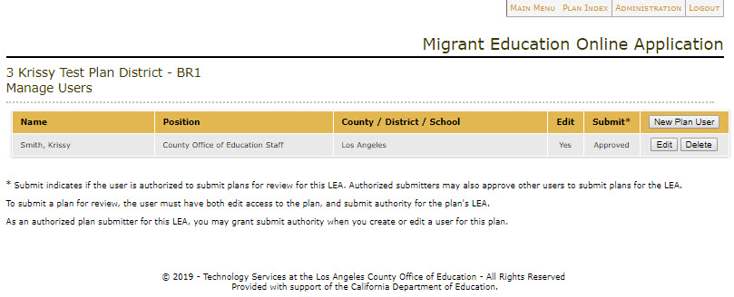
Manage Users
Please see more information on adding a new user to a plan in the
24–25 MEP Application Training available on the LACOE website.
Notes:
Facilitator: Emily
Say the following:
If users need to be added or removed to a BR, this can be done in the Manage Users Tab by the plan’s approved submitter. Please see the 24-25 Grant Application Training for more detailed instructions on how to add or remove users. The slides and recording of the Application training are available on the LACOE MEP Online Systems webpage.

Slide 18
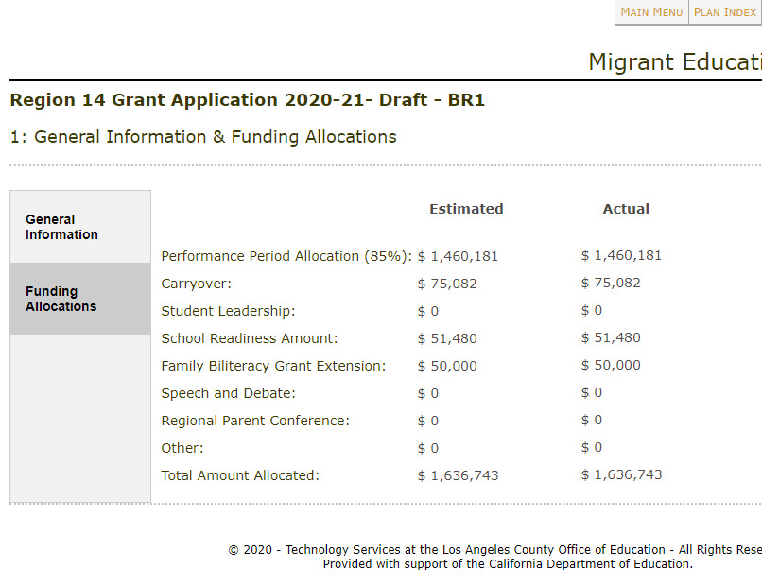
Section 1: Funding Allocations
In 2024–25,
the “Actual” allocation column will be updated before BR1 and again before BR2. Your total budget should always match the total amount in Section 1.
Notes:
Facilitator: Emily
Say the following:
Now let’s take a deeper look at some of the sections within the Budget Revision. We’ll start with Section 1, Funding Allocations. The “Estimated” column will display your original, estimated allocation that was used to create your application.
This year, during BR1, we will populate the “Actual Allocation” column for Region’s and DFD’s with the preliminary allocation. Then, during BR2, the “Actual allocation” column will be updated again to reflect an increased allocation and you can adjust your budget accordingly at that time. The important thing to remember when creating your BR is that your total budget should match the Actual Allocation listed in Section 1.
Please see the email that was sent out by Juli to MEP Directors last week for more information, and don’t hesitate to reach out to myself or Alex with any questions.

Slide 19
Editing a Budget Revision
Notes:
Facilitator: Emily
Say the following:
It is important to remember that this system was created to make modifications to your budgets. If you don’t have any changes to your budgets, you will not be able to submit a budget revision. Budget revisions should only be created if you plan to make a change to your budget.
To start making edits to your service or activities, the first step is to click the Read Section next to the section you wish you edit. Let’s take a closer look at some services/activities in Section 5.

Slide 20
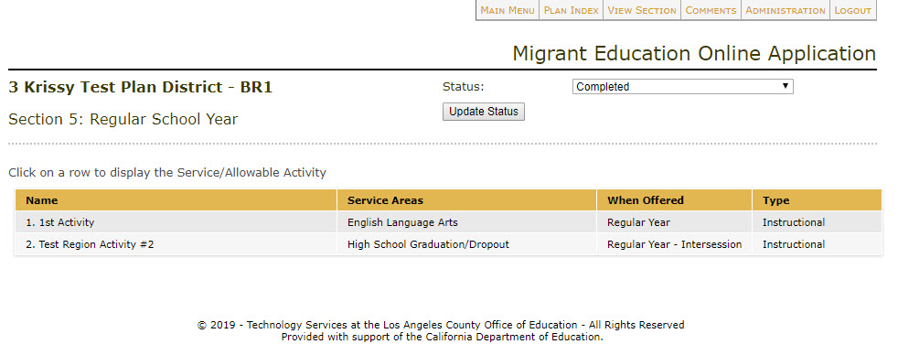
Service/Activity List
Change the status of the section you would like to revise from “Completed” to “Draft.”
Notes:
Facilitator: Emily
Say the following:
Once Section 5 has been selected, the user will be directed to the Service/Activity list.
To start editing the section, the user will need to:
Change the status from “Completed” to “Draft” in the dropdown menu.
And then select the “Update Status” button.
Please note that before you will be able to submit your budget revision once all edits have been, all sections will need to have been put back in “Completed” status.

Slide 21
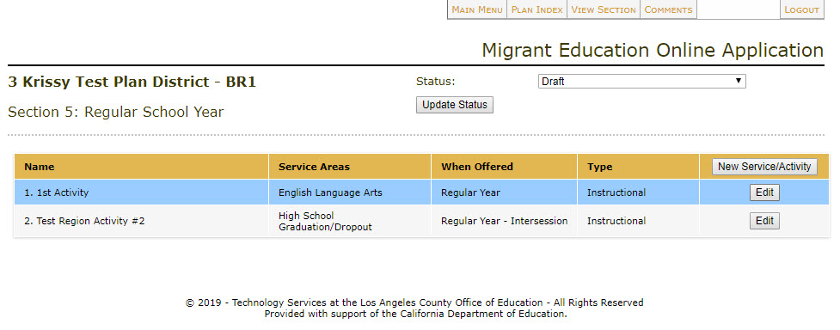
Edit or Create a Service/Activity
You can edit an existing service/activity or create a new service/activity.
Notes:
Facilitator: Emily
Say the following:
Now that the status has changed to Draft, select the Edit button for the service or activity you wish to modify. Doing this will take the user inside the individual Service or Activity.
If you want to create a new Service or Activity, you will select the “New Service/Activity button” instead of the “Edit” button. You must then complete all the tabs including the budget tab to create a new service or activity.
However, for this example we will be selecting an existing service.

Slide 22
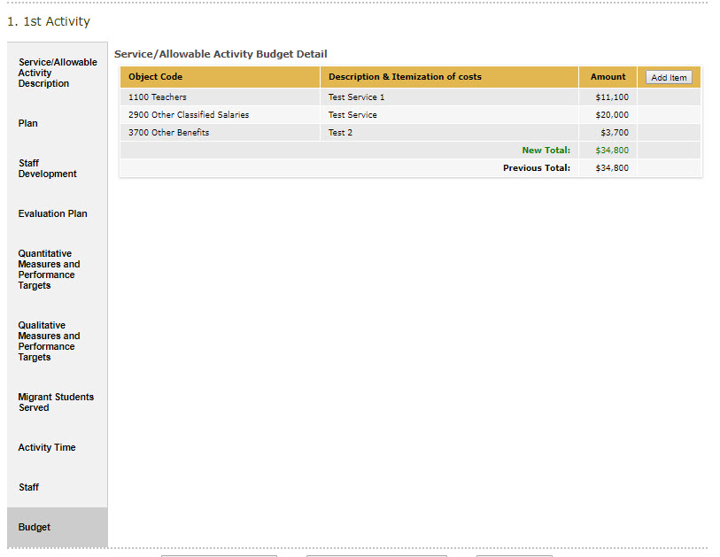
Revising a Service/Activity
All tabs can be edited during a budget revision.
Make sure each tab aligns with the budget.
Notes:
Facilitator: Emily
Say the following:
When revising the budget within a service or activity, the Budget Tab will originally display all existing budget entries. After changes are made to the budget table, the:
New Total: will show the total after BR entries have been made, and it will be displayed in green text, and the
Previous Total: will show the total of the most recent approved budget, and it will be displayed in black text. In this service no revisions have been made yet, so the previous total and new total are the same.
It is important to remember that if you make changes to your budget, you will most likely need to make changes to other relevant tabs as well. All tabs are open and editable during a Budget Revision.
An example would be if you’re changing the budget because you are hiring additional teachers. The change in budget for teacher increase would require the user to also update the staff tab, and potentially the migrant student served tab, plan tab, or other tabs as well, which you can see along the left side of the screen. As we discussed during the application training, please make sure that all tabs for one service are aligned and that the changes to the budget are reflected throughout the service.

Slide 23
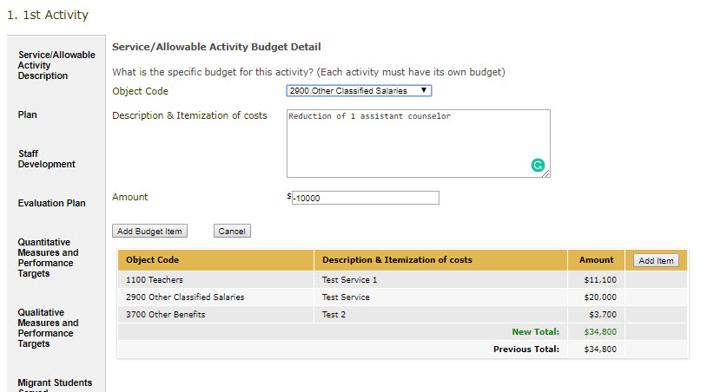
Revising the Budget
Notes:
Facilitator: Emily
Say the following:
To add a Budget Revision entry into the Service or Activity Budget Detail, the user will:
Click the Add Item button.
Enter the Object Code, Description & Itemization of Costs, and the Amount to be adjusted (+/-).
Then click the Add Budget Item.
To reduce the budget of a certain object code, you will need to add a new budget item for a negative amount that equals the amount of the reduction.
Clicking the “Add Budget Item” acts as a save button and will flag the service/activity as needing to be reviewed.

Slide 24
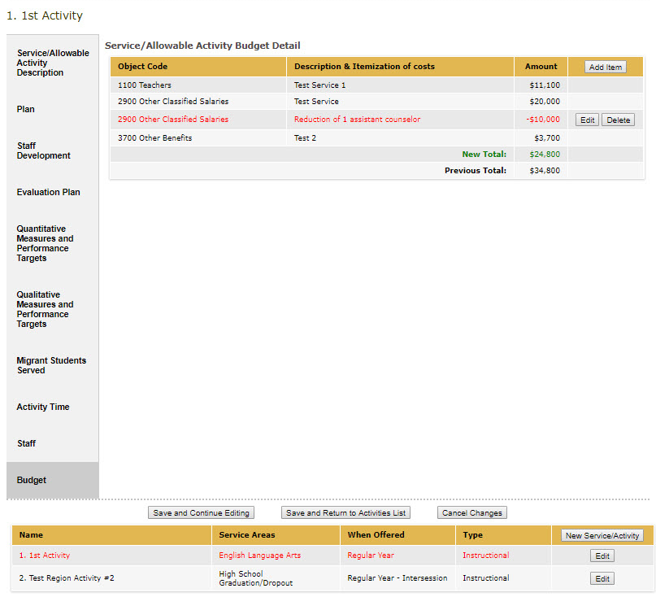
Reducing an Object Code Budget
Notes:
Facilitator: Emily
Say the following:
The new budget entry will now appear in red underneath its appropriate object code. As you can see, the negative $10,000 Budget Item has reduced the 2900 object code by $10,000. The New Total has been updated to reflect the reduction and is shown in green text.
The Service or Activity is now flagged red in the Service/Activity table, indicating that there has been a budget revision for this specific service.
Please note: In order to keep an audit record, services originally created will not be able to be deleted. If you are planning to cancel a service, please make a note in the service or activity description tab, and zero out all the budget items in the budget section. More information on how to cancel a service will be provided shortly.

Slide 25
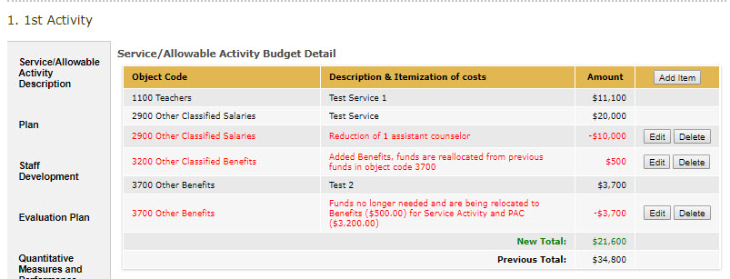



Budget Revision Entry Example
Important: only decrease object codes that are present in the budget table, and do not over-reduce an object code by more than was previously budgeted!
Notes:
Facilitator: Emily
Say the following:
Now let’s look at a Budget Revision Entry Example:
In this example:
Object Code 2900 has been reduced by $10,000 (select enter to activate PPT animation)
Object Code 3700 has been reduced by $3,700. (select enter to activate PPT animation)
Object Code 3200 has been increased by $500. (select enter to activate PPT animation)
The net adjusted change for this service/activity was -$13,200.
Subsequently, the total amounts at the bottom of the Budget Table should reflect these adjustments:
The new total for this service is now $21,600 (as displayed in green text).
And you can see the previous total for this service was $34,800 (as displayed in black text).
Important! Only decrease object codes with budget line items. In this example, the subgrantee only had budgets in object codes 1100, 2900, and 3700, therefore, we should not see a decrease in other object codes such as 4300, 5800, etc.
You also should not decrease the object code by more than what it was previously budgeted. For example, on this slide, object code 1100 only has a budget of $11,100, therefore we should not see a reduction of $20,000 in object code 1100. This can cause an issue when entering your expenditure reports.

Slide 26
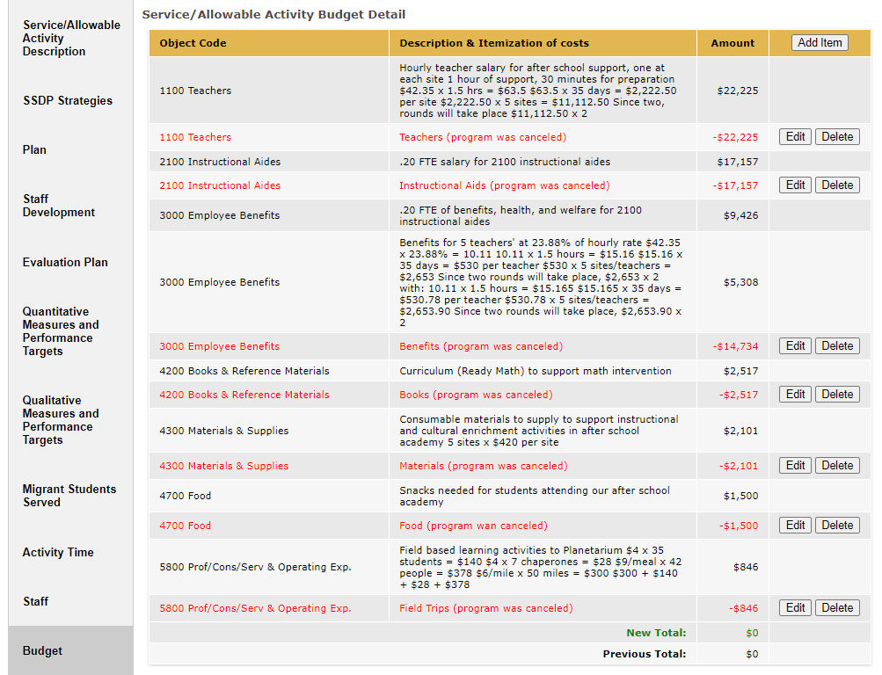
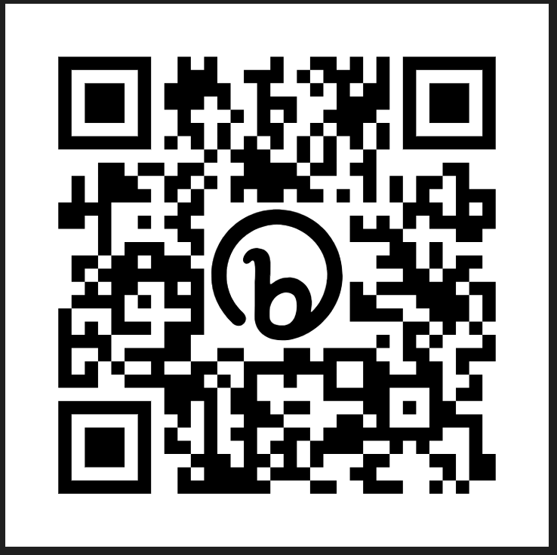
Cancelling a Service/Activity
Notes:
Facilitator: Emily
Say the following:
Here is an example of what a budget section looks like for a canceled service or activity. You will see that every line item that was originally added during the application approval was added again during BR1 as a negative amount to cancel out the budget. So, the new total is now zero.
Make sure you reduce the exact amounts for each object code. For example, in this scenario we had a budget of $1,500 in object code 4700. You must ensure you reduce this exact object code by the same amount to ensure your budget stays in alignment. If instead you reduce the $1,500 from object code 5800, you will end up creating a negative balance for object code 5800, and this can create an issue when it comes to submitting your expenditure reports.
To see a step-by-step instruction video on how to cancel a service/activity, please watch the YouTube video (QR code is providing on this slide).

Slide 27
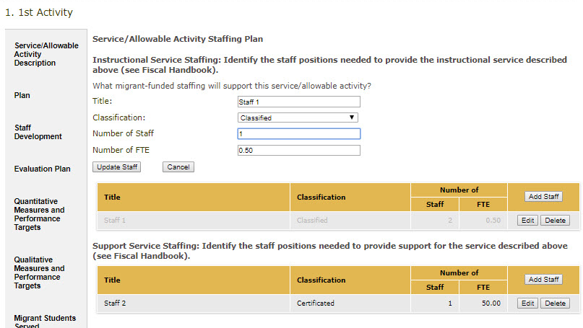
Revising the Staff Tab
Notes:
Facilitator: Emily
Say the following:
As mentioned before, any object codes that have been adjusted in the Budget Tab most likely also require adjustments in the other tabs. In this example, we described a reduction of an assistant counselor which required the classified staff to be reduced by 1. Therefore, we must now update the Staff Tab so that it is in alignment with the Budget Tab.
To complete this task, the user will click the Edit Button for the appropriate Staff item and make the changes to the staff table.
Once finished, click the Update Staff button. The ‘Update Staff’ button acts as a Save Button for the Staff tab and will flag the section in red and require the Service or Activity to be reviewed.

Slide 28
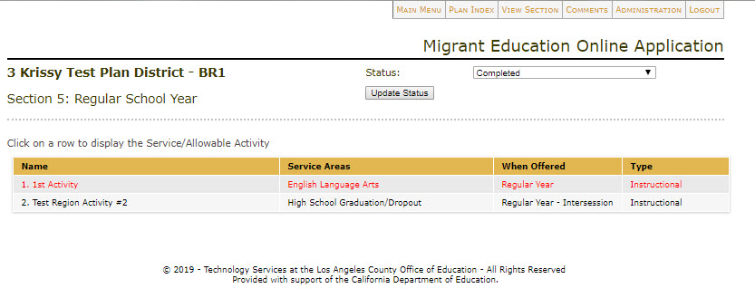
Complete the Service/Activity Revision
Change the status of a section from “Draft” to “Completed” after all edits have been made. All sections must be marked as “Completed” before submission.
Notes:
Facilitator: Emily
Say the following:
The user will continue the process we’ve just covered for ALL services or activities that require a budget revision. Please remember that the PAC and I&R budgets are located in section 13. If you need to make any staff changes to I&R and/or PAC, you will do so in Section 10 for I&R and Section 11 for PAC. Then, you will update the budget for I&R and/or PAC in section 13.
After all necessary changes have been made to services or activities in a section, the user must update the Status back to Completed in order to submit the Budget Revision for Review.

Slide 29
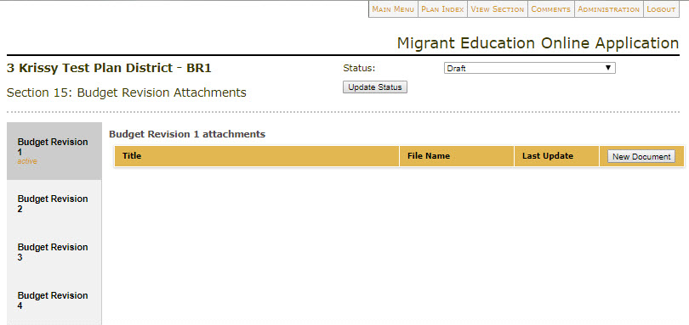
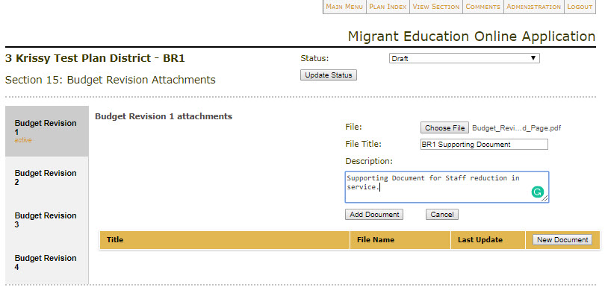
Budget Revision Attachments
Notes:
Facilitator: Emily
Say the following:
Now let’s talk about Section 15, - Budget Revision Attachments. This is where you will upload any supporting documentation for your budget revision, such as email pre-approvals. The status of Section 15 will need to be updated from Completed to Draft, which will allow you to upload documents. Once the section is set to Draft, the tab for the specific BR number will open and will be set to Active.
Within this tab, the user will select the New Document button, which will allow you to:
Attach any document in a PDF format.
Include a File Title.
And provide a description.
The user must then select the Add Document button to upload document(s).
Once all documentation has been uploaded, make sure you change the status of the section from “Draft” to “Completed.”
Other examples of supporting documentation are: contract agreements, pre-approval emails, and quotes.

Slide 30
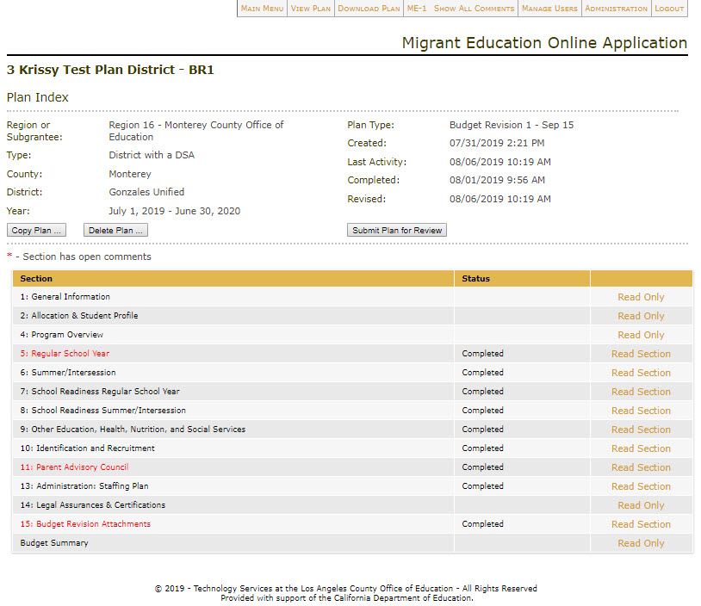
Budget Summary and ME-1
Notes:
Facilitator: Emily
Say the following:
You can now see that each section that contains a budget revision is flagged in red for easy identification. Once you have updated all sections with the necessary revisions, the final step is to check the Budget Summary and ME-1 prior to submitting to ensure all the numbers align.
To access the Budget Summary, the user will select the Read Only link for the Budget Summary section at the bottom of the list.
To access the ME-1, the user will click the ME-1 button located in the top menu.

Slide 31
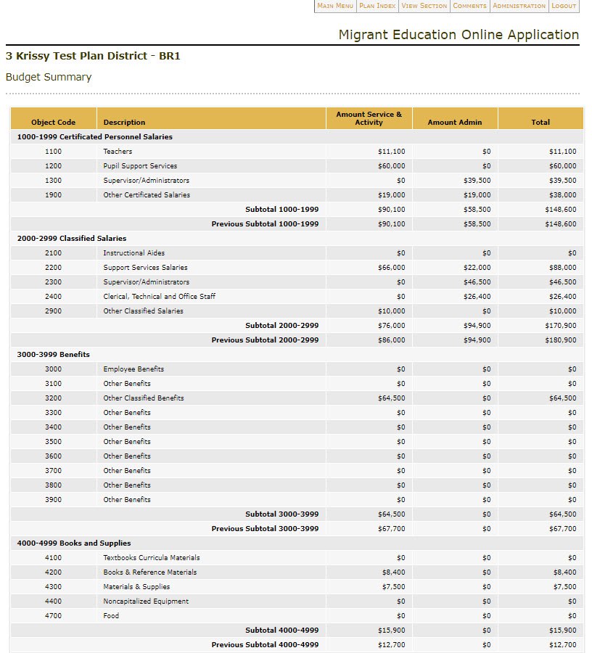
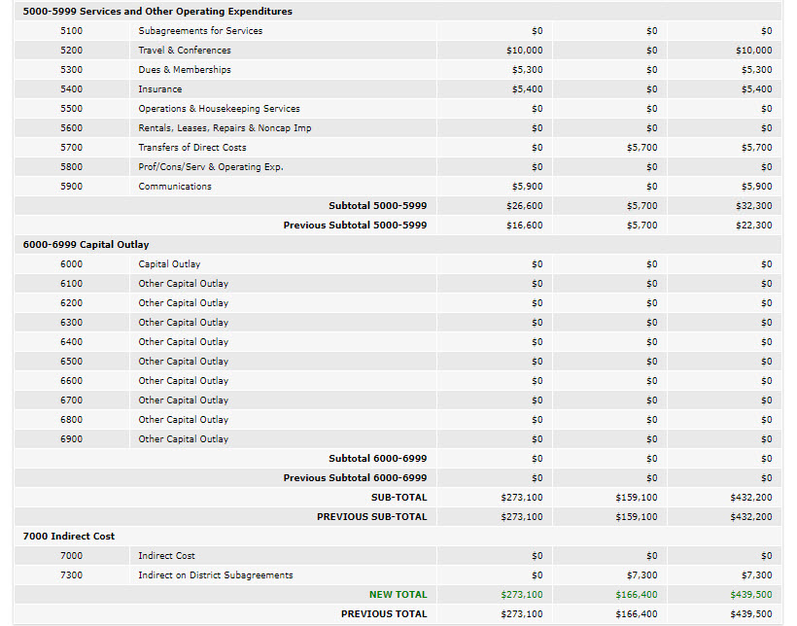
Budget Summary
2
Notes:
Facilitator: Emily
Say the following:
Let’s take a look at the budget summary first. The Budget Summary shows the total budget per object code for the current Budget Revision for Direct Services and Administration.
The user will be able to view the Previous Total and New Total at the bottom of the Budget Summary. The New Total is displayed in green text. The Previous Total is displayed in black text.
For Regions, the Budget Summary will only show the budgets for the RA plan, and does not include their DSA/MOU budgets. In order to view the Region’s budget plus the districts’ budgets, the Region user will need to open the ME-1.

Slide 32
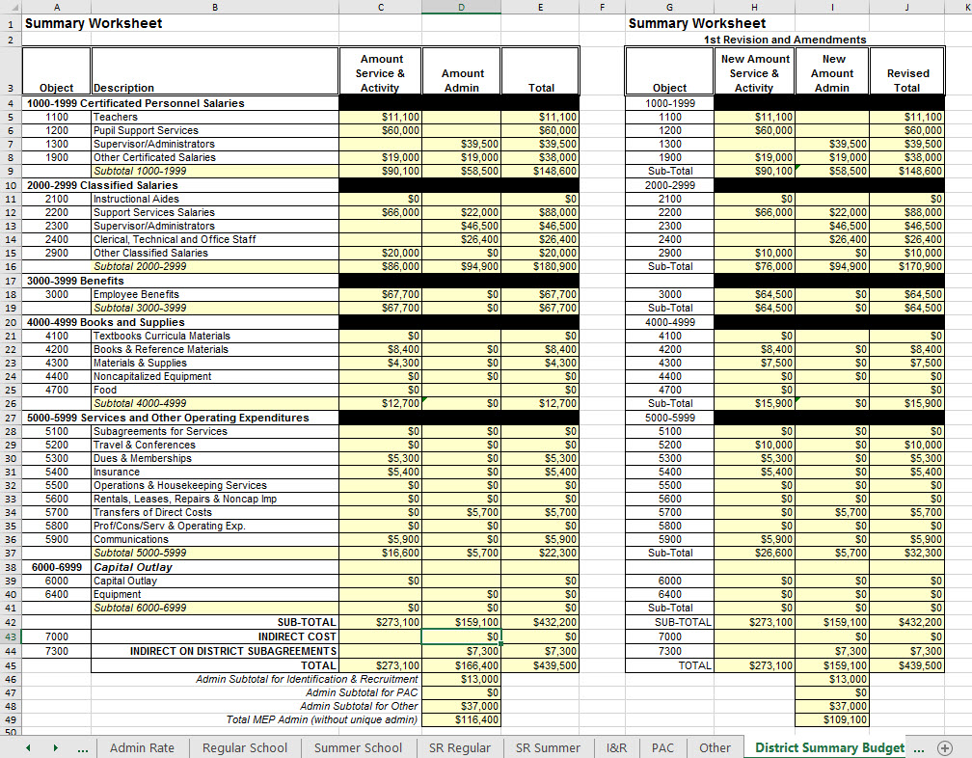
ME-1 Excel Download
Application Budget
1st Revision Budget
Notes:
Facilitator: Emily
Say the following:
Now let’s look at the ME-1 Excel Download.
By clicking the ME-1 button, the system will provide a budget workbook download that is similar to the ME-1 in the Grant Application. The difference is that the ME-1 downloaded from a Budget Revision will have the revisions that have been made automatically entered and calculated.
In each program component and budget summary tab of the workbook, users will be able to scroll to the right in order to see tables labeled as “1st Revision and Amendments,” “2nd Revision and Amendments,” etc.

Slide 33
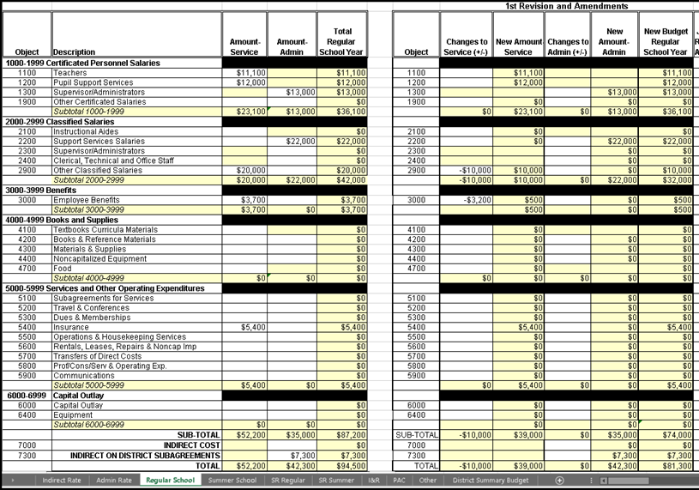
Checking the ME-1
Important: Always check the ME-1 before submission to ensure there are no negative values in the total columns.
-
-
-
-
Notes:
Facilitator: Emily
Say the following:
It is important that before submitting your Budget Revision, you thoroughly check the associated BR tables in the ME-1. In each tab, You want to ensure that each object code total under the “New Budget Column” does not include a negative number. In this example, you will see that for object code 5400, the subgrantee reduced this code in regular school year by $5,400. This created a negative balance because the subgrantee reduced this code without having a budget.
As a reminder, make sure that you only reduce object codes with existing budgets and do not over-reduce the existing budget for each object code. As mentioned before, creating negative balances could cause issues when you submit your expenditure reports and lead to fiscal non-compliance.
Make sure that you always complete this check in the ME-1 before submitting your Budget Revision. Regional reviewers should also make sure they check the total columns in the ME-1 for each of their DSAs/MOUs.

Slide 34
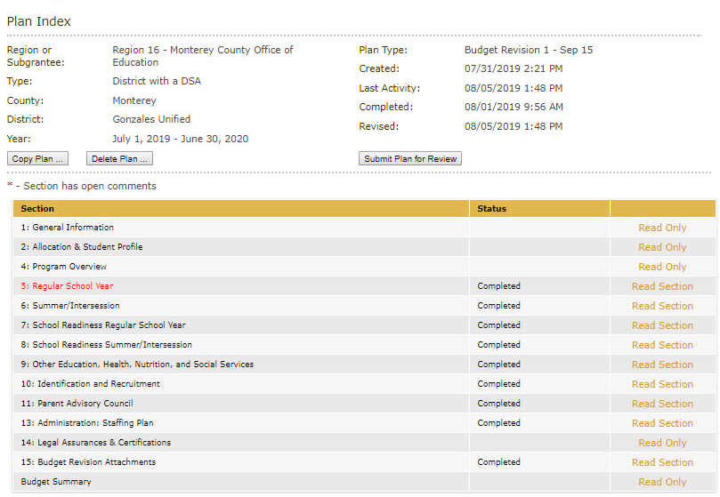
Submitting a Budget Revision
Notes:
Facilitator: Emily
Say the following:
Now that you have ensured that all your numbers are aligned in the budget summary and ME-1, it is time to submit your plan for review.
On the Plan Index page. The Submit Plan for Review button will only display if the user has saved a change in the Budget Revision and every section’s status has been set to Completed. If these actions have been done, the “Submit Plan for Review” button will appear in the Plan Index page, and the Authorized submitter will be able to submit the BR. If a section is still in “Draft” mode, they will not see the “Submit Plan for Review” button.
Only the authorized submitter will have access to select the Submit Plan for Review button.

Slide 35

Check for Understanding
Notes:
Poll #1:
True/False: You must pay attention to the fiscal year drop-down menu when creating a new budget revision to ensure you're creating a BR in the correct fiscal year. Answer: TRUE. Please ensure you are not creating a BR for the wrong fiscal year.
True/False: Before submitting your budget revision, you should carefully review each tab of the ME-1 to ensure there are no negative amounts in the total columns. Answer: TRUE. Reviewing the ME-1 for negative amounts before submission serves as a final check to make sure you have not over-reduced an object code, which could cause future problems with expenditure reports.
True/False: All sections must be set to “Completed” status before you will be able to submit your budget revision. Answer: TRUE. The submitter will not be able to submit the BR if any section is set to “draft” status.
True/False: If you have a $1,000 budget in Object Code 4300, it’s ok to reduce the OC 4300 budget by $1,500 during a BR as long as the total budgeted amount for that service isn’t negative. Answer: FALSE
Answer: FALSE. Remember, do not decrease object codes by more than they are budgeted!

Slide 36

Section 2 Update
Notes:
Facilitator: Emily
Say the following:
As I mentioned at the beginning of this training, there has been 1 update to the eMEP system. We will now review what the update entails.

Slide 37
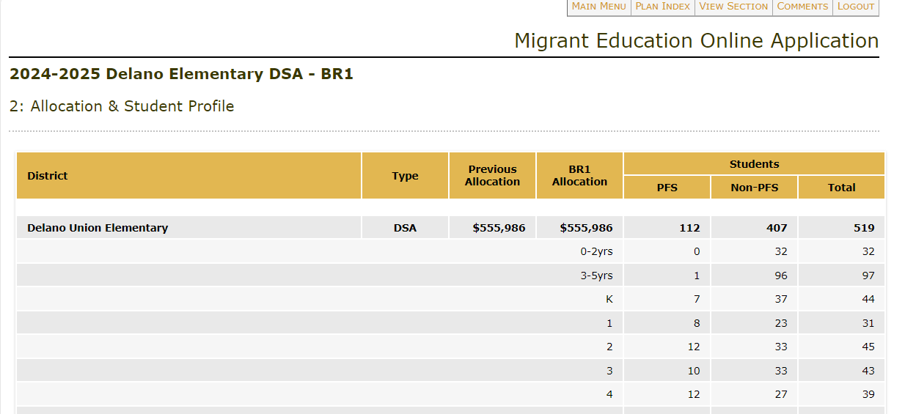
Section 2: System Update
DSA/MOU Section 2 before BR approval.
Notes:
Facilitator: Emily
Section 2 now has an update that will allow Regions to see the most recent updated allocations they have approved for their DSAs/MOUs. Let’s begin by looking at Section 2 for a DSA/MOU. Where there used to be only 1 column titled “Allocation,” there are now 2 columns titled “Previous Allocation” and “BR1 Allocation.” The BR# heading will update depending upon which BR is being submitted.
Here is what Section 2 will look like for a DSA/MOU before their BR has been approved. The “BR1 Allocation” still shows their previous allocation. This column will update after the BR has been approved by the Region and will automatically show any increases or decreases that have been made to their budgets during the BR.

Slide 38
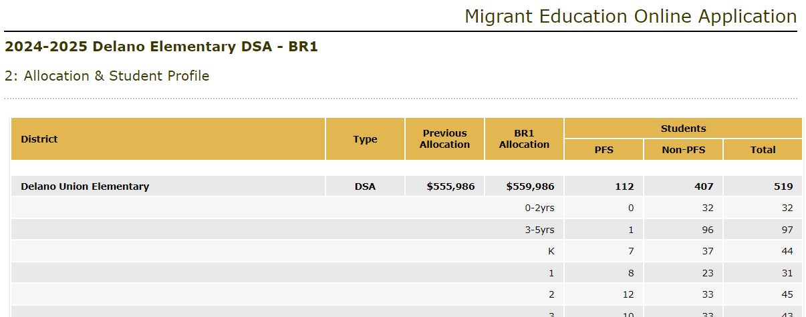
Section 2: System Update (2)
DSA/MOU Section 2 after BR approval.
Notes:
Facilitator: Emily
After the BR has been submitted by the DSA and approved by the region, then the “BR 1 Allocation” column will update. In this instance, the DSA added $4,000 to one of their budget tables which was approved by the region. The approved BR1 column now reflects the $4,000 increase.

Slide 39
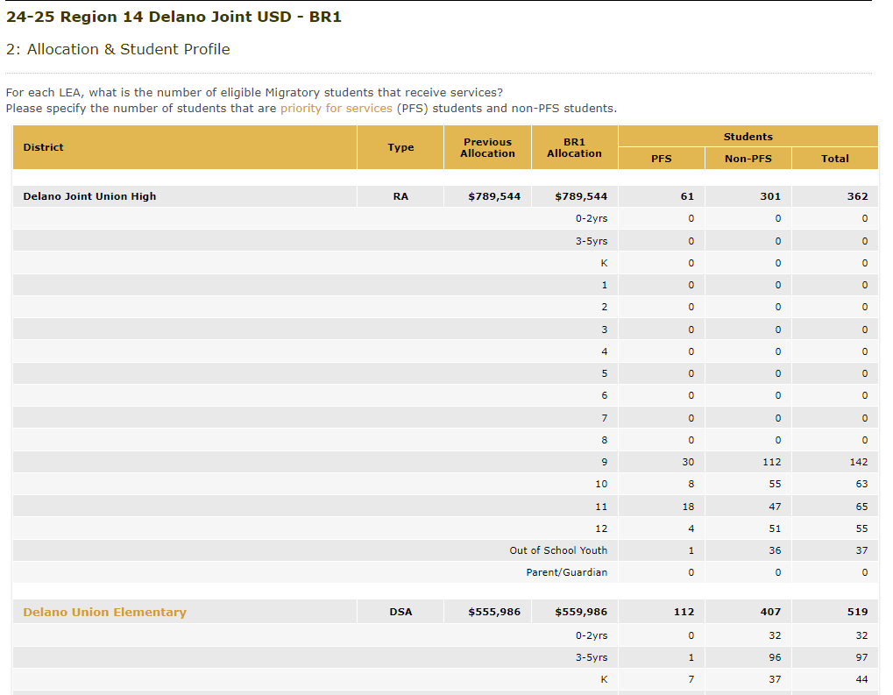
Section 2: System Update (3)
Region Section 2 after they have approved DSA/MOU BR.
Notes:
Facilitator: Emily
Now let’s take a look at Section 2 for a Region after they have approved a BR with an updated allocation for their DSA. As you can see, the BR1 column in the Region’s Section 2 now shows the DSA’s increased amount.
However, the Region allocation in the BR1 column is still the same. Just as for DSAs/MOUs, even if the Region changes their total budget during a BR the amount they see listed in the BR1 column will only reflect the updated amount once the CDE approves the Region BR.

Slide 40
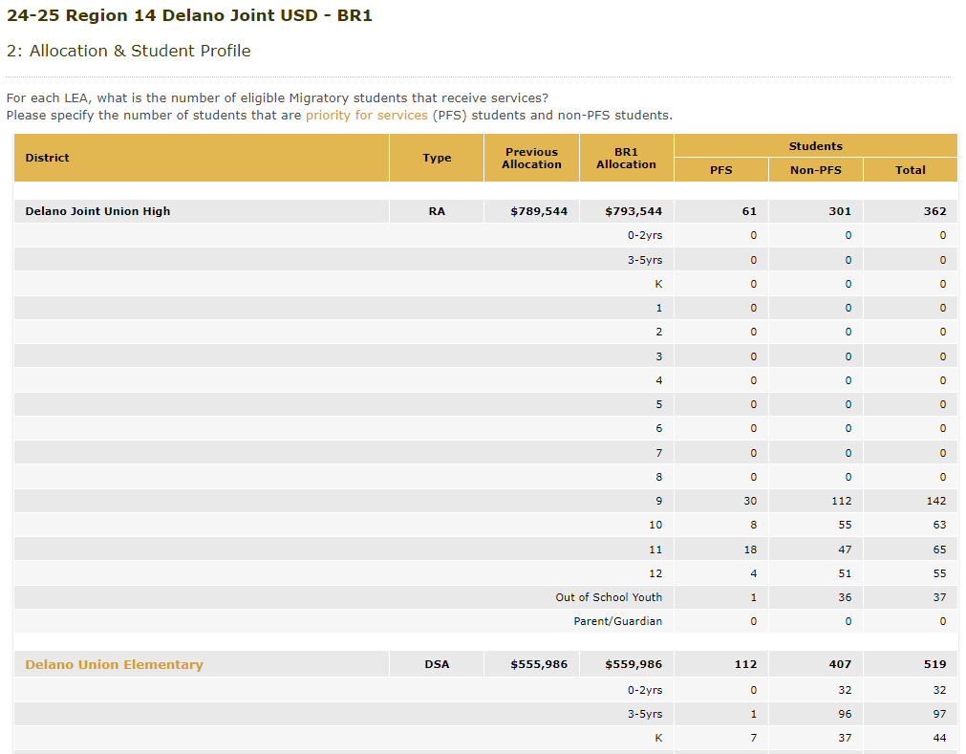
Section 2: System Update (5)
Region Section 2 after CDE approval.
The BR1 column for the DSA and the Region now show the updated allocation amounts.
Notes:
Facilitator: Emily
Here is what the Region’s “BR1 Allocation” column will look like after CDE approval. As you can see, the BR1 Allocation column shows an increase of $4,000.
Upon approval, the Region can go back into the BR and see the updated allocation amounts for all DSAs, MOUs and the Region in Section 2. This will function the same for DFDs who will be able to see any updates to their total budget/allocation in Section 2 after CDE approval.

Slide 41
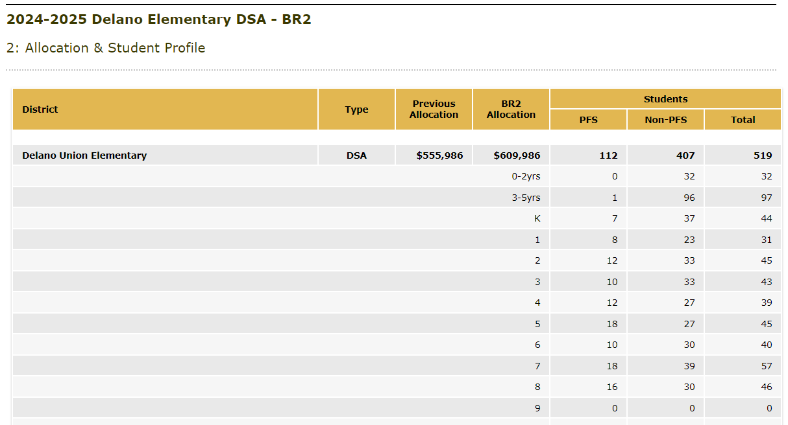
Section 2: System Update (6)
Example of DSA/MOU Section 2 after BR2 approval.
Notes:
Facilitator: Emily
As I mentioned, the heading of the new column will change for each BR. Here is an example of a DSA BR2 after Region approval. The new column is now titled “BR2 allocation” and will update once the BR2 has been approved by the Region.
If you have any questions about this update, please use the Q&A feature to get a response to your question or feel free to reach out after the training.

Slide 42

Reviewing a Budget Revision
Notes:
Facilitator: Emily
Say the following:
Now that we’ve covered how to create and edit a BR, let’s now talk about how to review a BR for those in attendance in charge of reviewing DSA/MOU BRs.

Slide 43
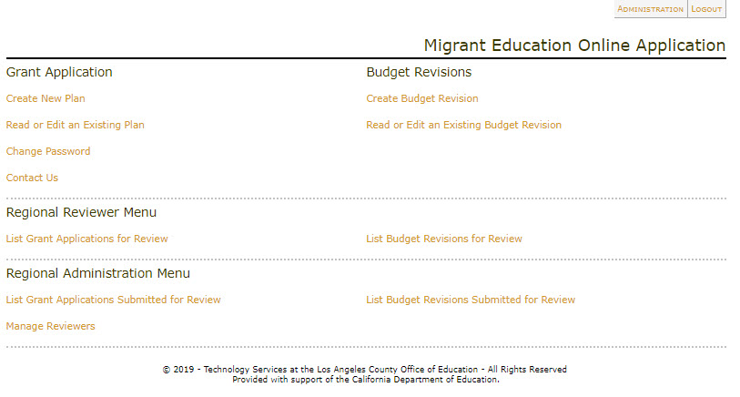
Regional Administration Menu
Notes:
Facilitator: Emily
Say the following:
When a BR is submitted, the Regional Administrator will receive an email. Their first step is to assign the submitted BR to any reviewers at their Region. To do this, they will click on the “List Budget Revisions Submitted for Review” link which is located in the Regional Administration Menu.

Slide 44
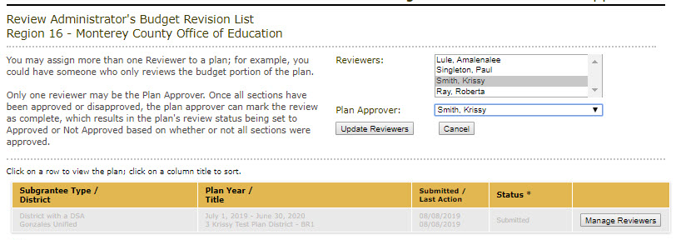
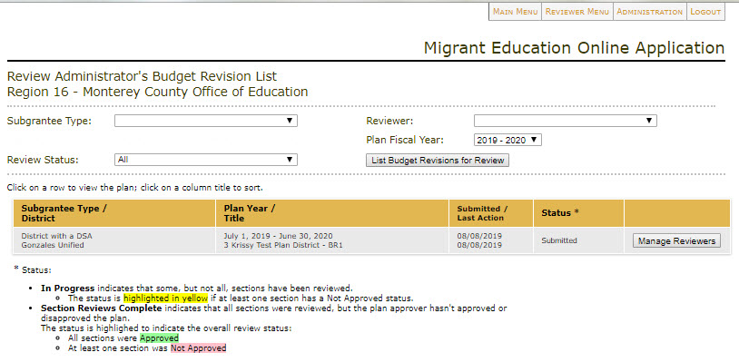
Assigning Budget Revision Reviewers
Notes:
Facilitator: Emily
Say the following:
The Regional Administrator will be directed to the Budget Revision List, as seen on this slide. They can use the filter options to find the submitted plan that they wish to assign. They should always ensure that the “Plan Fiscal Year” drop down menu is listing the correct fiscal year for that BR.
Once they find the Budget Revision that they wish to assign in the list, they should click on the “Manage Reviewers” button.
The system will then open an area for the region administrator to assign Reviewers and one Plan Approver for the DSA/MOU budget revision. Only the “Plan Approver” will be able to see the “Approve” button once the review is complete.
Also note, the Regional Administrator must assign themselves to a BR if they will be one of the reviewers and/or the Plan Approver.
Once all reviewers and the approver are assigned, the Region Administrator will select the “Update Reviewers” button. This Budget Revision Plan now has Reviewers and an Approver assigned. An automated email will be sent to all users who have been assigned to the BR.

Slide 45
Regional Reviewer Menu
Notes:
Facilitator: Emily
Say the following:
The assigned Reviewers can now access the Budget Revision they need to review in the Regional Reviewer Menu. Scores and comments can only be entered by accessing a BR through this menu, not the Administration Menu below. The Reviewer should click on the “List Budget Revisions for Review” link.

Slide 46
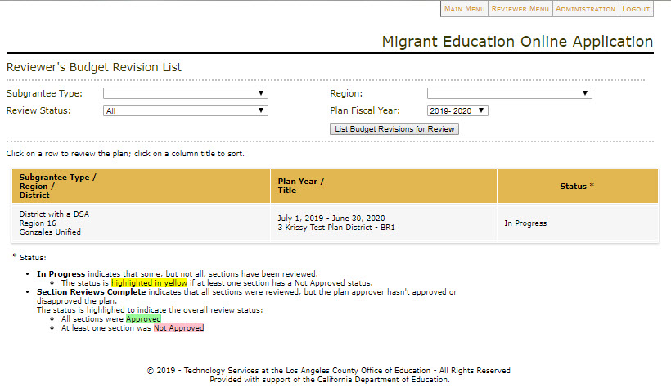
Reviewer List
Notes:
Facilitator: Emily
Say the following:
The Reviewers Budget Revision list will display all the Budget Revisions that have been assigned to that user. The reviewer should double click on the specific BR they wish to review.

Slide 47
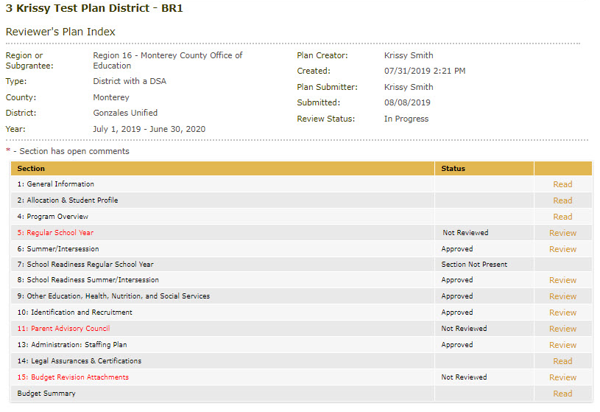
Plan Index for Reviewers
Notes:
Facilitator: Emily
Say the following:
Once they have opened the BR, the reviewer will see that all sections that require their review are marked with red text, and that that section’s status will be marked as “Not Reviewed” or “In Progress.”
Any section that did not have Budget Revisions edits will be in a black text and marked as approved.
Let’s now take a look at Section 5: Regular School Year.

Slide 48
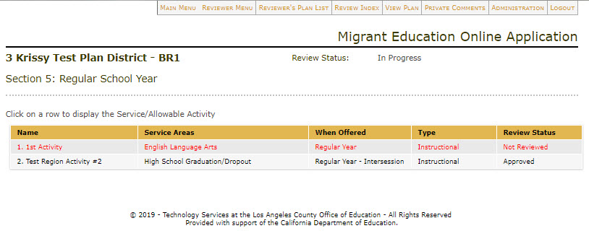
Service/Activity List for Reviewers
Notes:
Facilitator: Emily
Say the following:
To start the review of the red flagged Service/Allowable Activity, the reviewer will select the Not Reviewed link in the right column.

Slide 49
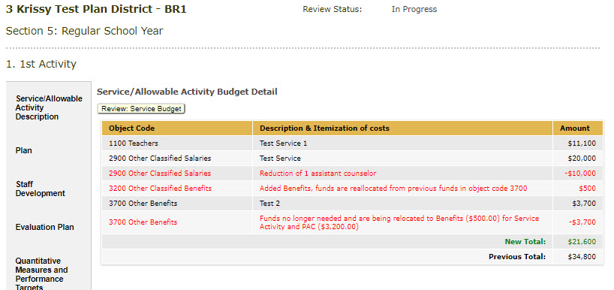
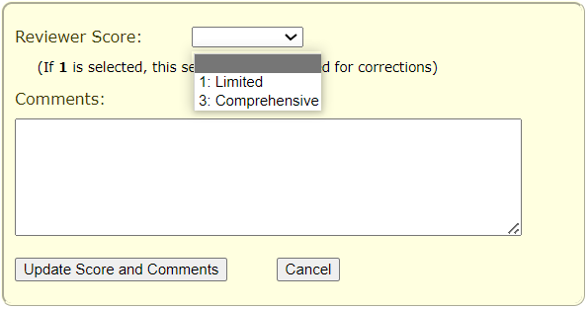
Service/Activity Review
Notes:
Facilitator: Emily
Say the following:
Within the service or activity, the Reviewer will only be able to provide a score in the Budget tab. However, the reviewer should still review all tabs to make sure they are aligned with the changes in the budget tab. If a reviewer does not approve of a change made in a non-budget tab they should disapprove the Budget tab and include a comment.
In the Budget Tab, all new budget items are identified in red. The New budget Total is displayed in green text, and the Previous Total is displayed below the New Total in black text.
The scoring mechanism is the same as in the grant application. The service or activity must receive a score of “Comprehensive” in order to be approved. If any service/activity is marked as Limited or Incomplete, the review status for that service/activity will update to Not Approved.

Slide 50

Approving a Section
Notes:
Facilitator: Emily
Say the following:
In the Plan Index, you can now see that Section 5 has an Approved Status.
The Reviewer will continue this process for all sections that have been revised, and therefore require their approval.
If any Section is marked as “Disapproved” the Plan Approver will be able to Disapprove the BR and send it back to the submitter so that they can make edits, then resubmit.

Slide 51
Check for Understanding
Notes:
Poll #2:
True/False: Reviewers will automatically be able to see submitted Budget Revisions by clicking on the “List Budget Revisions for Review” link in the Regional Reviewer Menu.
Answer: FALSE. The Regional Administrator must first assign Budget Revisions using the Regional Administrator menu before staff will be able to access them for review. This includes assigning themselves as a review to a submitted BR.
True/False: The Reviewer will be able to score and leave comments in each tab of a service/activity, just like in the application.
Answer: FALSE The reviewer will only have access to score and leave comments in the budget tab, and should write any comments that need to be addressed in the other tabs in the budget tab.
True/False: In the Section 2 update, users will be able to see their new allocation during a BR only after the BR has been approved by the Region (for DSAs/MOUs) or CDE (for Regions/DFDs).
Answer: TRUE. Please remember this update occurs only after a BR has been approved.

Slide 52

Approving a Budget Revision
Notes:
Facilitator: Emily
Say the following:
Once all sections in a BR have been marked as approved, let’s look at the steps for finishing the Budget Revision approval process.

Slide 53
Two Steps for BR Approval
1. Approve BR in eMEP
2. Approve BR in MEPEX
Notes:
Facilitator: Emily
Say the following:
There are 2 steps that must be followed in order to complete a Budget Revision approval. The first step occurs in the eMEP system, which is the system we have been looking at so far in this training.
The second step occurs in the MEPEX system, which is the separate yet connected system for expenditure reports. Both steps must be completed, otherwise the subgrantee’s next expenditure report will not populate correctly.

Slide 54
Order of Submission
1
2
3
4
Region approves all district BRs in eMEP and MEPEX*
CDE approves Region BR in eMEP and MEPEX
Districts submit BRs to Region
Region submits BR to CDE
*If a district will not submit a BR in eMEP, the Region must still indicate this in MEPEX. See slide 61 for instructions.
Notes:
Facilitator: Emily
Say the following:
Additionally, keep in mind that there is a proper order of operations for approval to ensure that all budgets and expenditures in the eMEP and MEPEX systems populate correctly. First, DSAs/MOUs submit their BRs to the Region. The Region must approve all DSA/MOU BRs in eMEP and MEPEX before submitting their Regional BR to CDE. The CDE can then approve the Region’s BR in eMEP and MEPEX.
Once the Budget Revision Plan has been approved, the subgrantee can create the subsequent Budget Revision.

Slide 55
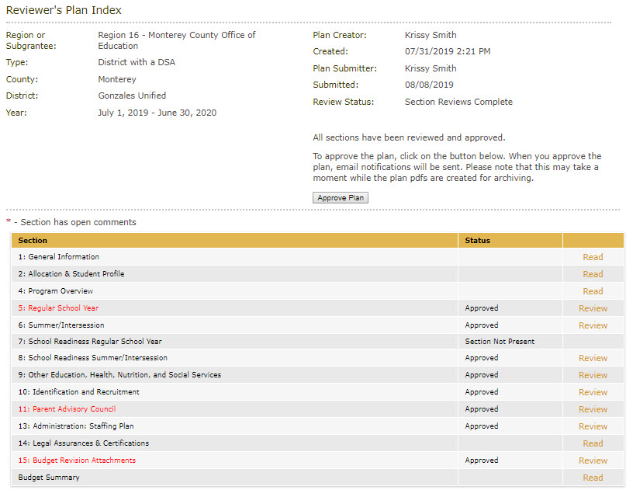
Approve Budget Revision in eMEP
The Approve Plan button will only be available when all sections requiring revision have been marked “Approved.”
Only the BR’s Plan Approver will have access to the Approve Plan button.
Notes:
Facilitator: Emily
Say the following:
Once all sections have been marked as Approved in the eMEP System, the assigned Budget Revision Approver will click the Approve Plan button that will appear on the Plan Index page.
An email will be sent to the plan submitter advising them that their BR has been approved.
I’ll now pass it over to my colleague Alex who will go over Step 2: BR approval in the MEPEX system.

Slide 56
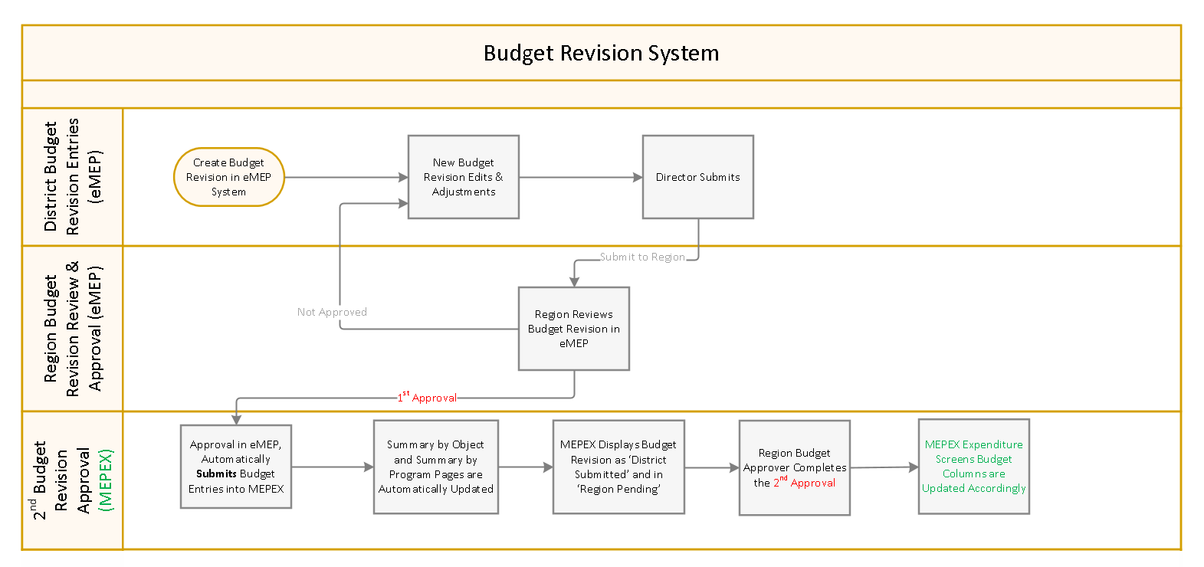
MEPEX Diagram for District to Region
Notes:
Facilitator: Alex
Say the following:
As Emily mentioned, the budget revision approval process is a two-step process. The first approval happens in the eMEP system, and the second in the MEPEX system. Let’s look at the budget revision approval process in a bit more detail:
The reimbursable districts create a budget revision plan in eMEP.
The Budget Revision Entries and Adjustments are entered in the eMEP.
The District Director/Coordinator Submits the Budget Revision to the Region Office.
The Region Assigns Reviewers to the District’s budget revision. The Region either approves the changes or disapproves the changes.
If the region approves the changes, the Region approver will approve the plan in the eMEP system. This will be the first step of the two-step approval process.
Now let us discuss how the first approval in the eMEP impacts the MEPEX system.
The first approval in eMEP System Automatically Submits Budget Entries into MEPEX. The MEPEX System will display Budget Revisions automatically in the Summary By Object and Summary by Program screens.
MEPEX will display the Budget Revision submission as District Submitted and the Budget Revision in Region Pending mode.
To complete the second approval in MEPEX, the Region must select the approve button in MEPEX (we will describe this process in the next slides).
Once the second approval is completed in the MEPEX Budget Revision tab under the Submit/Review/Approve Screen, the MEPEX Expenditure Screens are updated according to the Budget Revision Number.
The Budget Revision is Approved in the MEPEX System. As before, the MEPEX System will generate automatic Approval Emails.
Note, the region and direct funded districts would follow this same process, however, the steps for the region would be substituted by the CDE staff. Also, upon the CDE selecting the Approval button, the Business Rules will automatically run.
The Business Rules include:
Checking that District Budget Revisions have been Finalized or Approved. We will discuss when and how to finalize a BR in MEPEX in the upcoming slides.
Checking that previous Quarterly Expenditure Report has been Approved.
Please Note: This business rules run automatically, there is no effort required from user.
Once the Business Rules are cleared, the Budget Revision is approved in MEPEX and the MEPEX Expenditure Screens are updated according to the Budget Revision Number.

Slide 57
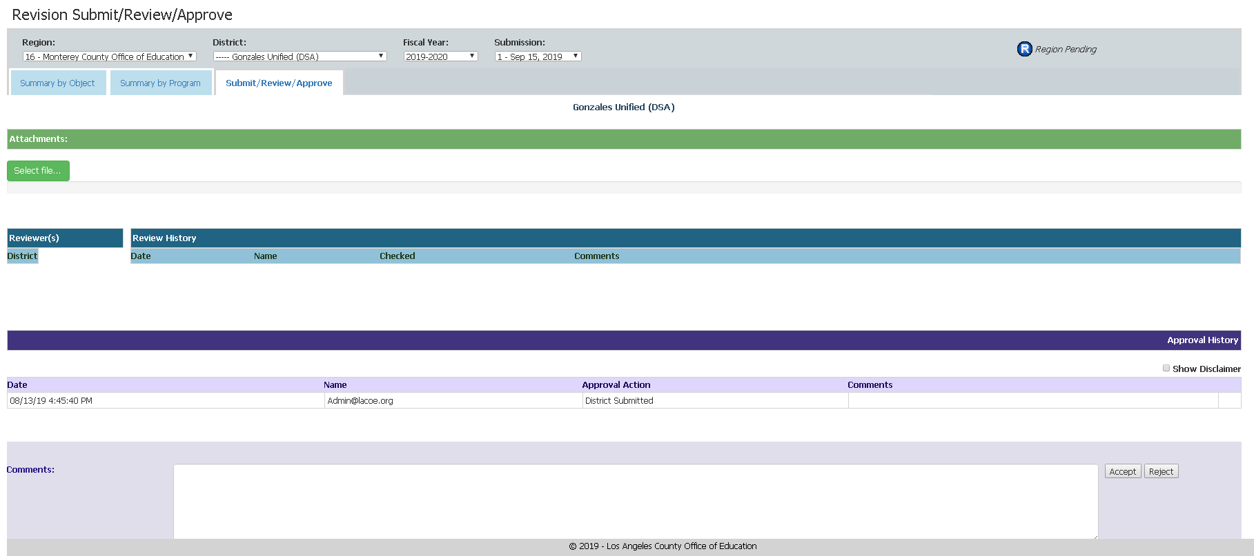
MEPEX Budget Revision Submission
MEPEX Budget Revision Submission
Notes:
Facilitator: Alex
Say the following:
As we stated before, once the Budget Revision has been approved in the eMEP System, the Budget Revision entries will automatically populate in the MEPEX – Revision screens. The Districts do not have to manually enter any Budget Revisions into the MEPEX System or submit anything in the MEPEX System.
The numbers will populate in the appropriate summary screens, and the status will change to Region Pending. In the sample above, the District is waiting for the Region Budget Approver to complete the second approval.
The Approval History box displays an entry with a date and time log, of when the Budget Revision numbers came from the eMEP System. As seen on the first red box.
The purple area is the area for the Region Approver to complete the second approval. The Region Approver will select the Accept button to complete the second level approval.

Slide 58
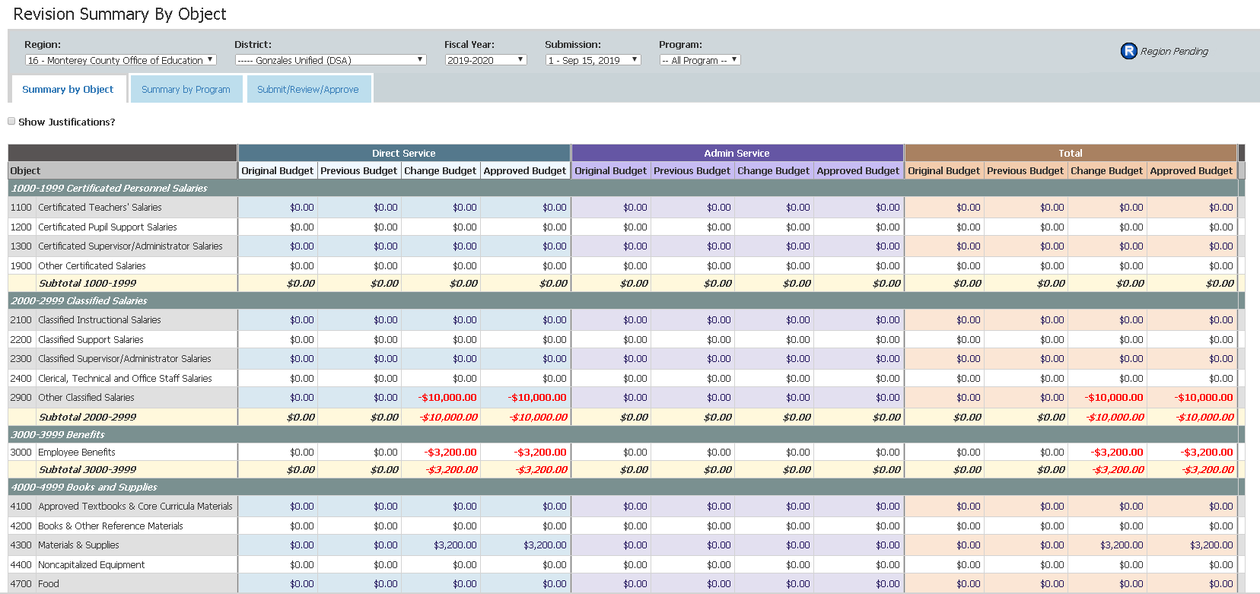
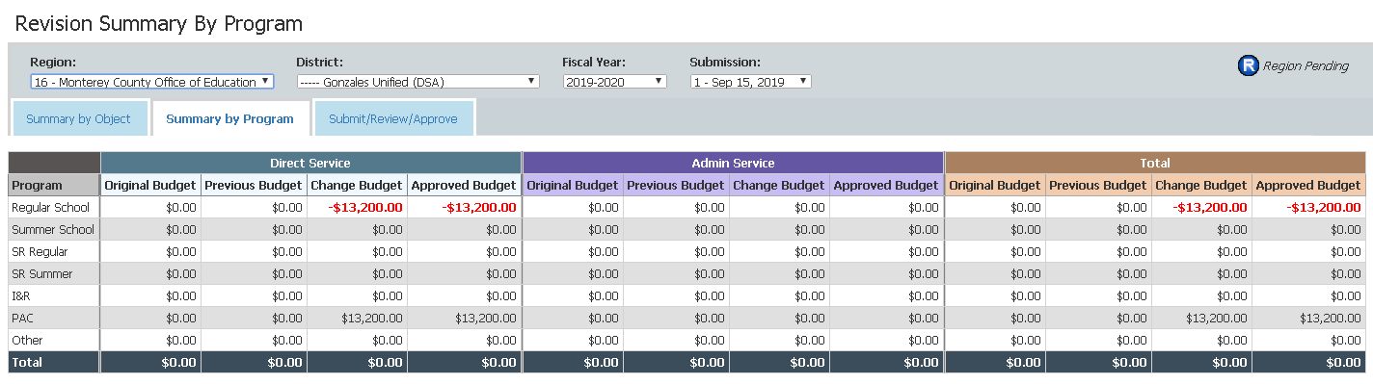
MEPEX Summaries Updated
VI. MEPEX (4)
Notes:
Facilitator: Alex
Say the following:
This is an example of the summary screens before the budget is approved.
The second approval in the MEPEX System also serves as a final fiscal check before the expenditure screens are updated. Reminder: The Revision Summary by Object and Revision Summary By Program displays the numbers at a program level and service/admin level.
Please note: the total allocated budget should match to the application and the grant award notification.
Also, districts should have all the funds provided to them, allocated.

Slide 59
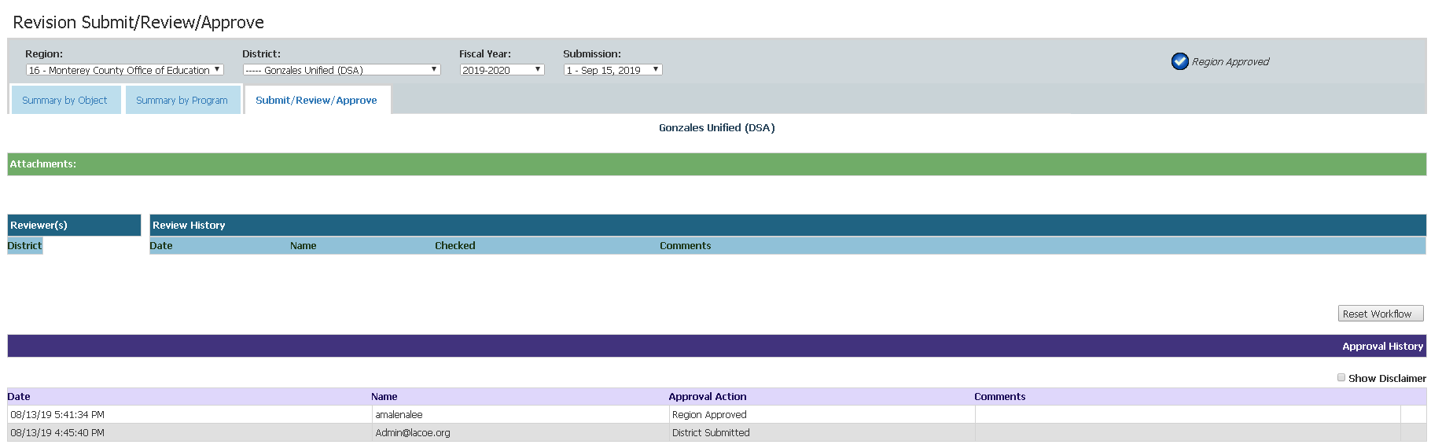
MEPEX Submit/Review/Approve Screen
MEPEX Budget Revision Approval
Notes:
Facilitator: Alex
Say the following:
Once the Region has completed the second approval, the Submit/Review/Approve screen under the Budget Revision tab will be updated. The screen displays a workflow history of the Submission from the eMEP System and the approval from the Region.
There is also a label at the top right-hand corner that updates to: Region Approved and the Approval History log is updated with the Date, Name of the Region Approver, and Approval Action.

Slide 60
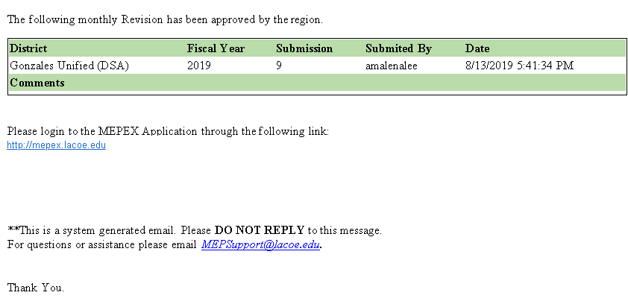
MEPEX Budget Revision Complete
Notes:
Facilitator: Alex
Say the following:
Once the Budget Revision submission is approved, the system generates a confirmation email (email sample shown here).
This completes the Budget Revision approval process.

Slide 61
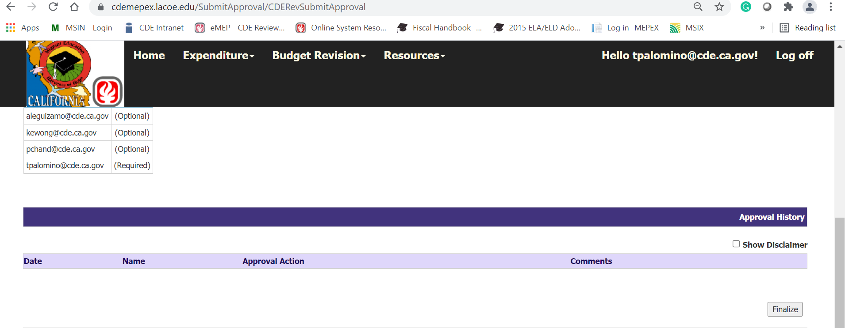
MEPEX Budget Revision Finalize Screen
VI. MEPEX (7)
Important: only click the “Finalize” button if the district will not submit a BR for that quarter.
Notes:
Facilitator: Alex
Say the following:
If a reimbursable district does not submit a BR. The region must go to MEPEX and select the Budget Revision dropdown tab, then select the Submit/Review/Approve option. Once the Submit/Review/Approve option is selected, the region will be directed to the screen shown on this slide. The Region will select the finalize button, located at the bottom right corner of the page. ONLY CLICK FINALIZE if the district DID NOT submit a BR.
Reimbursable districts should notify their regions, as soon as possible, if they are not planning to submit a BR.
Direct funded districts and regions should also notify CDE if they are not planning to submit a BR.

Slide 62
MEPEX Expenditure Screens Updated
The dates for the ‘Approved Budget’ rollover into the expenditure side are as follows:
Submission 1 – Sep. 15 | Revised Budget will first appear in the July Expenditure Screens
Submission 2 – Dec. 15 | Revised Budget will first appear in the October Expenditure Screens
Submission 3 – Mar. 15 | Revised Budget will first appear in the January Expenditure Screens
Submission 4 – May 31 | Revised Budget will first appear in the April Expenditure Screens
Notes:
Facilitator: Alex
Say the following:
The MEPEX Expenditure Screens are updated upon the second approval being complete.
The dates for when the Expenditure Approved Budget columns are updated, based on the budget revisions, are found in this table.
Please note, budgeted expenditures must be approved in the grant application, budget revisions, or through pre-approvals before the funds can be used.

Slide 63
Check for Understanding
Notes:
Poll #3:
True or False: You must manually enter budget revisions into the MEPEX system after you enter them in the eMEP. Answer: False, the BR entries will automatically populate in the MEPEX-Revision Screens.
True or False: To complete the approval of a BR, you must select the finalize button in the MEPEX system.
Answer: False, you must select the approval button in the MEPEX system. The finalize button should only be selected if the reimbursable districts, region, and direct funded districts do not submit a BR.
True or False: Regions must wait to submit their Regional BR to the CDE until they have approved all of their districts’ BRs.
Answer: True. Please be mindful of the proper order of submission so that budgets populate correctly.
Thanks for participating. I’ll now pass it back to Emily to finish the presentation.

Slide 64
Pre-Approvals
There are situations when a subgrantee cannot wait until a BR to revise their budget, for example if they increase student participation in a service and need additional funds for transportation.
Contact your consultant to request the
pre-approval.
Notes:
Facilitator: Emily
Say the following:
Thanks Alex. Let’s talk briefly about Pre-Approvals. When are pre-approvals needed?
Ideally subgrantees should plan their services/activities in advance and their budgets need to be created during the application approval process, or during the 4 budget revisions. However, there are situations when a subgrantee cannot wait until a BR. For example, you increase student participation for one of your summer services and you need additional funds for transportation. In this scenario, you can reach out to your consultant and request a pre-approval.
We try to avoid pre-approvals because it causes more work for you and your consultant. Also, for record and auditing purposes, we prefer all communication to happen within the system.

Slide 65
Common Mistakes
Regions forget to either approve or finalize their districts’ budget revisions in MEPEX.
Object codes are reduced more than their original budgets, causing negative balances.
Users are not able to create a new BR because a previous plan was kept in draft mode and never submitted.
Regions click the “Finalize” button instead of the “Approve” button in MEPEX for a submitted BR.
Notes:
Facilitator: Emily
Say the following:
Some of the most common mistakes we encounter when creating, reviewing, or approving a BR are:
Regions forgetting to either approve or finalize their reimbursable districts’ plans in MEPEX. If your district submitted a BR, you must approve in eMEP and MEPEX. If your district did not submit a BR, you must finalize in MEPEX.
As discussed earlier, it is crucial to be mindful while adjusting your budgets within a specific service. Make sure to only decrease object codes that have an assigned budget and avoid surpassing their original budgeted amounts.
Users not being able to create a new budget revision because previous Budget Revisions were kept in 'draft‘ mode. These drafts are typically never utilized or submitted for approval. The system only allows 1 active plan at a time. Please delete any old, unused plans.
Finally, remember that the “Finalize” button is only to be used if a reimbursable district will not submit a BR, never for BR approval.

Slide 66
Budget Revision 1
All DFDs and Regions must submit BR1 and make the necessary changes to properly reflect your 2024–25 services/activities.
Account for your entire 2024–25 grant allocation.
Submit your BR to the CDE by September 15, 2024.
Notes:
Facilitator: Emily
Say the following:
During budget revision one, all DFDs and Regions must submit a BR to CDE. The BR must reflect all the necessary changes to indicate what services or activities you will be providing in fiscal year 2024–25 and the total budget should match the actual allocation that is listed in Section 1. The due date for BR1 is September 15, 2024. For regions with reimbursable districts, your districts’ BR must be approved before the region submits their BR to CDE.

Slide 67
Helpful Tips
Label each budget item with the corresponding BR number. Budget changes made during Budget Revision 1 will be labeled with BR1, changes made during Budget Revision 2 will be labeled with BR2, etc. This will make it easier to track the changes throughout the year!
Use a different font color when making changes to non-budget tabs so that your edits are clearly visible.
Do not click the “save” button unless you have made an actual change to a service/activity.
Notes:
Facilitator: Emily
Say the following:
Here are a few tips and best practices that can help you as you edit and review BRs. [Read slide]

Slide 68

Questions & Answers
Notes:
Say: We’ll now take a quick moment address any questions that have been submitted in the Q&A feature of the Zoom meeting and have not yet been addressed. If we don’t have time to get to your question today, we will email you!

Slide 69

Presentation Materials
www.lacoe.edu/services/accountability/migrant-education/online-systems
Notes:
Facilitator: Emily
Say the following:
Thank you so much for time and attention, this presentation as well as the recording will be posted on the LACOE’s website within 1 week’s time.

Slide 70
Contact Information
Emily Smith
Education Programs Assistant
emsmith@cde.ca.gov
916-319-0227
Contact LACOE Technology Services staff for technical support with the eMEP system:
mepsupport@lacoe.edu
Notes:
Facilitator: Emily
Say the following: Please contact myself with and Budget Revisions questions, and you may also reach out to the LACOE helpdesk.
When reaching out to the LACOE help desk, please make sure that you (or your districts) are providing context such as their name, which district they are from, as well as screenshots of the issue they are experiencing. Additionally, please be aware that the LACOE TS team cannot reopen Region BRs once they have been approved by CDE unless authorized by the CDE. If, for any specific reason, you require a BR to be reopened after approval, kindly ensure that the Regional or DFD Director contacts their CDE consultant for further assistance.

Slide 71

Thank you for attending!
The Expenditure Report Training will now begin in a separate Zoom meeting.
71
Notes:
Facilitator: Emily
This webinar has come to an end. We will now take a short break and will begin the Expenditure Training at _____am. You can find the link to the Expenditure training in the calendar invite. Thank you!

