Slide 1
Welcome California Mini Corps Staff
The webinar will begin shortly. If you are joining as a group, please use the chat area on the right side of the screen for roll call (enter your name and title). Thank you.
If the sound is not coming through, please connect via telephone at 1-669-219-2599 include meeting ID 858 0529 7777 and enter password 782523.
Notes:
10 minutes prior to webinar time
[Say the following:]
Good afternoon everyone! Right now is a good time to do a sound check. Using the raise your hand function, please raise your hand if you can hear me. We will begin in a new minutes.
[Click to advance slide]

Slide 2
Webinar Participation
Mute your speaker
Use the Chat to enter your name and job title
Please raise your hand if you have any questions.
Notes:
[Say the following:]
For a successful experience with the webinar training, please follow these four steps to get ready for this webinar.
Mute your speaker
Please use the Chat function to enter your name, and job title at this time (I will give you a few seconds to do so).
Please raise your hand if you have any questions so that we can unmute you.
[Click to advance slide]

Slide 3
Webinar Participation (2)
If the sound is not coming through, please connect via telephone at 1-669-219-2599 include meeting ID 858 0529 7777 and enter password 782523.
Notes:
[Read slide]
If the sound is not coming through, please connect via telephone at 1-669-219-2599 include meeting ID 858 0529 7777 and enter password 782523.
[Click to advance slide]

Slide 4
California Mini Corps Grant Online Application System
July 23, 2020
2:00—4:00 p.m.
Notes:
[Begin recording]
[Say the following:]
Welcome and thank you for joining us on our webinar, “California Mini Corps Grant Online Application System.”
[Click to advance slide]

Slide 5
Welcome and Introductions
Session Facilitators
John Oses, Education Programs Consultant (EPC), MEO, CDE
Prakash Chand, Associate Governmental Program Analyst (AGPA), Division Support Office, CDE
Celina Torres, Administrator, Migrant Education Office (MEO), California Department of Education (CDE)
Participants
California Mini Corps Directors
Butte County Office of Education Leadership and staff
Notes:
[Begin recording]
[Say the following:]
My name is John Oses, and I am an Education Programs Consultant in the Migrant Education Office at the California Department of Education, or CDE.
As you may know, the CDE has contracted with Los Angeles County Office of Education’s (LACOE) Technology Services to develop an online application system.
For FY 2020—21, the Butte County Office of Education (BCOE) will be completing a grant application through the online system for the California Mini Corps Program.
This webinar is designed as an introduction to the Online grant application system for California Mini Corps Directors and Butte County Office of Education leadership and staff.
[Click to advance slide]

Slide 6
Session Objectives
  Participants will be able to:
Understand necessary application documents
Get online system access
Complete a plan
Submit a plan
Navigate the online system
Notes:
[Say the following:]
Participants will be able to:
Understand necessary application documents
Get online system access
Complete a plan
Submit a plan
Navigate the online system
[Click to advance slide]

Slide 7
Before We Begin
Online system originally created for MEP Subgrantees.
The CMC Central Office will complete a Direct Funded District Service Agreement (DFDSA) application.
Notes:
[Say the following:]
The grant application system is designed for the MEP grant and is not specifically tailored to the requirements of the Mini-Corps program. For this reason, several sections of the online application will not apply to the CMC grant. Throughout this presentation, I will denote the application sections not applicable to CMC.
The CMC Central Office will complete a Direct Funded District Service Agreement (DFDSA) application.
[Click to advance slide]

Slide 8
System Terminology
RA: Regional Application
DFDSA: Direct-Funded District Service Agreement
DSA: District Service Agreement
MOU: Memorandum of Understanding
Notes:
[Say the following:]
For reference, the following terms will be used throughout the webinar.
[Click to advance slide]

Slide 9
Outline
  System Access
  Completing a Plan
  Submitting a Plan
  Navigating the Plan Index Tab
  Examples of Scored Sections
  Actions After a Plan is “Disapproved”
Notes:
[Say the following:]
This webinar’s focus is to provide step-by-step guidance on how to complete the Grant Application. As previously mentioned, some of the steps delineated here will not pertain to the CMC Grant, as the online system is also used with MEP Regional Subgrantees, DFDSAs, DSAs, and MOUs.
We will start with how to “Access the System”.
Then “Completing a Plan.”
“Submitting a Plan.”
“Navigating a Plan.”
“Examples of Scored Sections.”
“Actions Taken After a Plan is Disapproved.”
[Click to advance slide]

Slide 10
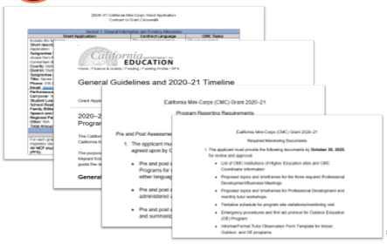
Necessary Documents
Notes:
[Say the following:]
Before starting the online application process, it is important that you reference the following documents:
CMC Grant General Guidelines and 2020—21 Timeline
CMC 2020—21 Contract to Grant Crosswalk
CMC Program Reporting Documents
CMC Program Monitoring Documents.
[Click to advance slide]

Slide 11
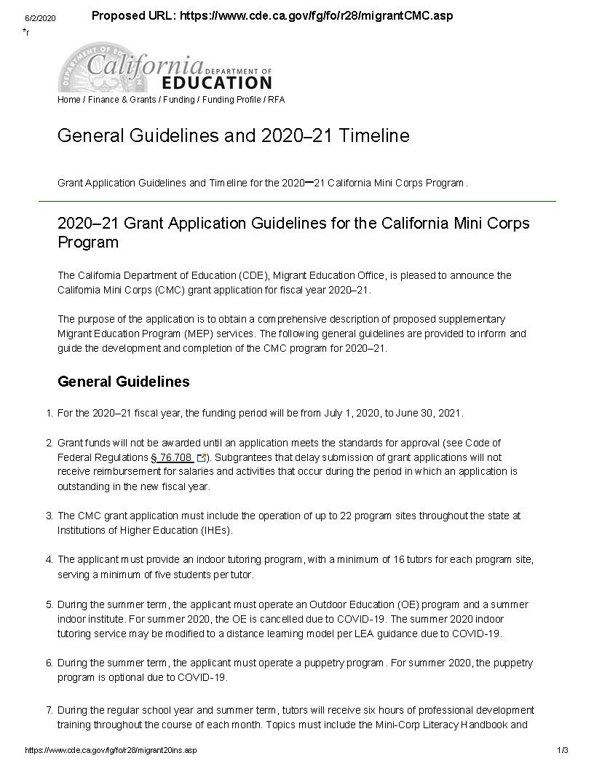
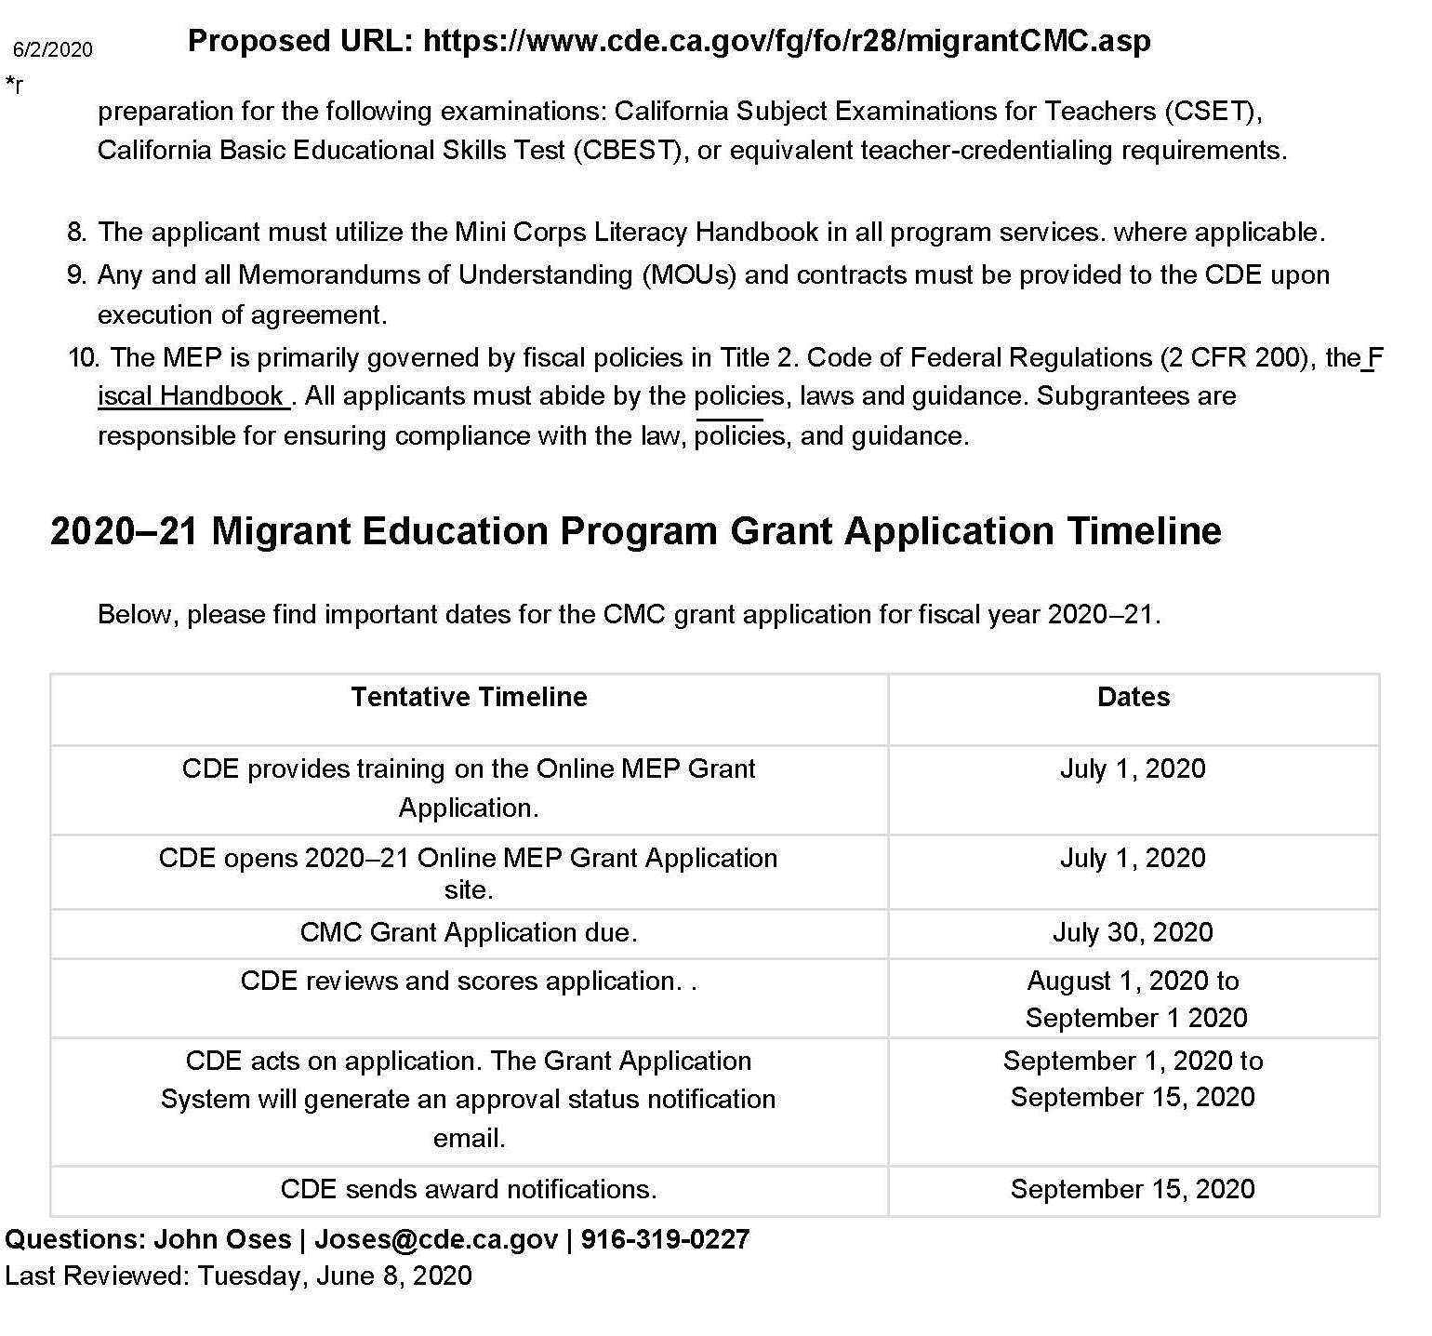
Necessary Documents (2)
CMC Grant General Guidelines and 2020—21 Timeline
Notes:
[Say the following:]
The CMC Grant General Guidelines provides the general requirements for the application in addition to the timeline for application submission, scoring and subsequent approval.
Take a few minutes to review. Do you have any questions? Please use the raise your hand feature in Zoom and I will unmute you.
[Click to advance slide]

Slide 12
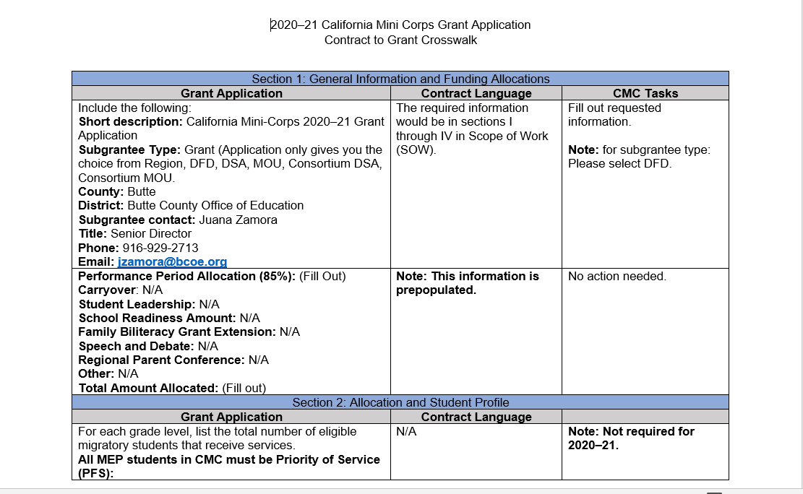
Necessary Documents (3)
CMC 2020—21 Contract to Grant Crosswalk
Notes:
[Say the following:]
The CMC 2020—21 Contract to Grant Crosswalk identifies which sections of the application you need to complete.
Column one (Grant Application) shows the various prompts in the grant application.
Column two (Contract Language) shows the contract language that will assist you with providing the requested information in the grant application.
Column three (CMC Tasks) shows the specific task that needs to be done.
Please utilize the Contract to Grant Crosswalk throughout this presentation as well as working on completing your grant application.

Slide 13
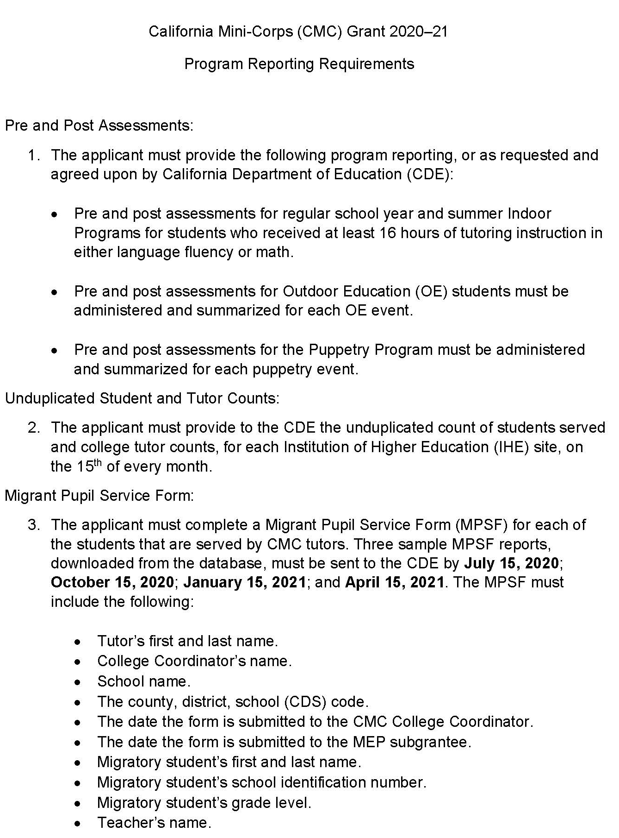
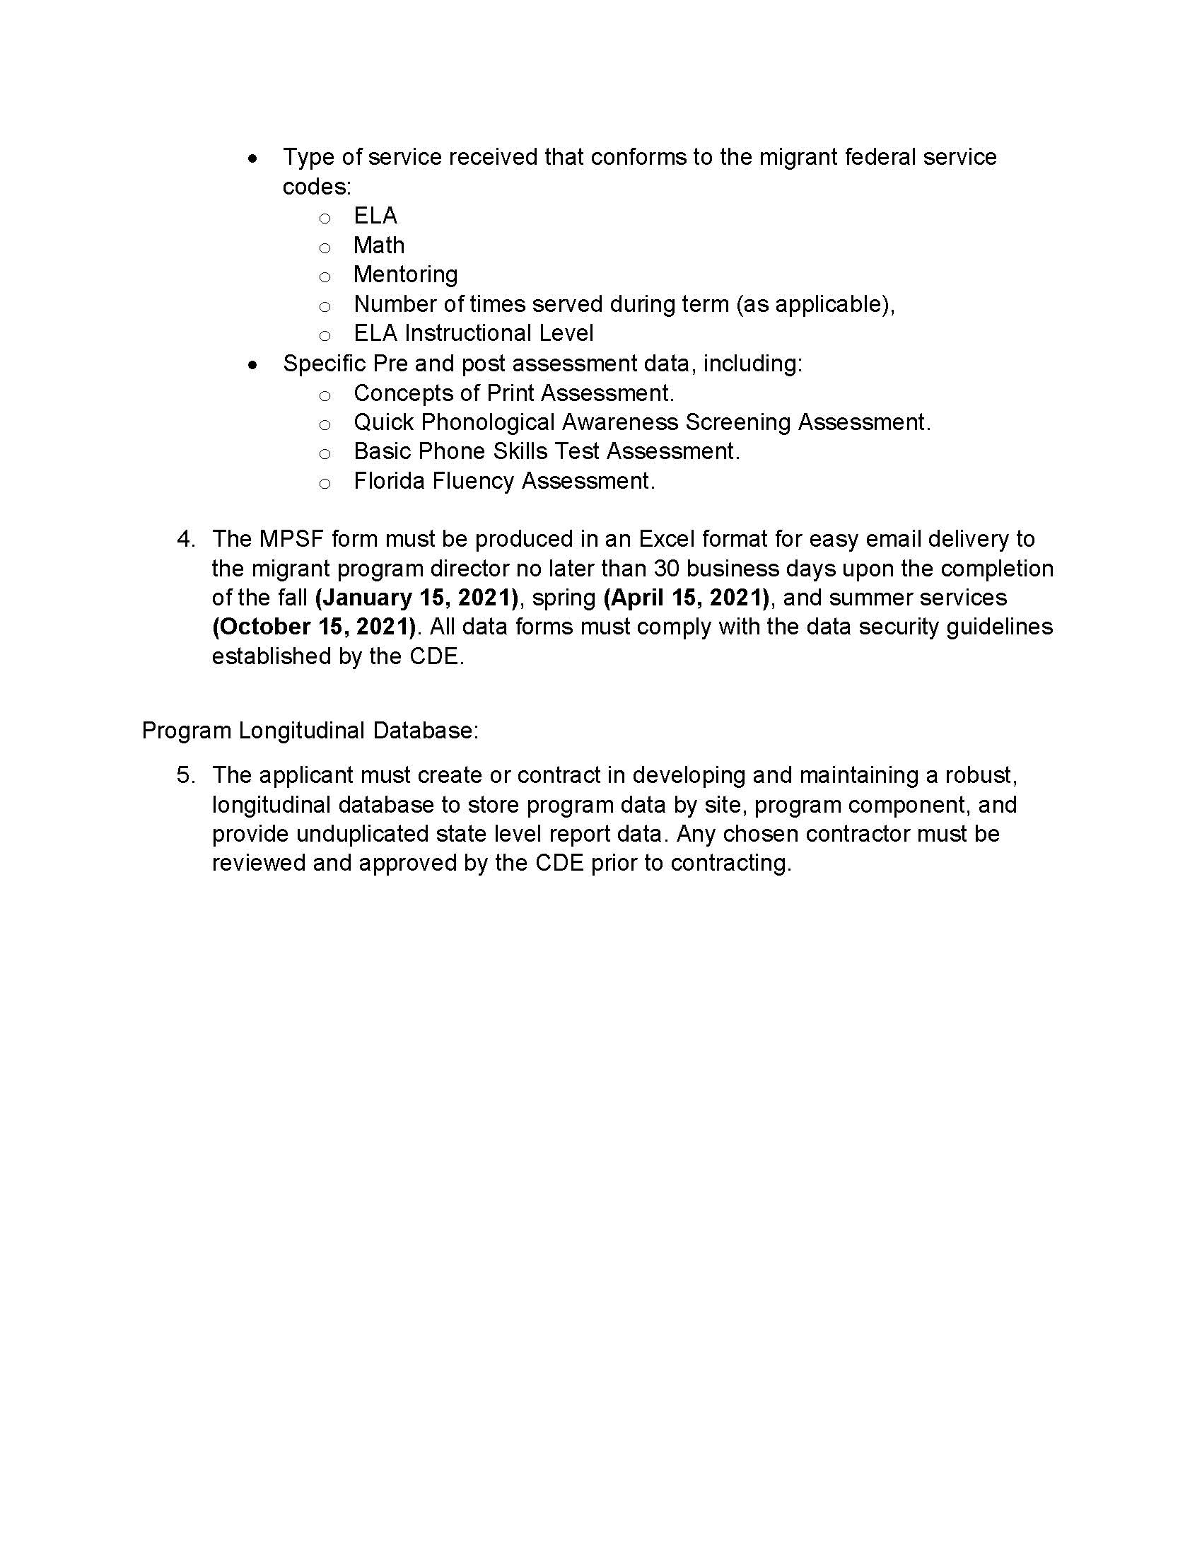
Necessary Documents (4)
CMC Program Reporting Documents
Notes:
[Say the following:]
The CMC Program Reporting Documents identifies the program reporting requirements and deadlines for report submissions to CDE for the CMC Grant.
[Click to advance slide]

Slide 14
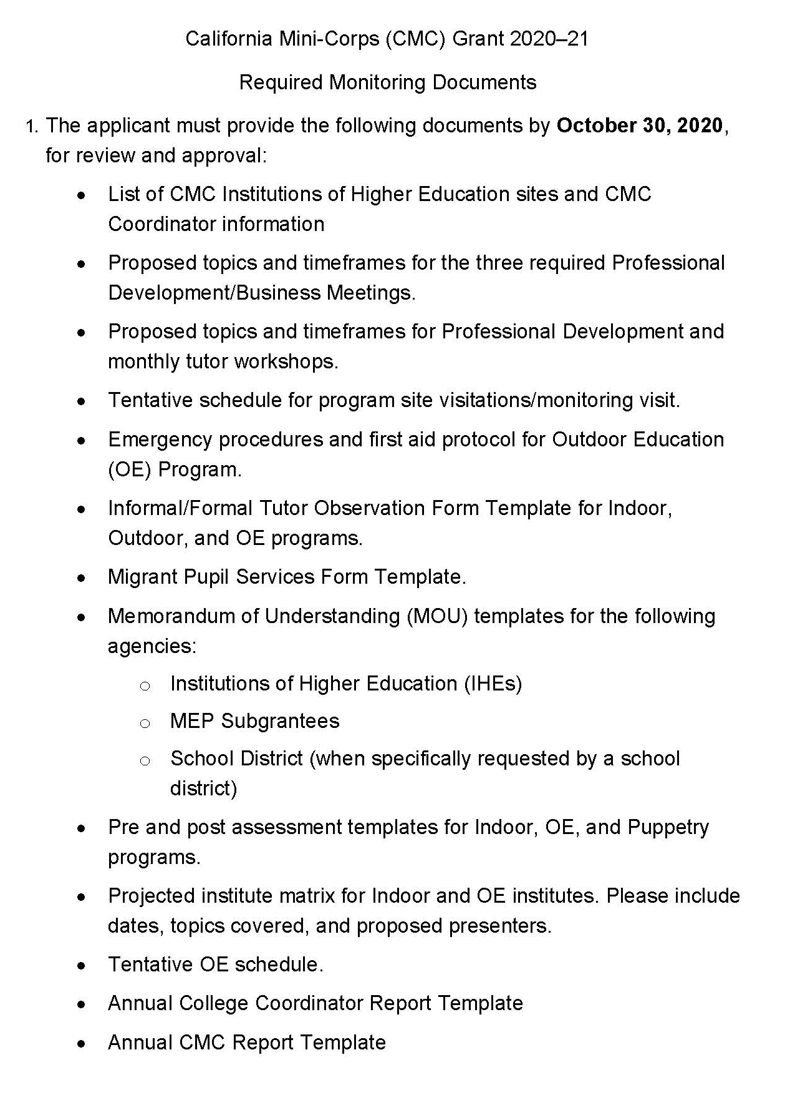
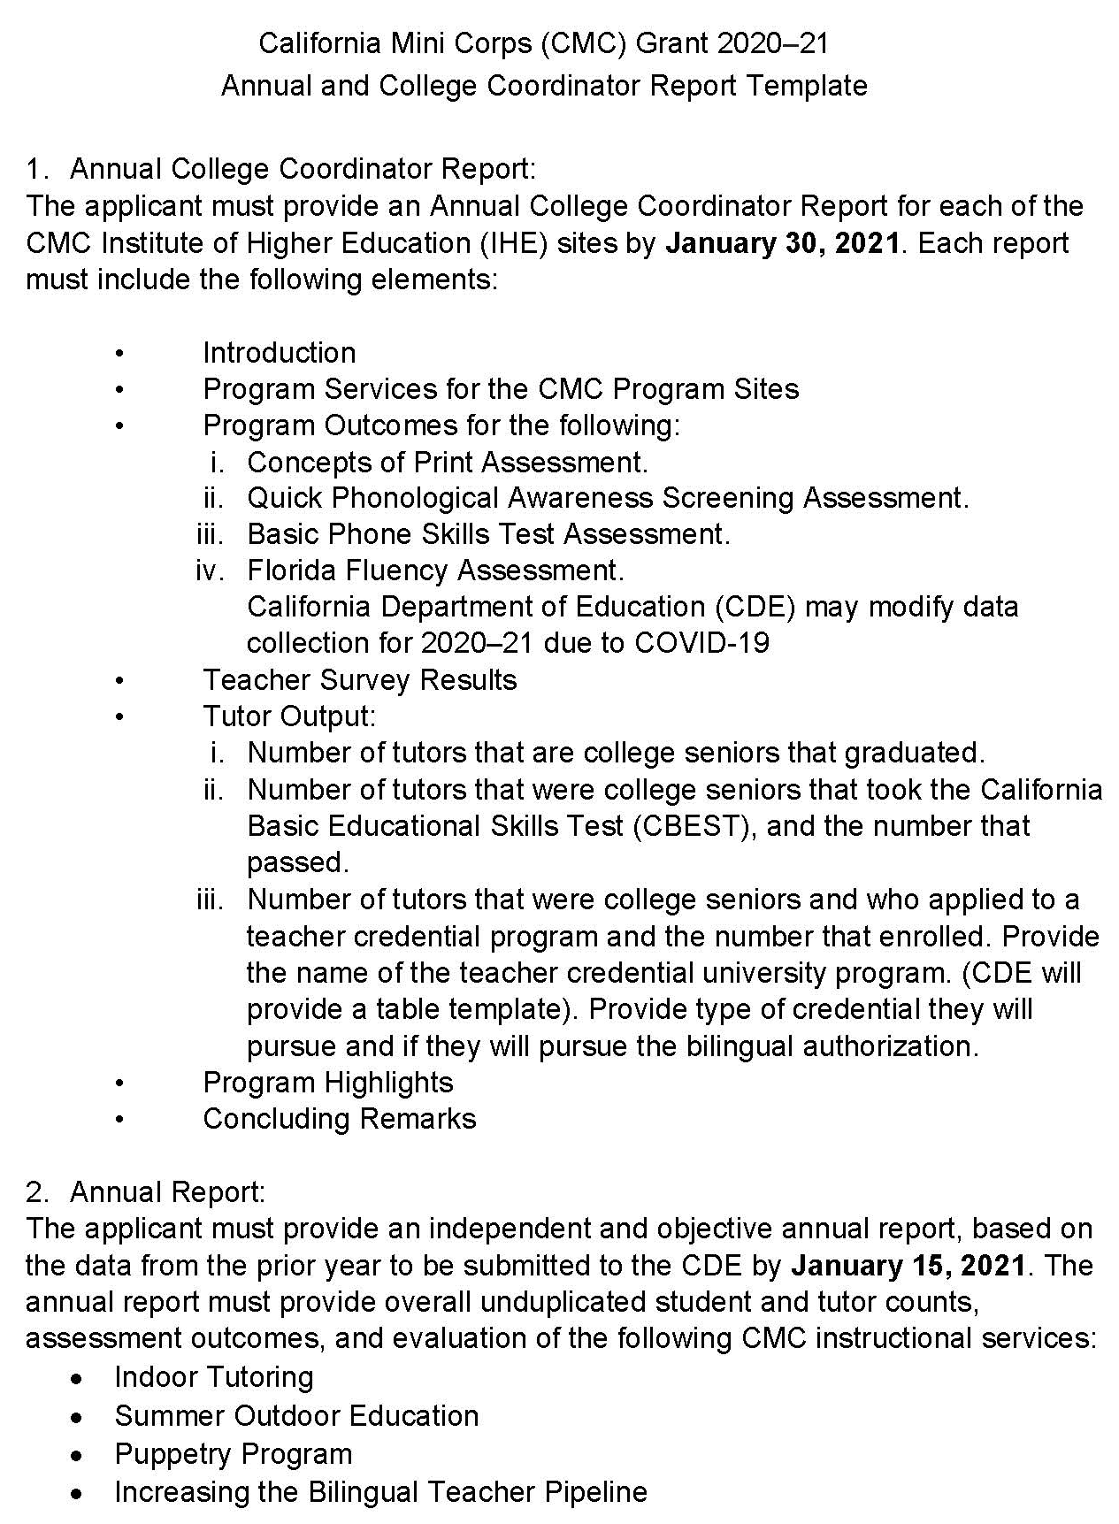
Necessary Documents (5)
CMC Program Monitoring Documents
Notes:
[Say the following:]
The CMC Program Monitoring Documents provides the program monitoring requirements and deadlines for report submissions to CDE for the CMC Grant.
[Click to advance slide]

Slide 15
I. System Access
Notes:
[Say the following:]
Now we will dive into how to access the system.
[Click to advance slide]

Slide 16
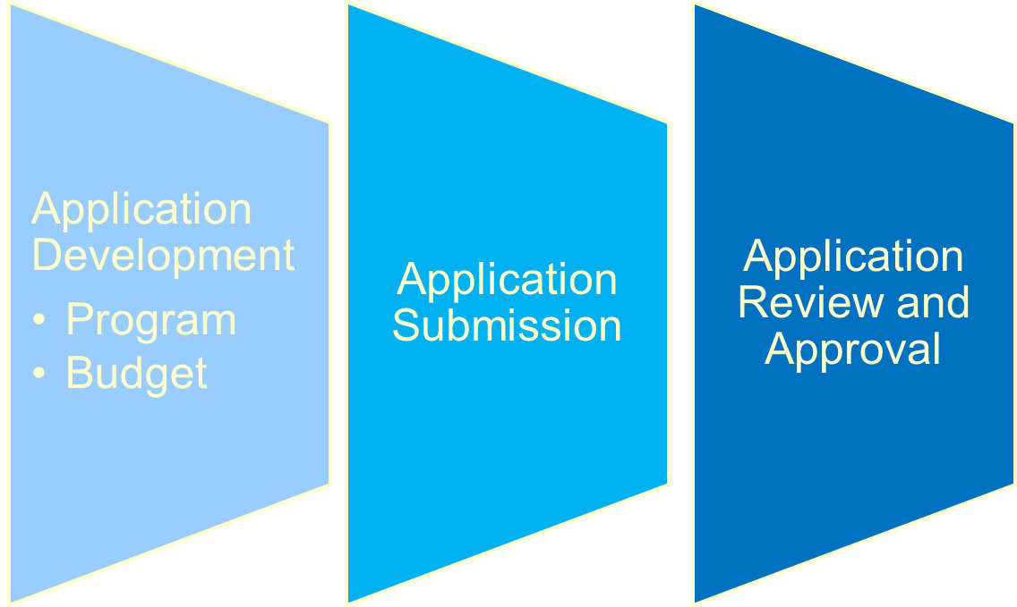
I. System Access (2)
System Flow
Notes:
[Say the following:]
The Migrant Education Online Application System supports three major functions:
Application Development
Program Development (services and activities)
Budget Development
2. Application Submission
3. Application Review and Approval
In the subsequent slides, we will present in more detail about these functions.
[Click to advance slide]

Slide 17
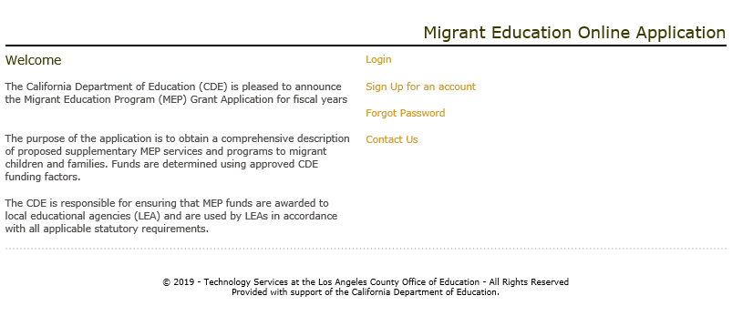
I. System Access (3)
System Access
2019–20.
Notes:
[Say the following:]
To access the Migrant Education Grant Application System, users will need to do the following:
Go to the website “http://cdemep.lacoe.edu”.
Select “Login”
Enter email and password.
As the CMC grant is a new application, the CDE will include the emails for the CMC Directors.
Afterwards, an email will be sent to you, this email will advise you that you have been added to a Region/DFDSA plan, and will provide a link to access the plan.
As a reminder, the CMC Grant application is currently considered as a DFDSA plan in the online system.
[Click to advance slide]

Slide 18
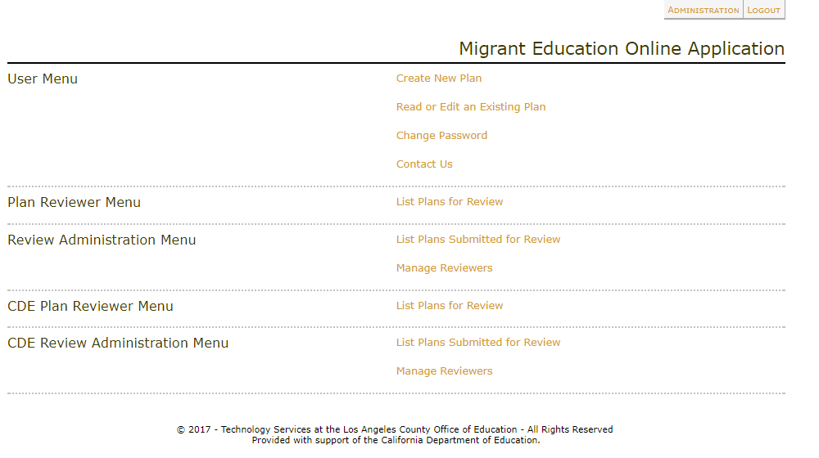
I. System Access (4)
Main Menu
Notes:
[Say the following:]
Next, in the User Menu click Create New Plan.
[Click to advance slide]

Slide 19
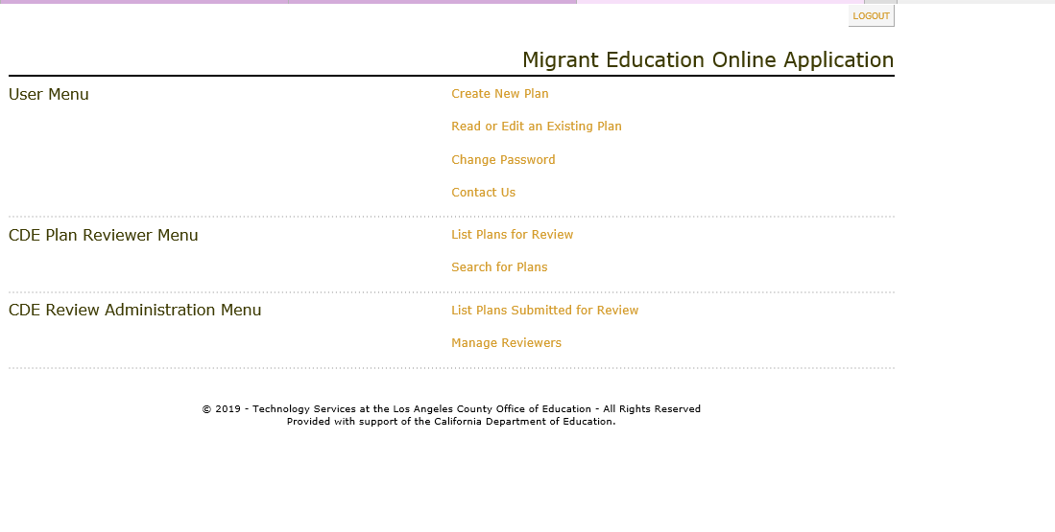


I. System Access (4)
Main Menu
Notes:
[Say the following:]
Once a user logs in, the user will see the main menu page.
On the main menu page, you will have three areas to select from:
User Menu: This is where you can create or edit Grant Applications for CMC.
Plan Reviewer Menu: This is where the regional reviewers will access submitted district plans that they are assigned to review. Note: The CMC will not have access to any prior plans.
Review Administrator Menu: This is where the regional administrator will assign regional reviewers to review submitted DSA and MOU applications. Please Note: this section is not applicable to the CMC application.

Slide 20
I. System Access (5)
CMC/RA/DFDSA User Roles
Submitter:
Director
Read Only
Assign this role to anyone you think will provide helpful comments.
Approver:
CDE MEO Staff
Editor:
Program Directors Program Coordinators Fiscal Staff Data Entry Specialist
Commenters (Comments Only)
CDE Staff Assign this role to anyone you think will provide helpful comments.
Notes:
[Say the following:]
We will now review how to assign user roles.
The CMC director or designee will assign the plan Submitters. Please note, plan submitters must be at or above the director level.
Approvers for the CMC Grant are the CDE/MEO consultants. The CDE System Administrator, Teresa Palomino, will assign the consultant , John Oses , to your corresponding DFDSA Plan, once it is submitted. Again, because this system was designed for the MEP grant, you will be labeled as a DFDSA plan .
For Editors, the CMC may assign one of the users listed above. However, this list is an example and CMC may add staff as applicable.
For Read Only users, the CMC may assign this role to anyone they think will provide helpful feedback.
For Commenters (Comment Only) users, the CMC may assign this role to anyone they think will provide helpful comments. In addition, the CMC should assign their CDE consultant as a comment only user.
[Click to advance slide]

Slide 21
II. Completing a Plan
Notes:
[Say the following:]
Now we will move on to “How to Complete a Plan”.
[Click to advance slide]

Slide 22
II. Completing a Plan (2)
Several Sections will not apply to CMC grant.
  Leave the section blank, then:
    Save Work
    Go to Status
    Select Complete
    Click Update Status
Sections that are not applicable will have the watermark below:
Not Applicable
Notes:
As previously mentioned, several sections of the grant application will not apply to the CMC grant. For those sections, please leave the section blank, then:
Save work
Go to Status
Select Complete
Click Update Status
The forthcoming sections that are not applicable will have the following watermark, Not Applicable.
Now, we will move on to creating a plan.
[Click to advance slide]

Slide 23
II. Completing a Plan (3)
Main Menu
Notes:
[Say the following:]
First, in the User Menu click Create New Plan.
[Click to advance slide]

Slide 24
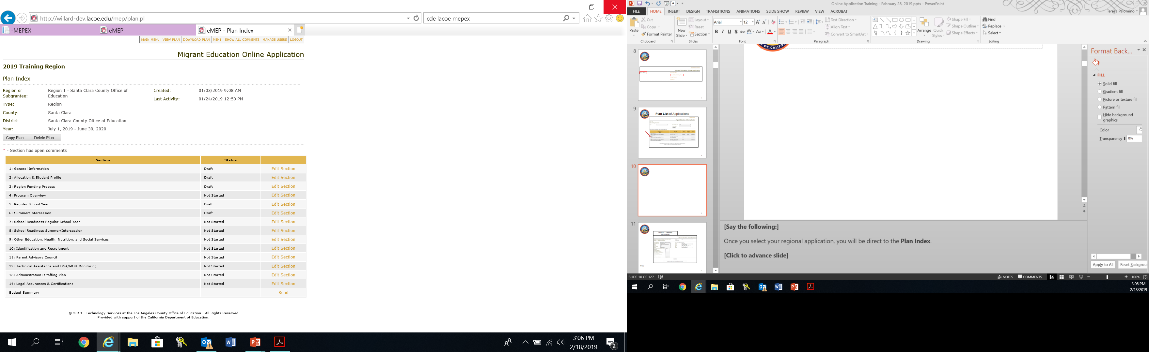
II. Completing a Plan (4)
Plan Index
Notes:
[Say the following:]
As the example shows, there are 14 sections in a application template.
Please Note: For the CMC application, please use the provided CMC Contract to Grant Crosswalk in order to properly complete all sections of the application.
[Click to advance slide]

Slide 25
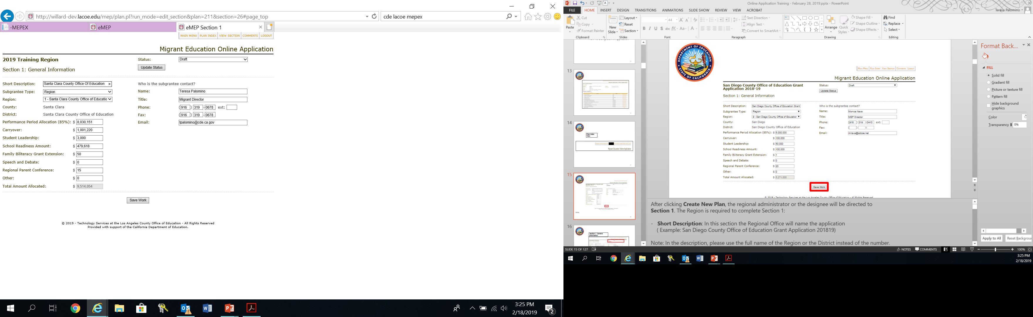

II. Completing a Plan (5)
Section 1: General Information
Rigoberto Elenes
Elenes@sccoe.edu
Notes:
[Say the following:]
Section 1- General Information:
The CMC Central Office, using the CMC Contract to Grant Crosswalk, will complete the following sections for their application.
Short Description: In this section the CMC Central Office will name the application (California Mini-Corps 2020–21).
Note: In the description, please use the LEA’s full name instead of the number.
- Subgrantee Type: In this section the CMC Central Office will select DFD.
Region: In this section the CMC Central Office will select the specific Region that the application is for through the drop down options (Butte County Office of Education).
County: This information is prepopulated by LACOE, (Not applicable to CMC Grant).
District: This information is prepopulated by LACOE, (Not applicable to CMC Grant).
After entering the aforementioned information, the MEO will insert the allocation information under “Other”. The CMC’s exact allocation will be informed by the State Migrant Education Office in the near future.
Under the text “Who is the Sub-grantee Contact”, you will name the CMC Director.
Once the section is fully completed, the CMC user will:
Save Work
Go to Status
Select Complete
Click Update Status
This will complete this section.
Once the section is complete:
Click Plan Index in the top menu in order to navigate to other sections.
[Click to advance slide]

Slide 26
II. Completing a Plan (6)
Notes for Section 1
  The CMC Central Office will be filling out a DFDSA application.
  Funding amounts will be auto-populated by LACOE
  The CMC’s exact allocation will be informed by the MEO in one week.
Notes:
[Say the following:]
To recap, here are some of the main points covered in section 1.
[Read Slide]
[Click to advance slide]

Slide 27
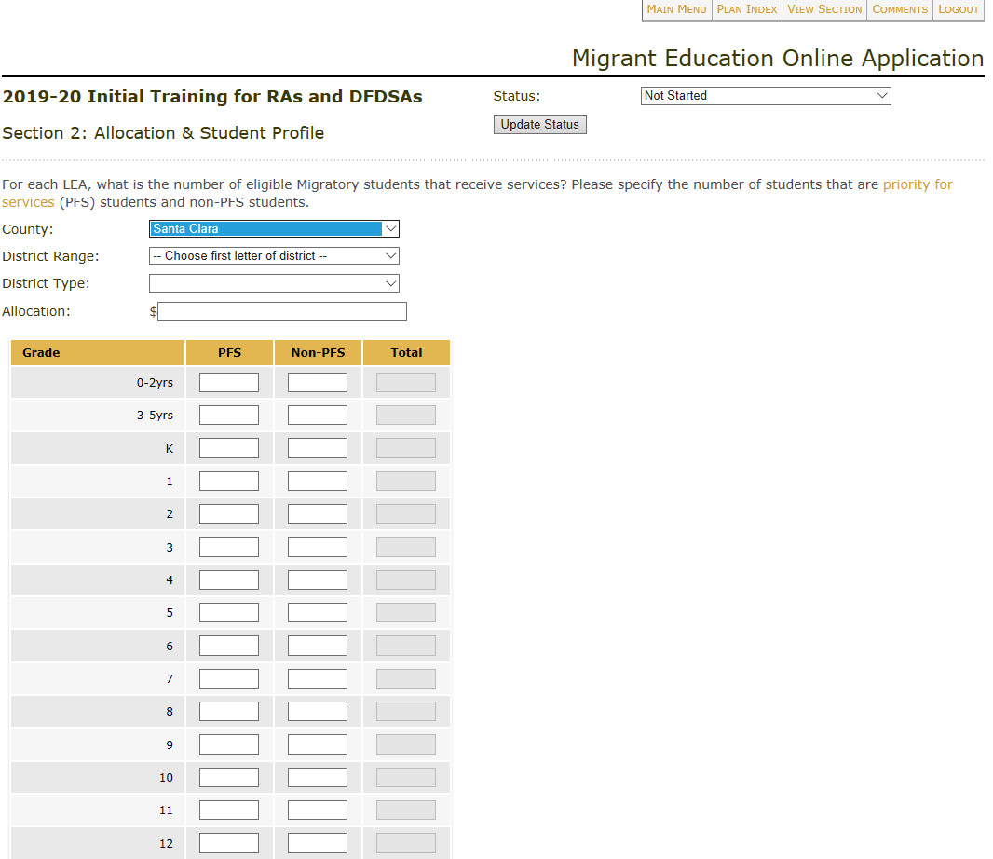
II. Completing a Plan (7)
Section 2: Allocation & Student Profile
Leave this section blank, then:
  Save Work
  Go to Status
  Select Complete
  Click Update Status
Not Applicable
Notes:
[Say the following:]
Section 2: Allocation and Student Profile
This section is specific to RA/DFDSAs and does not apply to the CMC Grant.
Leave this section blank, then:
Save Work
Go to Status
Select Complete
Click Update Status
Once the section is complete:
Click Plan Index in the top menu to navigate to other sections.
[Click to advance slide]

Slide 28
II. Completing a Plan (8)
Notes for Section 2
  This section only applies to RA/DFDSAs.
  Leave this section blank and select complete.
Notes:
[Say the following:]
To recap, here are some of the main points covered in section 2.
[Read Slide]
[Click to advance slide]

Slide 29
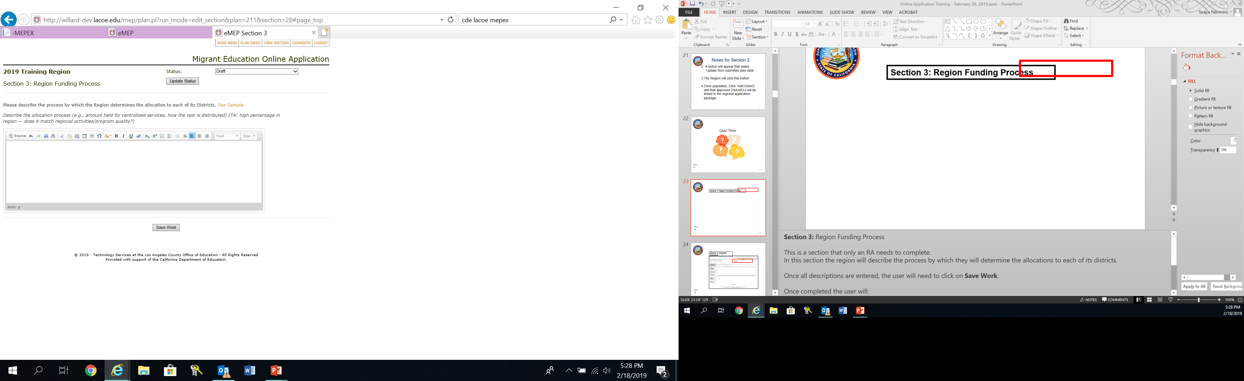
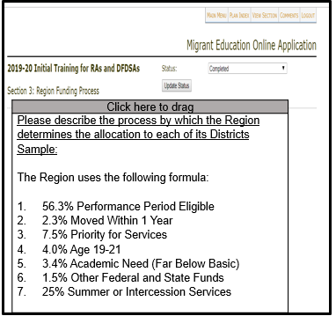
II. Completing a Plan (9)
Section 3: Region Funding Process
Notes:
[Say the following:]
Section 3: Region Funding Process
In this section the CMC Central Office will describe the process by which they allocate tutors within service areas.
Once section is fully completed, the user will:
Save Work
Go to Status
Select Complete
Click Update Status
This will complete this section.
Once the section is complete:
Click Plan Index in the top menu in order to navigate to other sections.
Please Note: starting in section 3, you will see the sample feature link. This feature, when clicked on, will provide an example of the type of information that should be included in that particular section. Please be aware that the sample provided is specific to RA/DFDSA applications. For the CMC Grant, please utilize the provided CMC Contract to Grant Crosswalk.
[Click to advance slide]

Slide 30
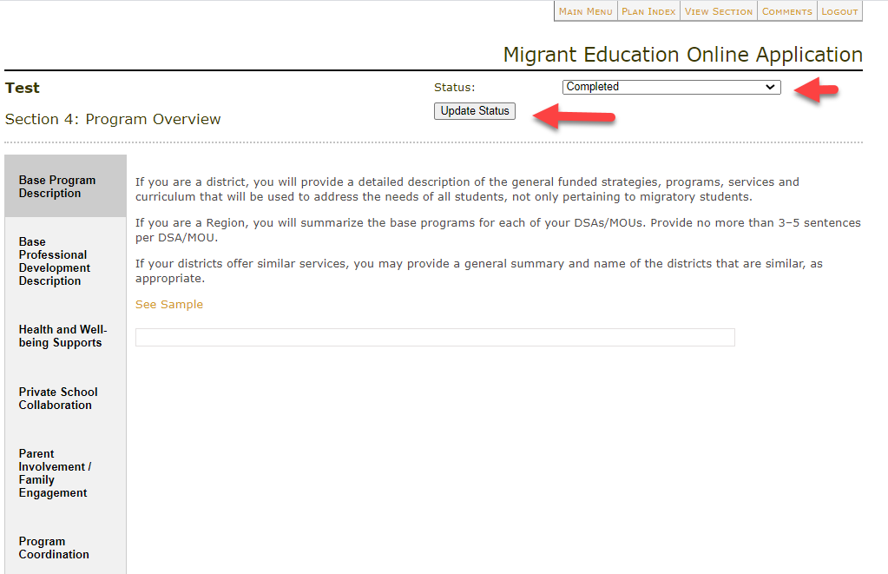
II. Completing a Plan (10)
Section 4: Program Overview
Not Applicable
Notes:
[Say the following:]
Section 4: Program Overview
In this section, there are six tabs that are not applicable to the CMC Grant. The CMC Central Office will change the status to completed and select the update status button.
For reference, the tabs are:
Base Program Description
Base Professional Development Description
Health and Well-Being Supports
Parent Involvement/Family Engagement
5. Private School Collaboration, and
6. Program Coordination
[Click to advance slide]

Slide 31
II. Completing a Plan (11)
Notes for Section 4
Section 4 Program Overview is only completed for RA/DFDSAs.
For CMC Grant, the CMC Central Office will change the status to completed and select the update status button.
Notes:
[Say the following:]
To recap, here are some of the main points covered in section 4.
[Read Slide]
[Click to advance slide]

Slide 32

Questions?
Notes:
[Say the following:]
At this point we can take any questions. Please use the raise your hand feature in Zoom so that I may unmute you.
[Say the following:]
I will now continue in discussing how to complete section 5.
[Click to advance slide]

Slide 33
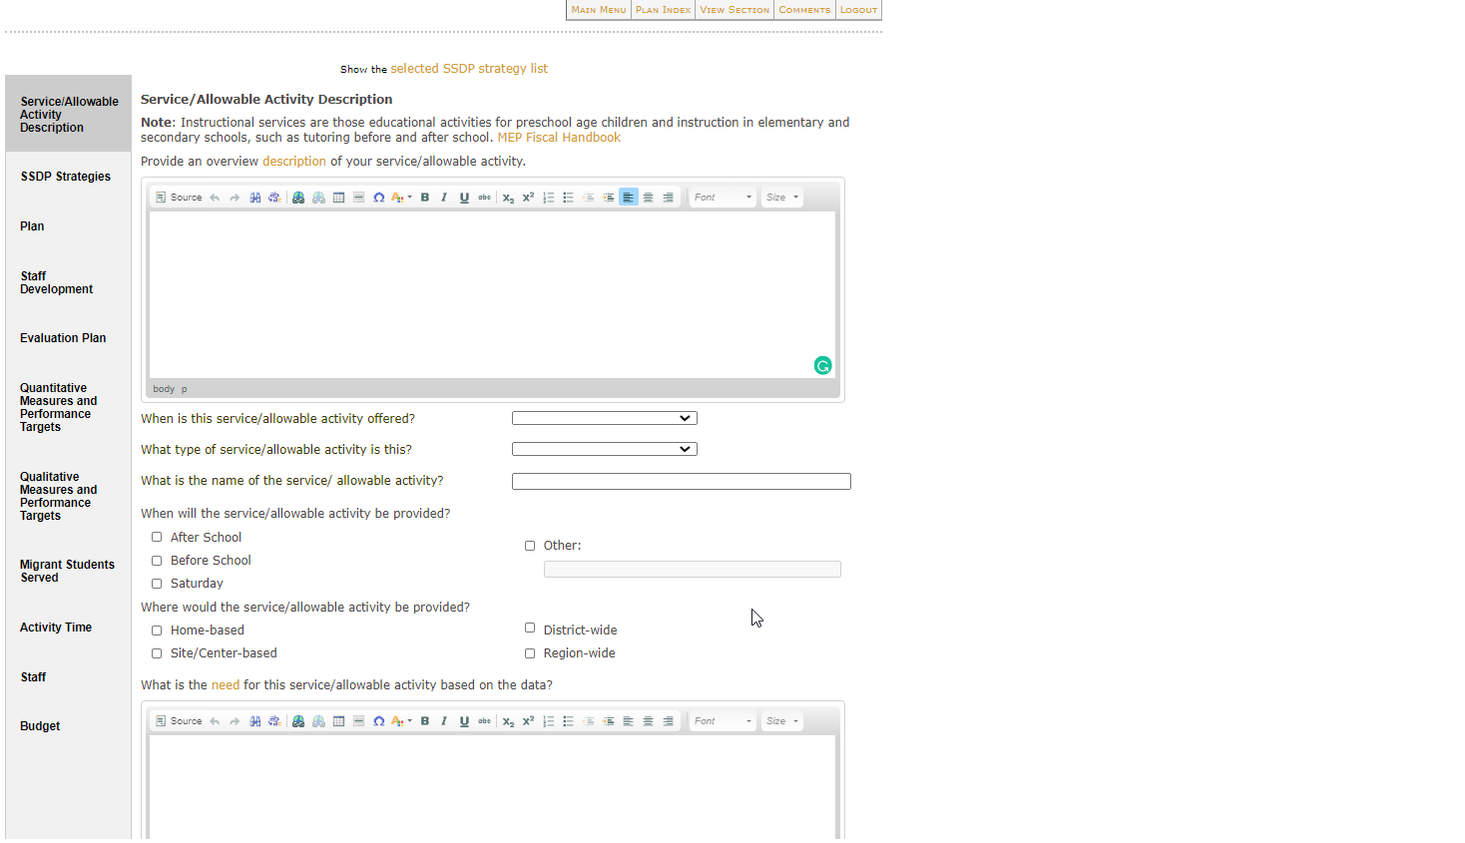
II. Completing a Plan (12)
Section 5: Regular School Year
Notes:
[Say the following:]
Section 5- Regular School Year: This section applies to all CMC programs that take place during the regular school year.
For each service/activity, there are 11 tabs where the user will provide information as directed in the CMC Contract to Grant Crosswalk.
Services/Allowable Activity Description
SSDP Strategies
Plan
Staff Development
Evaluation Plan
Quantitative Measures and Performance Targets
Qualitative Measures and Performance Targets
Migrant Students Served
Activity Time
Staff
Budget
[Click to advance slide]

Slide 34
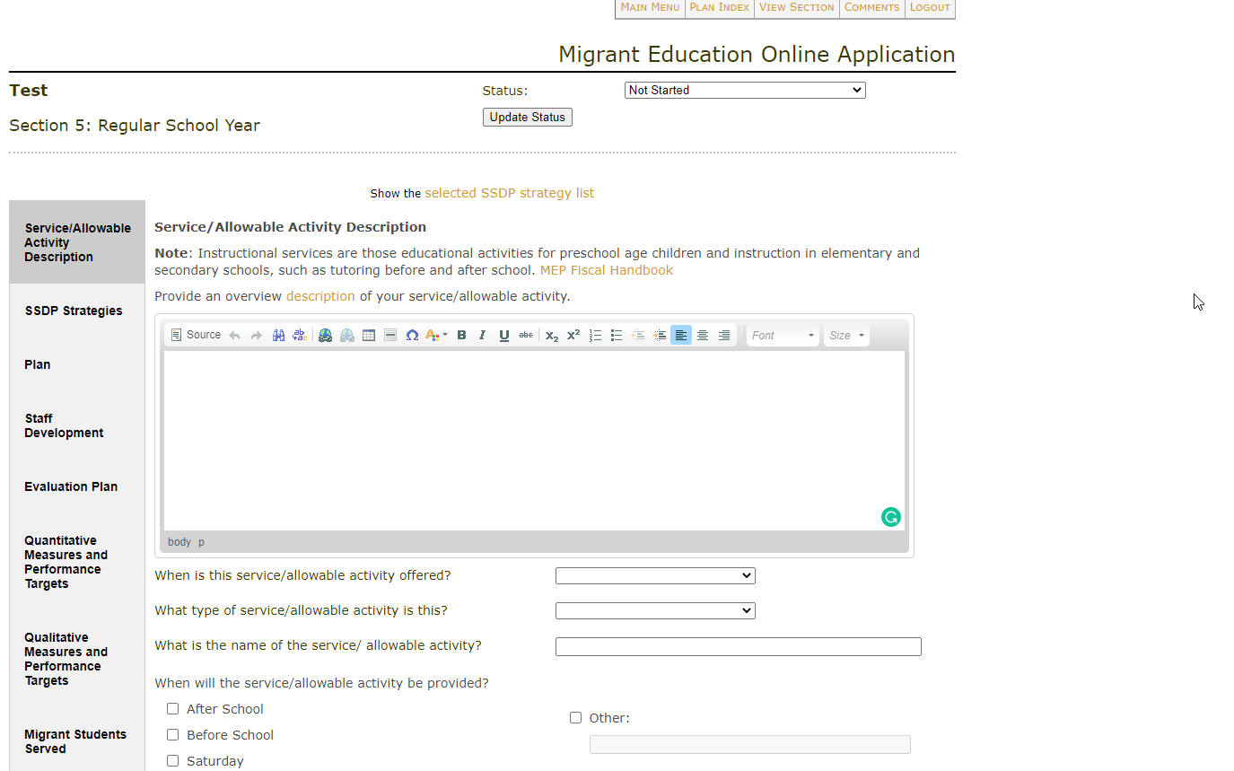
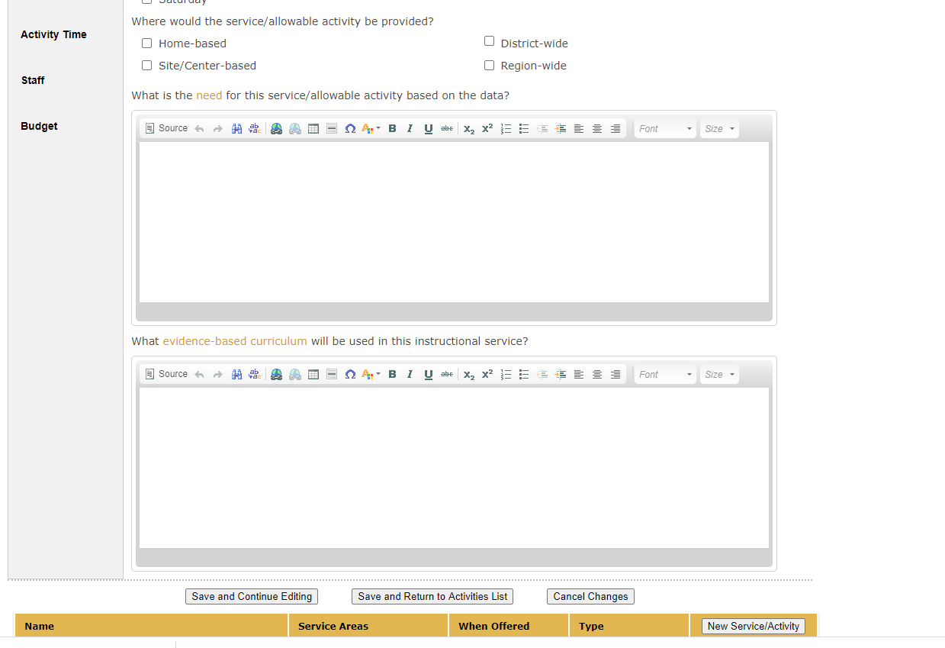
II. Completing a Plan (13)
Section 5: Regular School Year - Service/Allowable Activity Description
Notes:
[Say the following:]
Section 5: Regular School Year
Services/Allowable Activity Description:
This tab is comprised of eight required sections. Please follow the directions provided in the CMC Contract to Grant Crosswalk. At this moment please share with us what the Grant Crosswalk says about this section using the annotation in Zoom.
Once tab is completed, the user will:
Save Work
And Select Next Tab
[Click to advance slide]

Slide 35
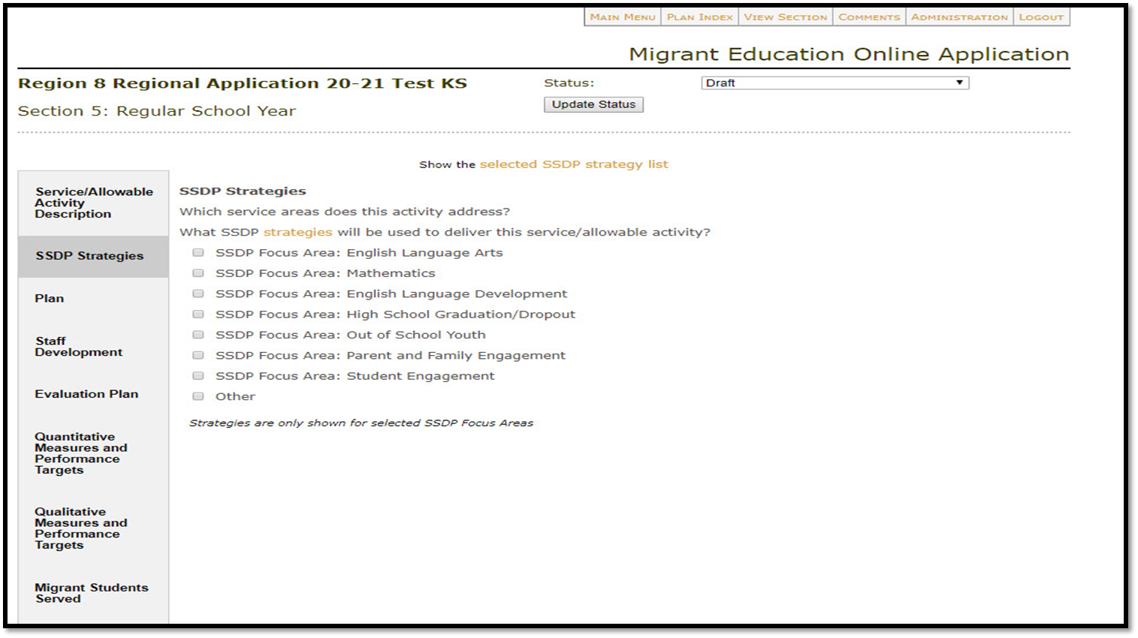
II. Completing a Plan (14)
Section 5: Regular School Year – SSDP Strategies
Leave blank
Not applicable
Notes:
[Say the following:]
Section 5: Regular School Year
SSDP Strategies:
Within this tab, the user will find all the SSDP Focus Areas. This feature was previously located under the “Service/Allowable Activity Description” Tab.
For the CMC Grant, please leave this section blank, then select:
Save Work
And Select Next Tab
[Click to advance slide]

Slide 36
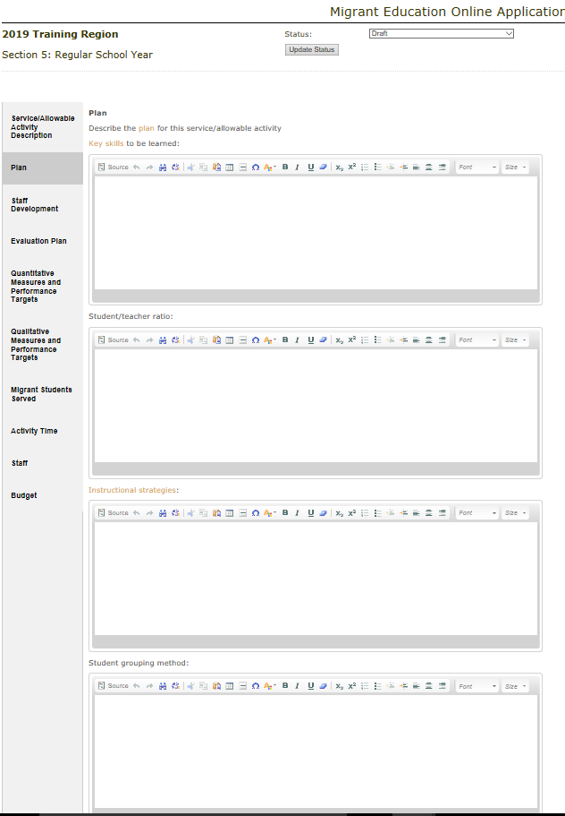
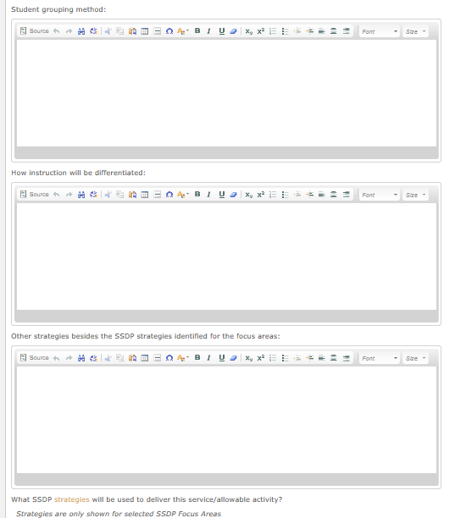
II. Completing a Plan (15)
Section 5: Regular School Year - Plan
Notes:
[Say the following:]
Section 5: Regular School Year
Plan:
In this tab the CMC Central Office will provide a detailed description of the program. Using the CMC Contract to Grant Crosswalk, please address the following questions:
Key skills to be learned
Student/teacher ratio
Instructional strategies
Student grouping method
How instruction will be differentiated
Other strategies besides the SSDP strategies identified for the focus areas (when you select one or more focus areas on the first tab, the relevant SSDP strategies will pop up in this section.
What SSDP strategies will be used to deliver this service/allowable activity
Let’s do a quick practice. Please review the Grant Crosswalk. What will you begin to enter? Please use the annotation feature in zoom.
Once tab is completed, the user will:
Save Work
And Select Next Tab
[Click to advance slide]

Slide 37
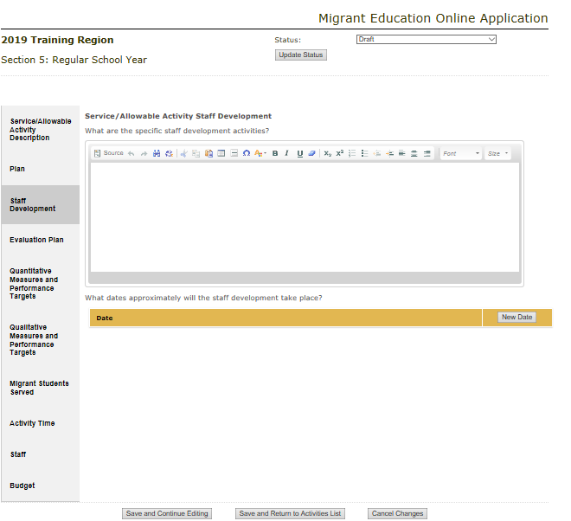
II. Completing a Plan (16)
Section 5: Regular School Year - Staff Development
Notes:
[Say the following:]
Section 5: Regular School Year
Staff Development:
In this tab the CMC Central Office, using the CMC Contract to Grant Crosswalk, will provide a detailed description of the specific staff development activities and the estimated dates.
Once the field is completed, the user will:
Save Work
And Select Next Tab
[Click to advance slide]

Slide 38
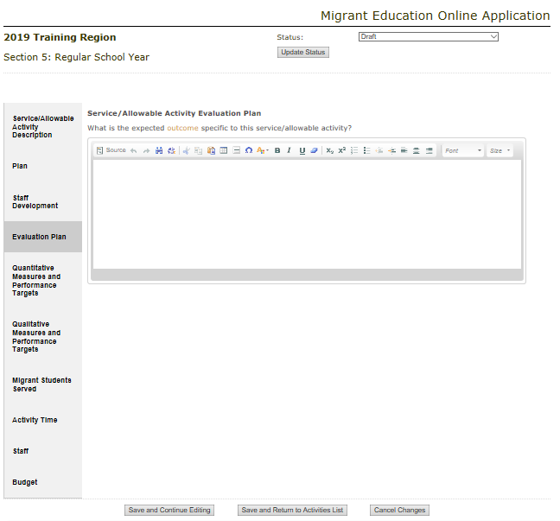
II. Completing a Plan (17)
Section 5: Regular School Year - Evaluation Plan
Notes:
[Say the following:]
Section 5: Regular School Year
Evaluation Plan:
In this tab, the CMC Central Office, using the CMC Contract to Grant Crosswalk, will identify the expected outcomes specific to the activity.
Once tab is completed, the user will:
Save Work
And Select Next Tab
[Click to advance slide]

Slide 39
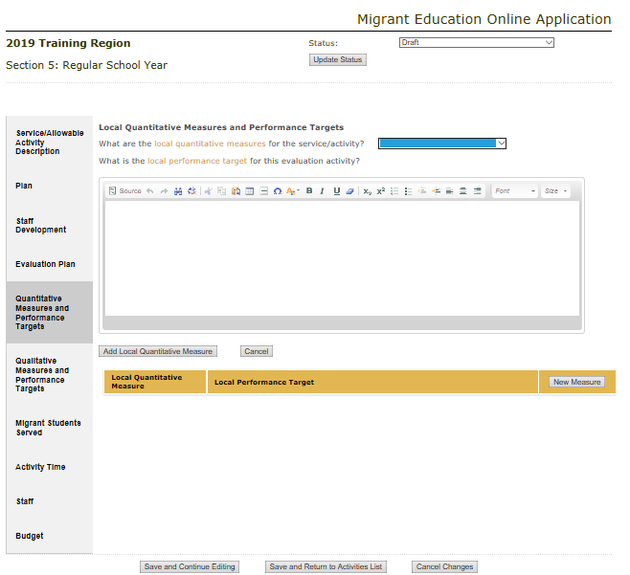
II. Completing a Plan (18)
Section 5: Regular School Year - Quantitative Measures and Performance Targets
Notes:
[Say the following:]
Section 5: Regular School Year
Quantitative Measures and Local Performance Targets:
In this tab the CMC Central Office, using the CMC Contract to Grant Crosswalk, will provide the information for the local performance target and how they will be measured. Quantitative data is data that can be numerically counted or expressed. We expect to see quantitative measures, in most cases, pre/posttests, for all student achievement areas such as ELA; math; Science, Technology, Engineering and Math; etc.
The local quantitative measure is the tool you are going to use to evaluate student learning (i.e., pre/posttest). The local performance target identifies the improvement you are aiming for.
For example: By the end of this service, 80 percent of migratory students will increase achievement by 15 percent from pre- to posttest.
Once tab is completed, the user will:
Save Work
And Select Next Tab
[Click to advance slide]

Slide 40
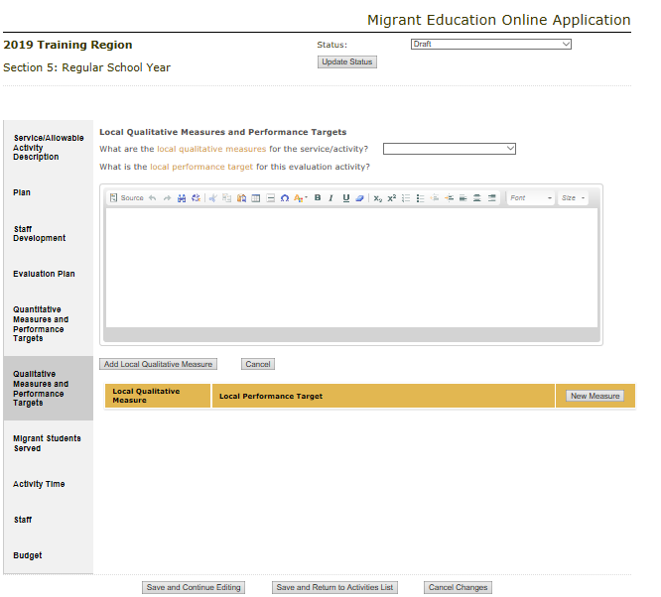
II. Completing a Plan (19)
Section 5: Regular School Year -Qualitative Measures and Performance Targets
Notes:
[Say the following:]
Section 5: Regular School Year
Qualitative Measures and Local Performance Targets:
In this tab, the CMC Central Office, using the CMC Contract to Grant Crosswalk, may provide the information for the local performance target and how student achievement will be measured.
Unlike quantitative data, qualitative data cannot be numerically counted. This type of data describes characteristics, attributes, or qualities of something. A common qualitative data collection method is the use of surveys that ask people to respond to various items.
Please Note: For the CMC Grant, this tab is not required and may type N/A.
Once tab is completed, the user will:
Save Work
And Select Next Tab
[Click to advance slide]

Slide 41
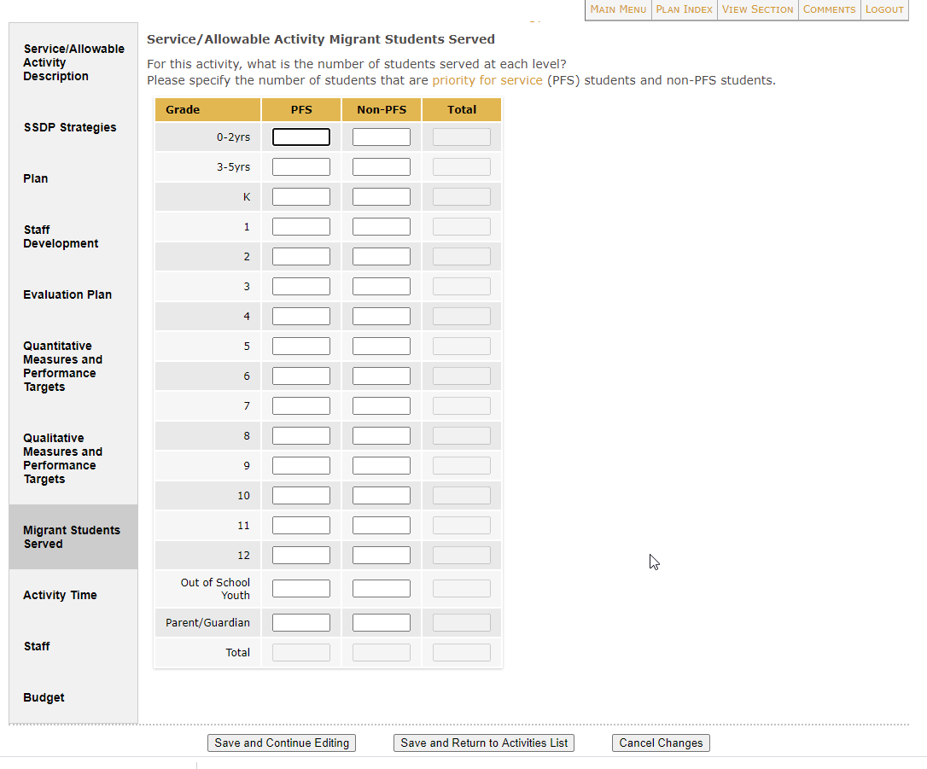
II. Completing a Plan (20)
Section 5: Regular School Year - Migrant Students Served
Notes:
[Say the following:]
Section 5: Regular School Year
Migrant Students Served:
In this tab, the CMC Central Office, using the CMC Contract to Grant Crosswalk, will provide the information on the number of Priority For Services (PFS) and Non-PFS students that you are proposing to serve by this service/allowable activity only.
Once tab is completed, the user will:
Save Work
And Select Next Tab
[Click to advance slide]

Slide 42
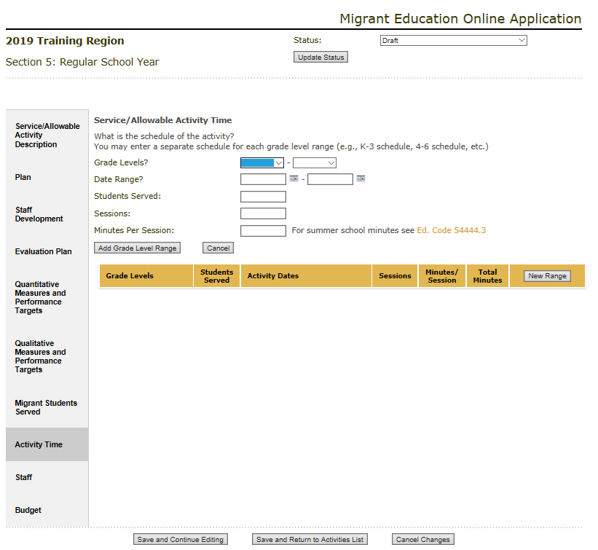
II. Completing a Plan (21)
Section 5: Regular School Year – Activity Time
Notes:
[Say the following:]
Section 5: Regular School Year
Activity Time:
In this tab, the CMC Central Office, using the CMC Contract to Grant Crosswalk, will provide all information pertaining to the activity time, including:
Grade Levels (please be sure this matches the total in the Migrant Students Served tab)
Date Range
Students Served (please be sure this matches the total in the Migrant Students Served tab)
Sessions
Minutes per Session
Total Minutes
Once tab is completed, the user will:
Save Work
And Select Next Tab
[Click to advance slide]

Slide 43
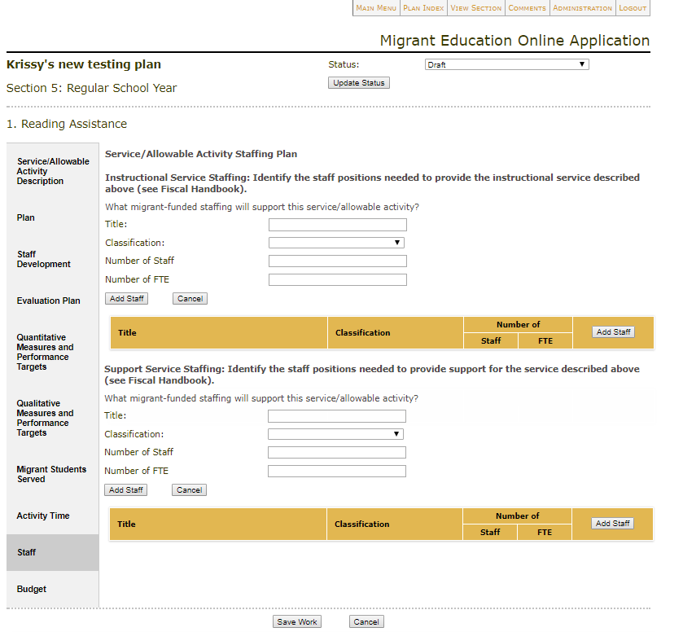
II. Completing a Plan (22)
Section 5: Regular School Year - Staff
Notes:
[Say the following:]
Section 5: Regular School Year
Staff:
In this tab, the CMC Central Office, using the CMC Contract to Grant Crosswalk, will provide information pertaining to all Instructional and Support Staff as two separate areas. Each area needs to be entered independently.
Required information includes:
Title
Classification
Number of Staff
Number of Full Time Equivalent (FTE)
Please Note: CMC tutors are considered support staff, as they do not yet possess a certificated teaching credential. CMC Coordinators are partly considered instructional staff. Part of their FTE will be under administration (section 13 of the application) and the other as instructional.
Once tab is completed, the user will:
Save Work
And Select Next Tab
[Click to advance slide]

Slide 44
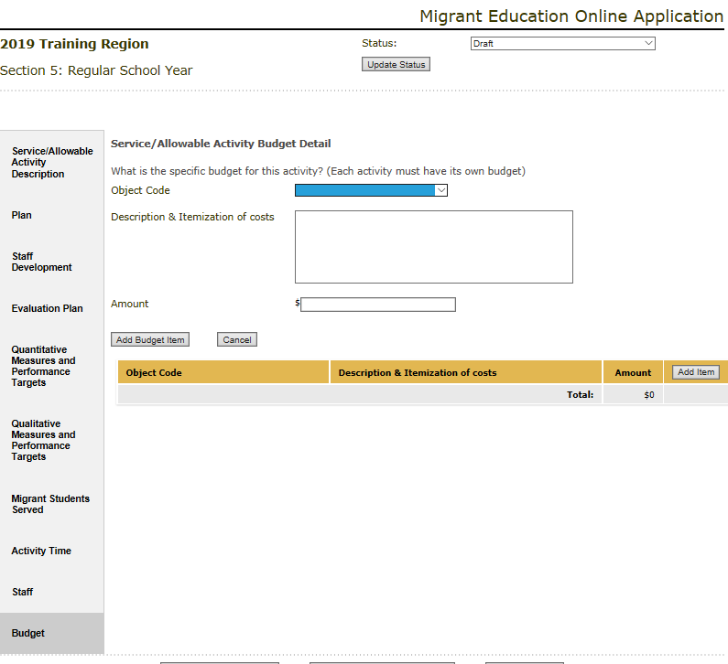
II. Completing a Plan (23)
Section 5: Regular School Year - Budget
Notes:
[Say the following:]
Section 5: Regular School Year
Budget:
In this tab, the CMC Central Office, using the CMC Contract to Grant Crosswalk, will enter a detailed account of all budget items that apply to the service/allowable activity description.
For each budget item, the user will select the Add Item button to create the fields for the Object Code dropdown menu, the Description & Itemization of Costs textbox and the total budget dollar Amount for each service/allowable activity.
Then the user will click Add Budget Item and the information of the budget item will be saved below the yellow bar. To add another budget item, the user will click Add Item. The process then starts again.
Please Note:
Include all service PD connected to Indoor tutoring, such as the Summer Indoor Institute and Monthly Tutor Meetings.
Administrative expenses are inputted in the Administration section of the application (section 13).
Once the tab is completed, click on Save Work.
Once saved, the Service/Activity will appear in the table of activities in Section 5.
Once section is complete:
Go to Status
Select Complete
Click Update Status
This will complete this section.
Once the section is complete:
Click Plan Index in the top menu to navigate to other sections.
[Click to advance slide]

Slide 45
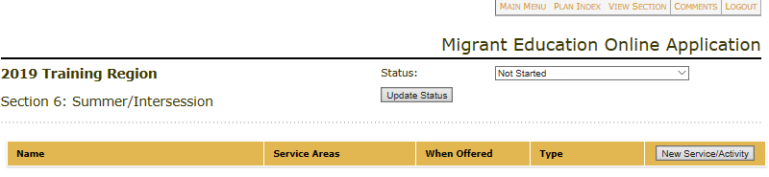
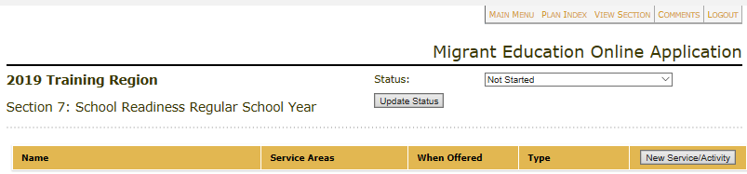
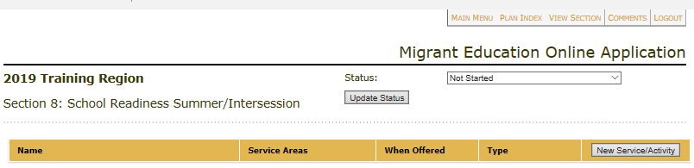
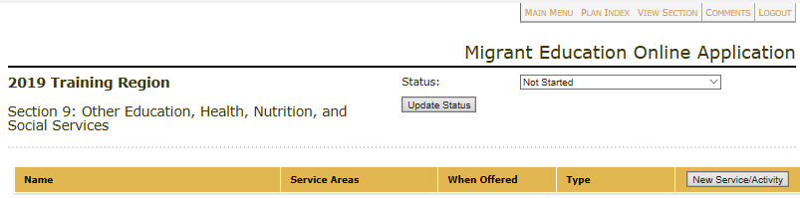
II. Completing a Plan (24)
Section 6: Summer/Intersession
Follow the directions listed for Section 5, using the CMC Contract to Grant Crosswalk.
Leave the following sections blank and mark the status as completed:
Section 7: School Readiness Regular School Year
Section 8: School Readiness Summer/ Intersession
Section 9: Other Education, Health, Nutrition and Social Services
Notes:
[Say the following:]
For sections 5 and 6 (Summer/Intersession), the service/activity entry format and directions remains the same. For Sections 7 through 9, leave these sections blank and just mark the status as completed.
[Click to advance slide]

Slide 46
II. Completing a Plan (25)
Notes for Sections 5–6
For Regular School Year (Section 5), please create one service for the following program.
  Regular School Year—Indoor Tutoring
For Summer (Section 6), please create one service for each of the following programs.
  Summer School—Indoor Tutoring
  Outdoor Education
  Summer Puppetry
Notes:
[Say the following:]
To recap some of the main points covered in section 5 and 6.
[Read Slide]
[Click to advance slide]

Slide 47
II. Completing a Plan (26)
Notes for Sections 7–11
Leave the sections blank and mark the status as completed.
Please refer to the CMC Contract to Grant Crosswalk for more information.
Notes:
[Read Slide]
[Click to advance slide]

Slide 48
Questions?
Notes:
[Say the following:]
At this point we can take any questions. Please use the raise your hand feature in Zoom so that I may unmute you.
[Click to advance slide]

Slide 49

15 Minute Break
Notes:
Break
(15 minutes)

Slide 50

Quiz Time!
True or False?
The CMC Indoor Tutoring Program for Regular School Year and Summer should be entered as one service under Regular School Year?
Notes:
[Say the following:]
Now that we had a chance to stretch, it’s Quiz Time!
Using the poll features in Zoom, please answer the following question, [Read Question].
Answer: False. The CMC Indoor Tutoring Program for Regular School Year should be included within Section 5 and the Summer Indoor Tutoring Program in Section 6.
[Click to advance slide]

Slide 51
Quiz Time! (2)
True or False?
The CMC Central Office should leave blank and mark complete the following sections in the online application:
Section 7: School Readiness-RSY
Section 8: School Readiness-Summer
Section 9: Other Education
Section 10: Identification and Recruitment
Section 11: Parent Advisory Council
Notes:
[Say the following:]
Next question, using the poll features in Zoom, please answer the following question, [Read Question].
Answer: True! The CMC Central Office should leave blank and mark complete sections 7 through 11, as those sections apply to RA/DFDSAs.
[Click to advance slide]

Slide 52
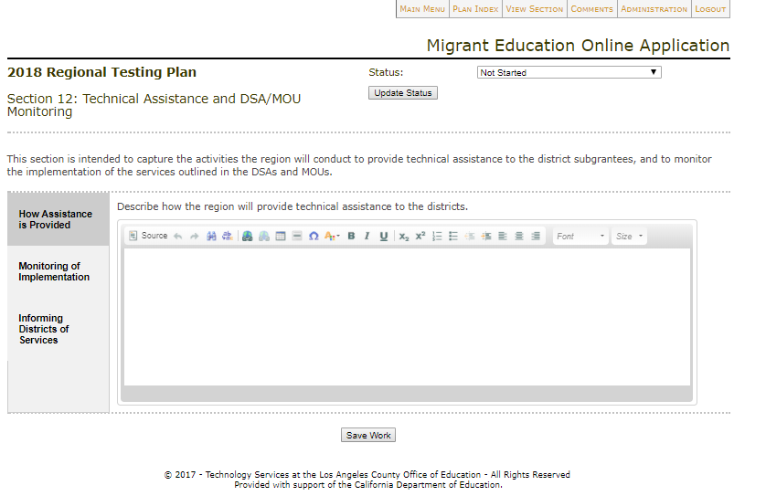
II. Completing a Plan (27)
Section 12: Technical Assistance and DSA/MOU Monitoring
Notes:
[Say the following:]
Now we will move on to Section 12.
Section 12: Technical Assistance and DSA/MOU Monitoring
This section is comprised of the following three tabs.
How Assistance is Provided
Monitoring of Implementation
Informing Districts of Services
[Click to advance slide]

Slide 53
II. Completing a Plan (28)
Section 12: TA and DSA/MOU Monitoring – How Assistance is Provided
Notes:
[Say the following:]
Section 12: Technical Assistance and DSA/MOU Monitoring
How Assistance is Provided:
In this tab, the CMC Central Office, using the CMC Contract to Grant Crosswalk, will provide a detailed description on how they will provide technical assistance to:
CMC Coordinators, such as Ad Hoc Meetings.
Quarterly Business Meetings.
Site monitoring visits.
Once tab is completed, the user will:
Save Work
And Select Next Tab
[Click to advance slide]

Slide 54
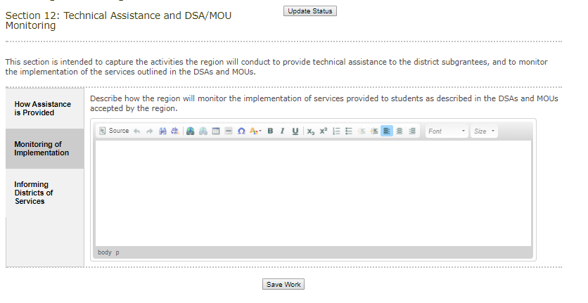
II. Completing a Plan (29)
Section 12: TA and DSA/MOU Monitoring – Monitoring of Implementation
Notes:
[Say the following:]
Section 12: Technical Assistance and DSA/MOU Monitoring
Monitoring of Implementation:
In this tab, the CMC Central Office, using the CMC Contract to Grant Crosswalk, will provide a detailed description of how they will monitor the implementation of services as described in the services.
Once tab is completed, the user will:
Save Work
And Select Next Tab
[Click to advance slide]

Slide 55
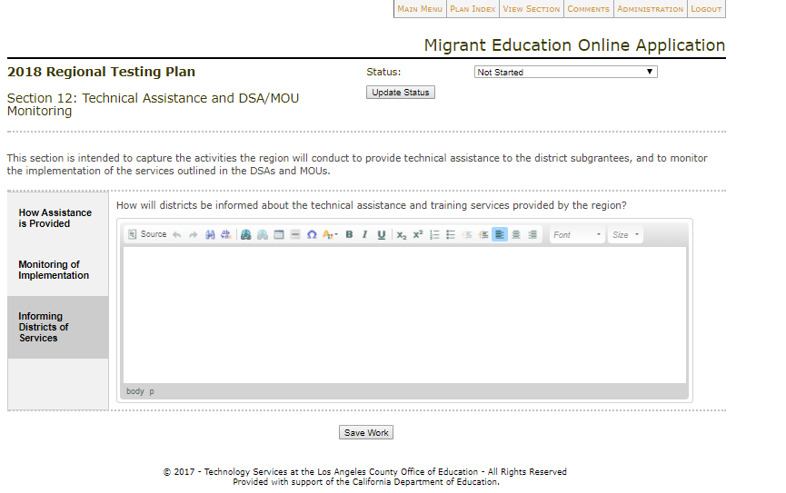
II. Completing a Plan (30)
Section 12: TA and DSA/MOU Monitoring – Informing Districts of Services
Notes:
[Say the following:]
Section 12: Technical Assistance and DSA/MOU Monitoring
Informing Districts of Services:
In this tab, the CMC Central Office, using the CMC Contract to Grant Crosswalk, will describe in detail how technical assistance is provided to IHEs and districts of the services CMC provides.
Once tab is completed, the user will:
Save Work
Once section is complete:
Go to Status
Select Complete
Click Update Status
This will complete this section.
Once the section is complete:
Click Plan Index in the top menu to navigate to other sections.
[Click to advance slide]

Slide 56
II. Completing a Plan (31)
Notes for Section 12
Please refer to the CMC Contract to Grant Crosswalk for more information in completing this section 12.
Notes:
[Say the following:]
To recap some of the main points covered in section 12.
[Read Slide]
[Click to advance slide]

Slide 57
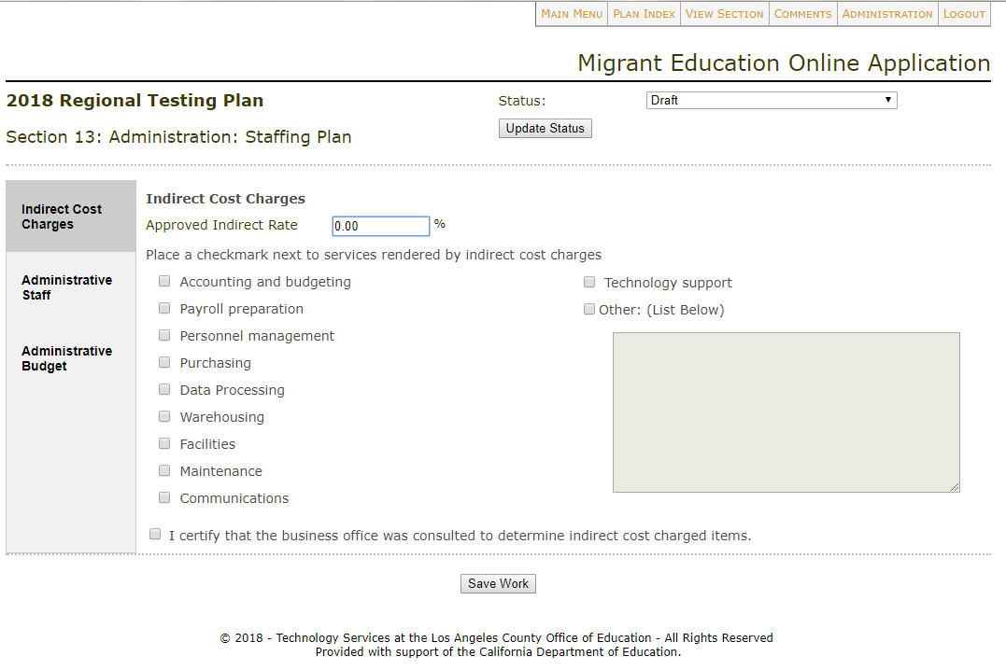
II. Completing a Plan (32)
Section 13: Administration: Staff Planning
Notes:
[Say the following:]
Section 13: Administration: Staff Planning
In this section, the CMC Central Office, using the CMC Contract to Grant Crosswalk, will address each of the three tabs in the following manner:
Indirective Cost Charges
Administrative Staff
Administrative Budget
[Click to advance slide]

Slide 58
II. Completing a Plan (33)
Section 13: Administration: Staff Planning – Indirect Cost Charges
Notes:
[Say the following:]
Section 13: Administration: Staff Planning
Indirect Cost Charges:
In this tab, provide the approved Indirect Rate and select the services to be rendered by the indirect charges.
For the “Approved Indirect Rate”, please consult your local fiscal department to obtain the approved indirect cost rate. The CDE annually provides the approved indirect cost rate for federal and state programs to each County Chief Business Officer. Additional information may be found on the CDE Indirect Cost Rate web page at https://www.cde.ca.gov/fg/ac/ic/.
Once tab is completed, the user will:
Save Work
And Select Next Tab
[Click to advance slide]

Slide 59
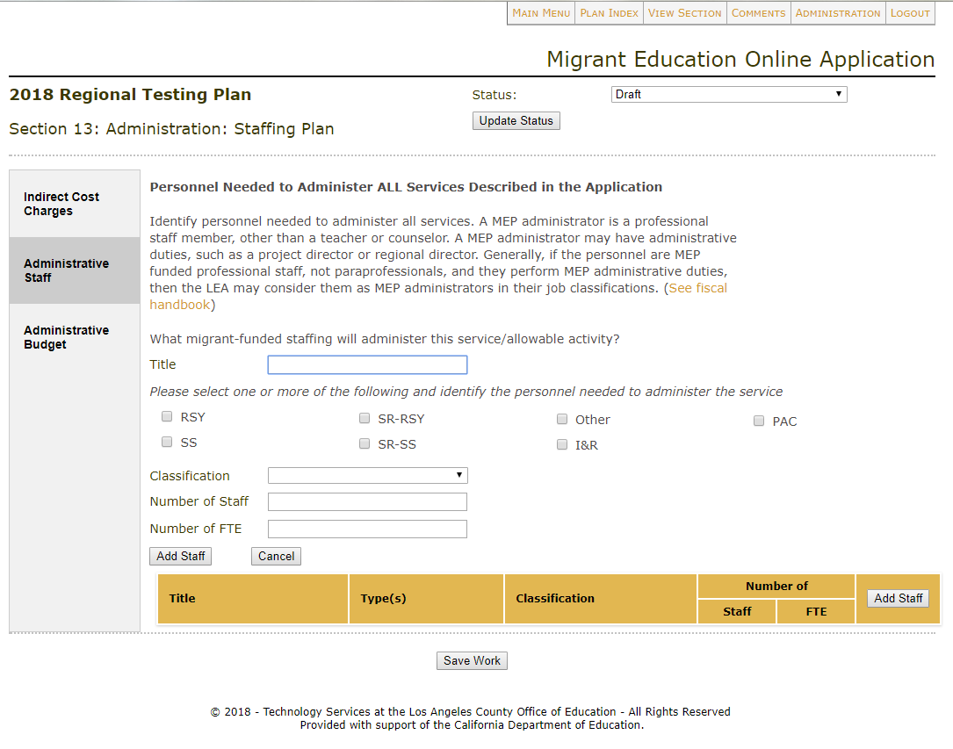
II. Completing a Plan (34)
Section 13: Administration: Staff Planning – Administrative Staff
Notes:
[Say the following:]
Section 13: Administration: Staff Planning
Administrative Staff:
In this tab, provide administrative staffing information, such as CMC Central Office Administration, Office Assistants, and CMC Coordinators.
The user will select the Add Staff button to enter the required information for the position such as: Title, Program(s), Classification, Number of staff, and Number of FTE. This step is then repeated as needed.
Once tab is completed, the user will:
Save Work
And Select Next Tab
[Click to advance slide]

Slide 60
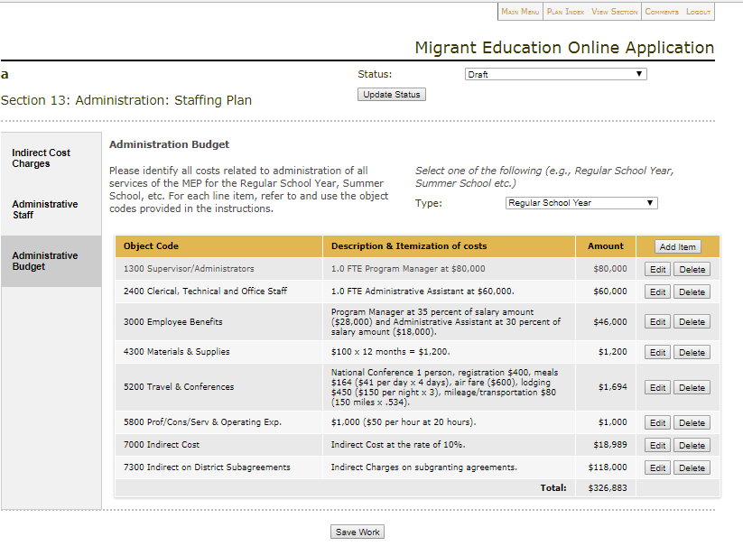
II. Completing a Plan (35)
Section 13: Administration: Staff Planning – Administrative Budget
Notes:
[Say the following:]
Section 13: Administration: Staff Planning
Administrative Budget:
In this tab, enter the costs related to administration of all services and allowable activities.
The user will select first the Program Type, then Object Code; enter a Budget Description and a Budget Amount.
The description must be of a specific and sufficient detail to clearly identify all of the costs associated with a budget item and include, but not limited to, the following examples:
Object code 1300 – 1.0 FTE CMC Coordinator at $80,000. Or, annual salary of $100,000 x .75 FTE equal $75,000.
Object code 2400 – 1.0 FTE Office Assistant at $60,000.
Object code 3000 – Employee benefits: Program Manager at 35 percent of salary amount ($28,000) and Administrative Assistant at 30 percent of salary amount ($18,000).
Object code 4300 – Materials and supplies (pens, pencils, notepads, markers) $100 x 12 months = $1,200.
Object code 5200 – National Conference 1 person, registration $400, meals $164 ($41 per day x 4 days), air fare ($600), lodging $450 ($150 per night x 3), mileage/transportation $80 (150 miles x .534).
Object code 5800 – Consultant, staff professional development $1,000 ($50 per hour at 20 hours).
Please Note: Please include all Professional Development/Consulting Contracts for related CMC services under object code 5800.
For example:
RSY—Cityspan Database Enhancements/Maintenance.
RSY—Public Profit Annual Report Development
RSY—WestEd ELA Literacy Trainings and Assessment.
Indirect costs by Program Type are entered here under Object Code 7000.
For additional guidance on what constitutes an administrative cost, see the MEP Fiscal Handbook on the CDE Migrant Program Funding web page at https://www.cde.ca.gov/sp/me/mt/meofiscalhndbk15.pdf.
Once the tab is completed, click on Save Work.
Once section is complete:
Go to Status
Select Complete
Click Update Status
This will complete this section.
Once the section is complete:
Click Plan Index in the top menu to navigate to other sections.
[Click to advance slide]

Slide 61
II. Completing a Plan (36)
Notes for Section 13
For the “Approved Indirect Rate”, please consult your local fiscal department to obtain the indirect rate.
Please include all Professional Development/Consulting Contracts for related CMC services under Object Code 5800.
Indirect costs are entered by Program Type (e.g., Regular School Year) under Object Code 7000.
Notes:
[Say the following:]
To recap, here are some of the main points covered in section 13.
[Read Slide]
[Click to advance slide]

Slide 62
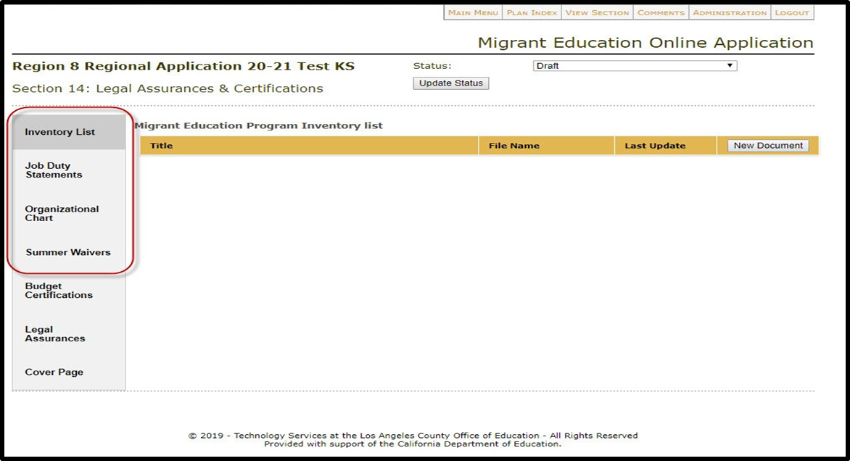
II. Completing a Plan (37)
Section 14: Legal Assurances & Certifications
Notes:
[Say the following:]
Section 14: Legal Assurances & Certifications
In this section, the CMC Central Office, using the CMC Contract to Grant Crosswalk, will have seven tabs to address:
Inventory List
Job Duty Statements
Organizational Chart
Summer Waivers
Budget Certifications (ME-1)
Legal Assurances
Cover Page
[Click to advance slide]

Slide 63
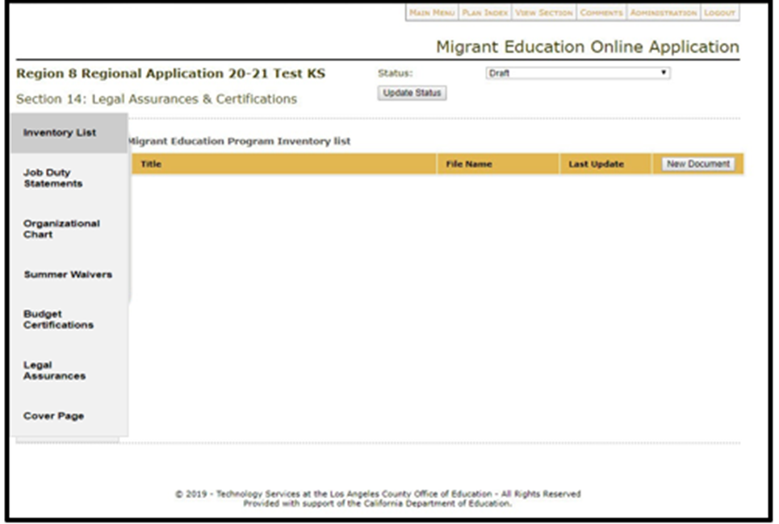
II. Completing a Plan (38)
Section 14: Legal Assurances & Certifications – Inventory List
Notes:
[Say the following:]
Section 14: Legal Assurances & Certifications
Inventory List:
In this tab, upload the program inventory if CMC Grant funds were used for the purchases. This inventory list should also include the subgrantee’s vehicle inventory list and migrant data device inventory list. This helps consolidate multiple lists into one.
Once tab is completed, the user will:
Save Work
And Select Next Tab
[Click to advance slide]

Slide 64
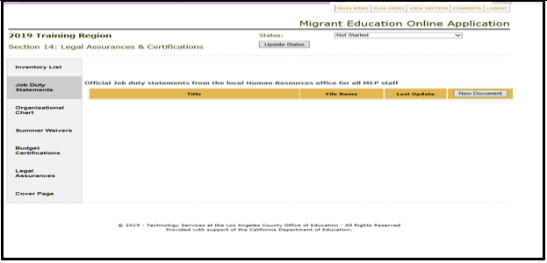
II. Completing a Plan (39)
Section 14: Legal Assurances & Certifications – Job Duty Statements
Notes:
[Say the following:]
Section 14: Legal Assurances & Certifications
Job Duty Statements:
In this tab, upload job duty statements from the local Human Resources for all CMC Grant funded staff for the current fiscal year.
Once tab is completed, the user will:
Save Work
And Select Next Tab
[Click to advance slide]

Slide 65
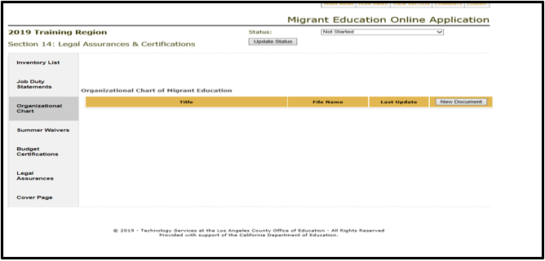
II. Completing a Plan (40)
Section 14: Legal Assurances & Certifications – Organizational Chart
Notes:
[Say the following:]
Section 14: Legal Assurances & Certifications
Organizational Chart:
In this tab, upload the organizational charts for all CMC Grant funded personnel, including names and titles.
Once tab is completed, the user will:
Save Work
And Select Next Tab
[Click to advance slide]

Slide 66
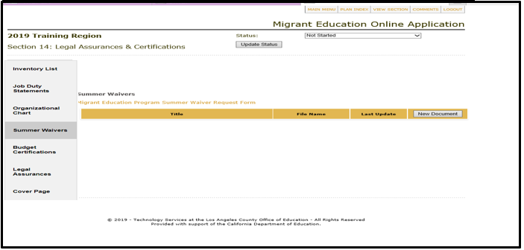

II. Completing a Plan (41)
Section 14: Legal Assurances & Certifications – Summer Waivers
Notes:
[Say the following:]
Section 14: Legal Assurances & Certifications
Summer Waivers:
In this tab, type N/A, as this tab is specific to RA/DFDSAs.
Afterwards:
Save Work
And Select Next Tab
[Click to advance slide]

Slide 67
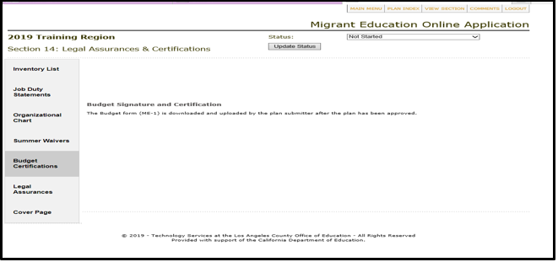
II. Completing a Plan (42)
Section 14: Legal Assurances & Certifications – Budget Certifications
Notes:
Section 14: Legal Assurances & Certifications
Budget Certifications: (ME-1)
Once the application is approved, an email with the link to the Plan Index will be sent to the plan submitter. The submitter needs to take the following actions:
[Say the following:]
For the CMC application, the submitter needs to download the ME-1, sign and upload the signed ME-1 as directed in the email.
Once tab is completed, the user will:
Save Work
And Select Next Tab
[Click to advance slide]

Slide 68
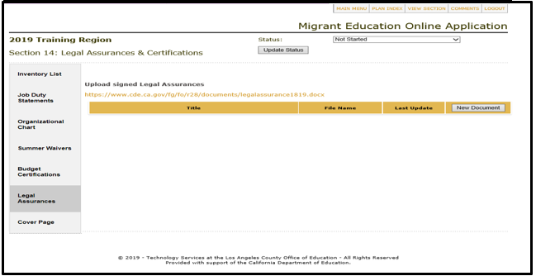
II. Completing a Plan (43)
Section 14: Legal Assurances & Certifications – Legal Assurances
Notes:
[Say the following:]
Section 14: Legal Assurances & Certifications
Legal Assurances:
In this tab, upload two sets of signed copies of legal assurances, including the CDE Legal Assurances and the MEP Legal Assurances. Please include the complete package of the legal assurances.
In prior years, the Legal Assurances had to be signed and uploaded prior to the grant application submission. However in the 2020—21 grant application, the Legal Assurances process is now being moved to be completed after the approval of the application.
The latest Legal Assurances are provided on the CDE Migrant Education Request for Applications web page and can be downloaded via the hyperlink in orange color.
Once tab is completed, the user will:
Save Work
And Select Next Tab
[Click to advance slide]

Slide 69
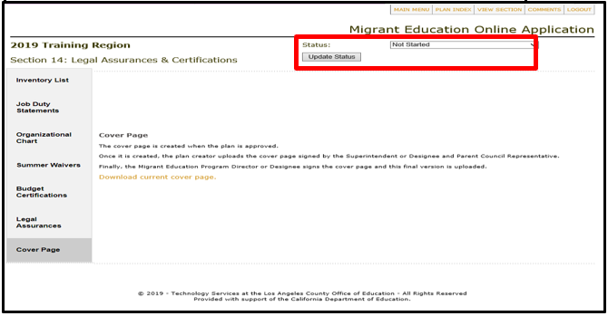
II. Completing a Plan (44)
Section 14: Legal Assurances & Certifications – Cover Page
Notes:
[Say the following:]
Section 14: Legal Assurances & Certifications
Cover Page:
Once the application is approved, an email with the link to the Cover Page will be sent to the plan submitter. The submitter needs to take the following actions:
For the CMC application, please sign the Cover Page and upload the signed copy as directed in the email. The application package is then considered complete.
Once section is complete:
Go to Status
Select Complete
Click Update Status
This will complete this section.
Once the section is complete:
Click Plan Index in the top menu to navigate to other sections.
[Click to advance slide]

Slide 70
II. Completing a Plan (45)
Notes for Section 14
For the CMC application, after the signed Cover Page and the signed ME-1 are uploaded, the hard copy of the two pages identified below will be mailed to the CDE for record keeping:
  Signed Cover Page
  Signed RA Summary Budget, the first worksheet in the ME-1 workbook where signatures are required
Notes:
[Say the following:]
To recap some of the main points covered in section 14.
[Read Slide]
[Click to advance slide]

Slide 71
II. Completing a Plan (46)
Notes for Section 14
For the CMC application, the Legal Assurances will be completed after the approval of the application.
Notes:
[Say the following:]
To recap some of the main points covered in section 14.
[Read Slide]
[Click to advance slide]

Slide 72
Questions?
Notes:
[Say the following:]
At this point we can take any questions. Please raise your hand so that I may unmute you.
[Click to advance slide]

Slide 73
III. Submitting a Plan
Notes:
[Say the following:]
Thank you all again for your continued active participation. We are close to the finish line.
We will now talk about “Submitting a Plan”.
[Click to advance slide]

Slide 74
III. Submitting a Plan (2)
Prior to submission, upload the following complete documents in Section 14 with appropriate signatures (if applicable):
  Inventory List
  Job Duty Statements
  Organizational Chart
Notes:
[Read Slide]
[Click to advance slide]

Slide 75

III. Submitting a Plan (3)
Submitting a Plan
Notes:
[Say the following:]
Once all sections have been completed and every single section status has been updated to Complete, the application is ready to be submitted.
If there is any section that is not applicable to the CMC grant, such as Section 10 I&R, please update the status of that section to Complete to make it ready for submission.
To submit, the identified Plan Submitter will login and go to the Plan Index and click the “Submit Plan for Review” button.
[Click to advance slide]

Slide 76

III. Submitting a Plan (4)
Notes:
[Say the following:]
Once the Plan is submitted, the status will show:
Review Status: Submitted
[Click to advance slide]

Slide 77
IV. Navigating the Plan Index Tabs
Notes:
[Say the following:]
Now we will move to “Navigating the Plan Index Tabs”.
[Click to advance slide]

Slide 78

IV. Navigating the Plan Index Tabs (2)
Plan Index Tabs
Notes:
[Say the following:]
After reviewing the content of the application, we want to again draw your attention to the navigation tabs on the top of each application, especially the ME-1 tab. As you have just seen, the budget pieces are embedded in each of the services and allowable activities. The System automatically aggregates the budget information from the application into the budget documents creating the ME-1 worksheet.
[Click to advance slide]

Slide 79

IV. Navigating the Plan Index Tabs (3)
ME-1
Notes:
[Say the following:]
ME-1
Selecting the ME-1 tab will generate an Excel sheet completed with budget items from the budget sections of the application.
This includes both Direct Service and Administration budget items for the following:
Regular School Year
Summer School/Intersession
Not applicable sections, such as:
School Readiness Regular School Year
School Readiness Summer/Intersession
Other Education, Health, Nutrition, and Social Services
Identification and Recruitment
Parent Advisory Council
[Click to advance slide]

Slide 80

IV. Navigating the Plan Index Tabs (4)
ME-1 – Indirect Rate
Notes:
[Say the following:]
ME-1
Indirect Rate
The indirect cost in this worksheet is auto calculated based on the indirect rate the CMC Central Office enters in section 13 Administration and the proposed budget entered by the MEO. It is designed as a tool for the sole purpose of double checking the indirect costs in the CMC application Summary Budget in the ME-1.
Please consult with the local fiscal department to identify the indirect rate that should be used. If the officially approved indirect cost rate for the application year becomes available, it should be used in the application. The new indirect cost rates will be posted to the CDE Indirect Cost Rate web page sometime in mid-April.
[Click to advance slide]

Slide 81


IV. Navigating the Plan Index Tabs (5)
ME-1 – Administrative Rate
Notes:
[Say the following:]
ME-1 - Administrative Rate
The administrative rate was calculated by the system based on administration costs entered by the CMC Central Office. The administrative rate is calculated as (Total Admin Costs-MEP Unique Admin Costs)/(Total Allocation-MEP Unique Admin Costs). The MEP Unique Admin includes PAC, I&R, and Health, which are sections that are not applicable to the CMC Grant.
[Click to advance slide]

Slide 82
  V. Examples of Scored Sections
The fourteen sections in a Regional Application:
Notes:
[Say the following:]
Let’s review some examples of scored sections of the application.
[Click to advance slide]

Slide 83

V. Examples of Scored Sections (2)
Notes:
[Say the following:]
Review Example
We are using a mock service in Section 5 as an example of what a Review screen looks like. Here you will see that the “service allowable description” was marked incomplete as shown by the red highlight.
Below you will see the “need” section marked as either adequate or comprehensive as indicated by the green highlight.
[Click to advance slide]

Slide 84


V. Examples of Scored Sections (3)
Notes:
[Say the following:]
In this screenshot you will see that only one area has been scored (the section highlighted in green). All other areas have not been scored as indicated by the pale yellow highlight.
[Click to advance slide]

Slide 85
VI. Actions Taken After a Plan is “Disapproved”
Notes:
[Read Slide]
[Click to advance slide]

Slide 86
VI. Actions Taken After a
Plan is “Disapproved” (2)
If any section within the plan is marked as Limited or Incomplete, the plan cannot be approved and must be “disapproved”.
Notes:
[Read Slide]
[Click to advance slide]

Slide 87
VI. Actions Taken After a
Plan is “Disapproved” (3)
Once “disapproved”, the unapproved sections of the plan will be unlocked for correction. An email notification will be sent to the Submitter.
Notes:
[Read Slide]
[Click to advance slide]

Slide 88
VI. Actions Taken After a
Plan is “Disapproved” (4)
Once the CMC Central Office addresses the unapproved sections, the Submitter will resubmit the plan to MEO and the review process will be repeated for those sections that were initially not approved.
Notes:
[Read Slide]
[Click to advance slide]

Slide 89

VI. Actions Taken After a
Plan is “Disapproved” (5)
Step One on how to Create a Comment:
Notes:
[Say the following:]
However, before resubmitting the application. There is a communication capability which allows CMC Central Office users and CDE reviewers to add comments.
This capability will allow the CDE reviewer to make additional comments on those areas that might need further details.
This process is intended to reduce the number of times the application gets disapproved.
In Step 1 on how to create a comment box, select the Comments tab under the specific section you want to provide further feedback on. A pop up box will appear.
All comments are saved and logged under the “Show All Comments” tab.
The CDE will not review comments prior to the initial submission. Once the application is submitted, the CDE will review 1–2 comments per section. Numerous comments may not be reviewed.
[Click to advance slide]

Slide 90
Application Timeline
August 23, 2020: Application Due to CDE
  Sooner is preferable.
CDE will review application in 3—4 weeks.
Notes:
[Say the following:]
We appreciate receiving the CMC grant application by August 23, 2020. However, sooner is appreciated.
[Click to advance slide]

Slide 91
System Questions
Los Angeles County Office of Education
Technology Services
Migrant Online Application System Help Desk
Sample reasons to contact LACOE are:
  Online application webpage will not load.
  Online application system password reset not working.
  Glitch in a particular section of the online application.
Notes:
[Say the following:]
If you have any further online system questions, please see the contact information for LACOE’s Help Desk. Some sample reasons to contact LACOE are the following:
Online application webpage won’t load.
Online application system password reset not working.
Glitch in a particular section of the online application.
[Click to advance slide]

Slide 92
Application Questions
John Oses, EPC,MEO, CDE
Phone: 916-319-0227
Email: Joses@cde.ca.gov
Prakash Chand, AGPA, DSO, CDE
Phone: 916-319-0624
Email: Pchand@cde.ca.gov
Notes:
[Say the following:]
If you have any further programmatic questions, please do not hesitate to contact me. For any budget related questions, please contact, Prakash Chand, at the information listed above.
[Click to advance slide]

Slide 93

System Resources
https://www.lacoe.edu/Technology/MEP-Online-Systems
Notes:
[Say the following:]
Here a screenshot of where you can find various resources such as: the last three webinar recordings, presentations, and rubric. As a reminder, these webinar recordings are focused on RA/DFDSAs.
[Click to advance slide]

Slide 94
Any Last Questions?
Notes:
[Say the following:]
This concludes our webinar on the Online Grant Application System for the CMC Grant.
At this point we can take any questions. Please raise your hand so that I may unmute you.
[Click to advance slide]

Slide 95
Thank you!
John Oses Education Programs Consultant, CDE JOses@cde.ca.gov 916-319-0227
Notes:
This concludes our webinar. Thank you for your active participation and I look forward to speaking with everyone soon.

